Slide 1
https://myshpl.com/
Saarvasri Herbs Pvt.Ltd

Slide 2
“On the, average farmers are able to harvest only 50% of the yield potential due to stress “
Those stresses are –BIOTIC AND ABIOTIC STRESS.
The yield gap can be caused by biotic and abiotic stresses with a stronger ,Negative impact of abiotic stress then biotic stress.
https://myshpl.com/
Saarvasri Herbs Pvt.Ltd

Slide 3
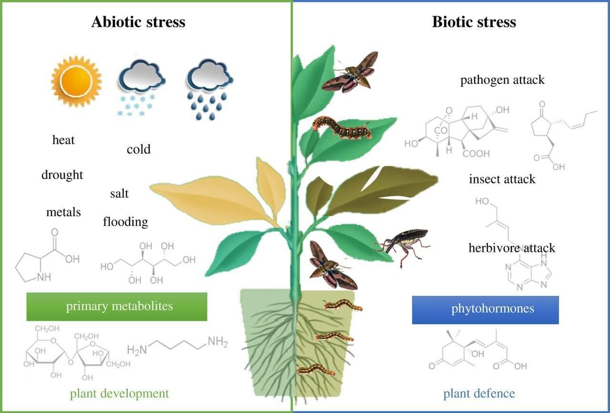
BIOTIC STRESSES
Disease
Pathogen attack
Insect attack
Herbivore attack
Bacteria
Viruses
Fungi
Parasites
ABIOTIC STRESSES
Heat – Low or
High
Cold
Salt
Drought
Flooding
Salinity
METALS
https://myshpl.com/
Saarvasri Herbs Pvt.Ltd

Slide 4
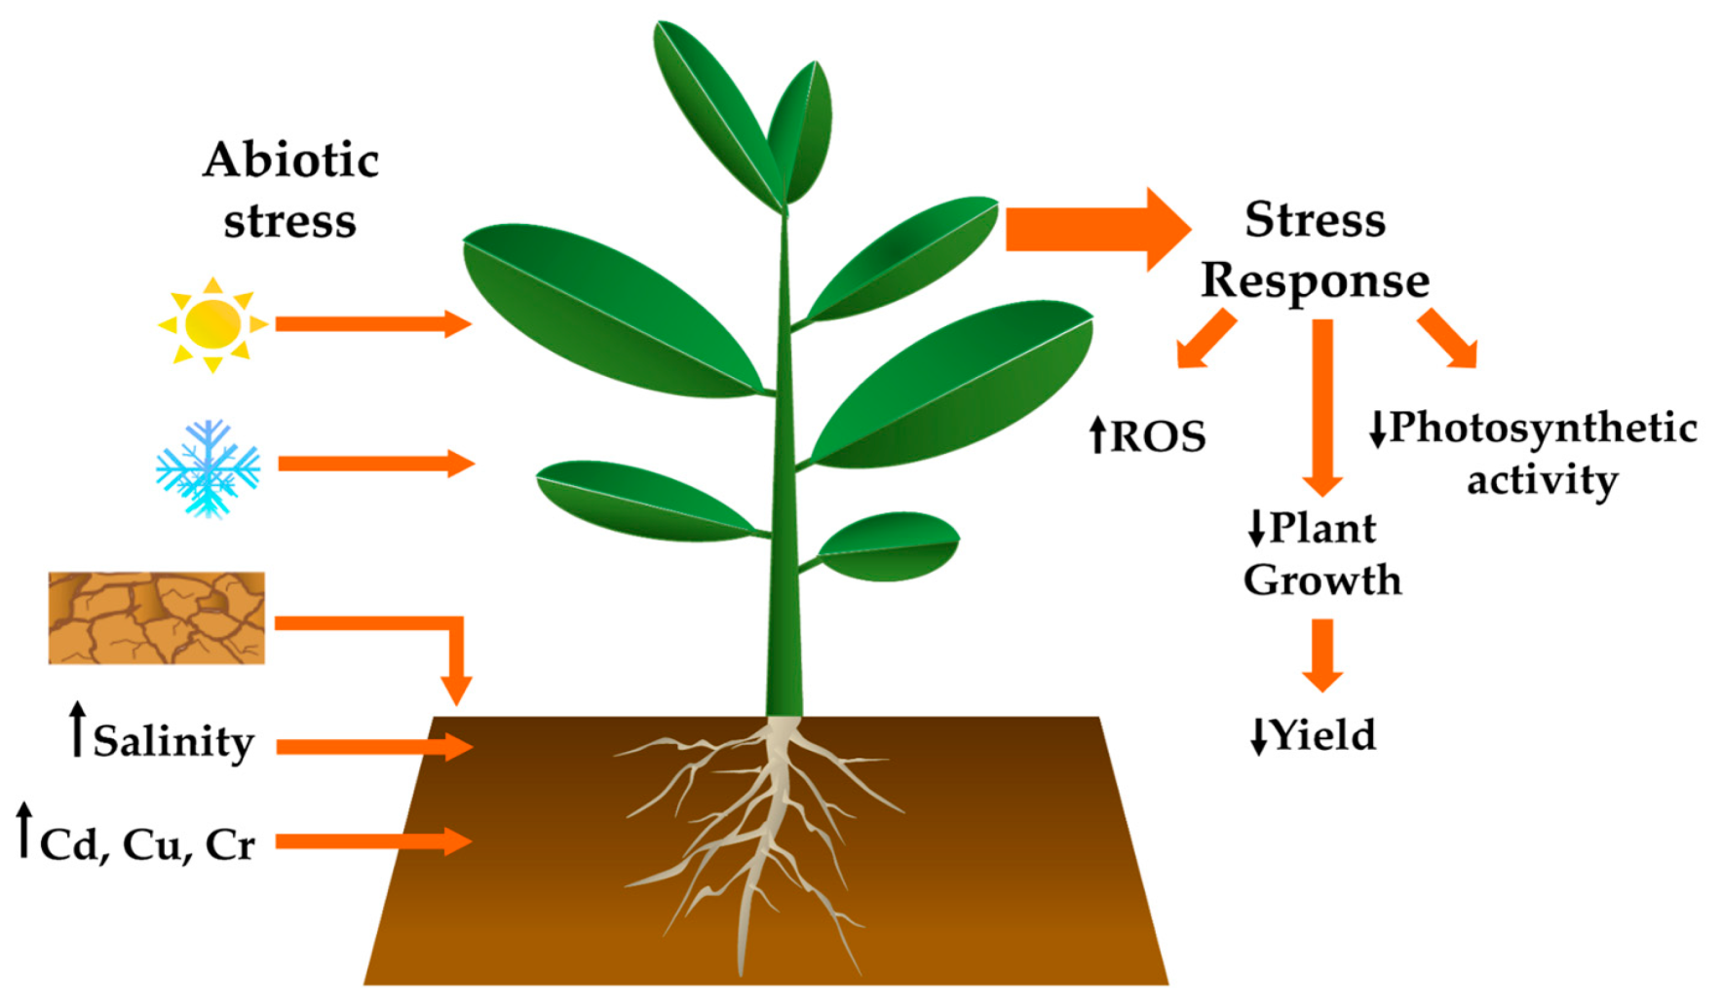
ABIOTIC STRESSES
Abiotic stresses affect 96.5% of the global rural land according to FAO. (FOOD AND AGRICULTURE ORGANIGATION)
Abiotic stresses are environmental conditions that reduce the growth and yield of crops below optimal levels.
Abiotic stresses after accure not a single stresses but as multiple stresses, interacting sometimes in negative ways.
https://myshpl.com/
Saarvasri Herbs Pvt.Ltd

Slide 5
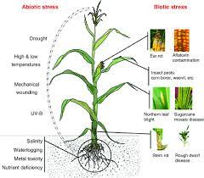
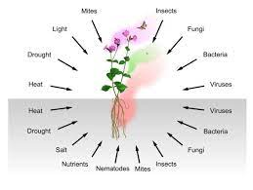
BIOTIC STRESS AND ITS FACTORS
Biotic stress includes various plant pathogens such as bacteria, fungi, viruses , nematodes, insects and others. Pathogen infection frequently results in changes in plant physiology, the loss of biomass, early flowering, the decreased seed set, the accumulation of protective metabolites, and many other changes
https://myshpl.com/
Saarvasri Herbs Pvt.Ltd

Slide 6
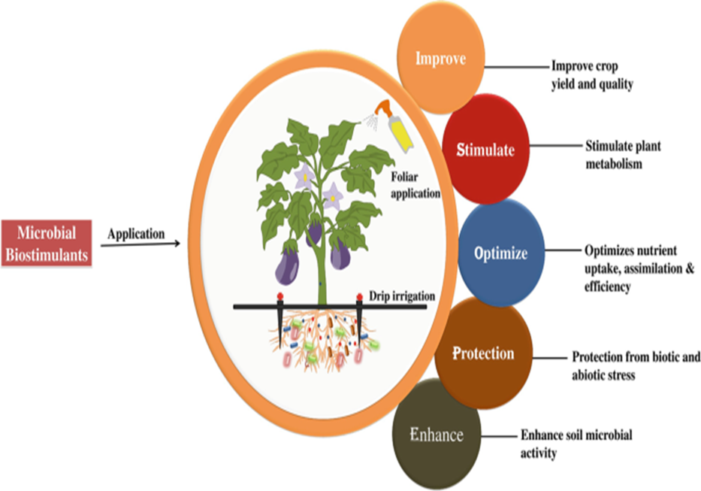
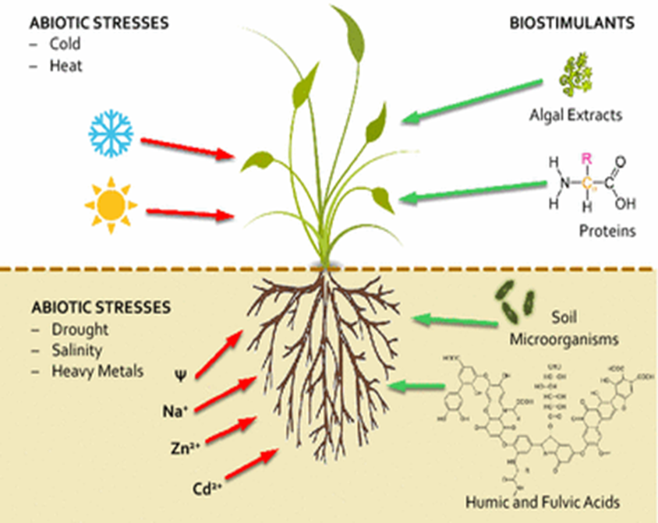
WHY TO USE BIOSTIMULANTS IN CROP PRODUCTION ?
https://myshpl.com/
Saarvasri Herbs Pvt.Ltd

Slide 7
https://myshpl.com/
Saarvasri Herbs Pvt.Ltd

Slide 8
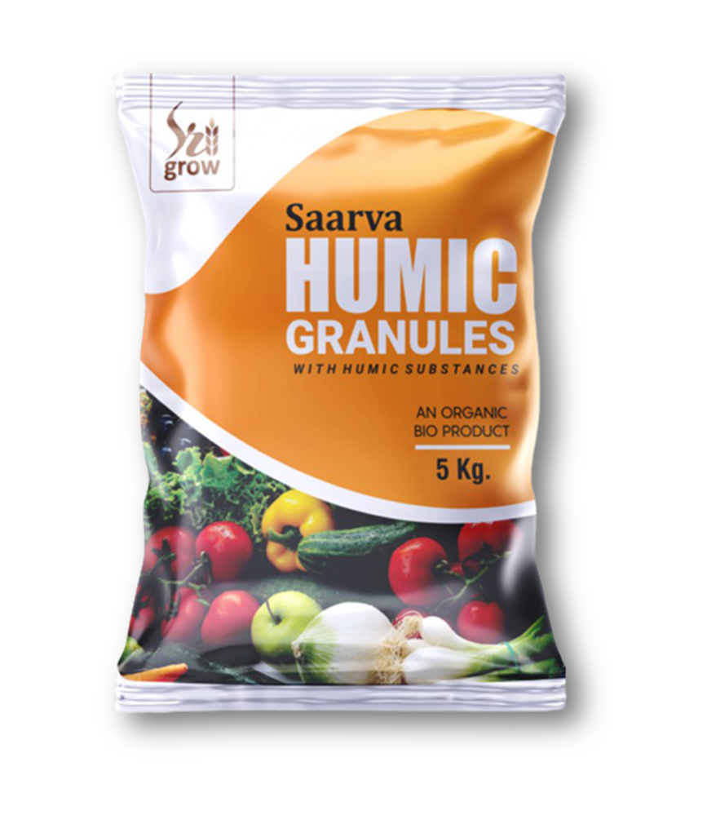
SAARVA HUMIC GRANULES
.
The application of Humic granules encourages root development. It stimulates the growth of microorganisms that possess organic plant nutrients. It acts as soil conditioner. Humic granules also prevent fungus and other bacteria prone disease problems that occur during summer months.
Increases soil fertility
Increases crop production
Encourages root development
Stimulates the growth of microorganisms
Acts as soil conditioner
Prevent fungus and other bacteria prone disease
DIRECTION OF USE- 5-8 kg per acre in case of field crops and 100-150 gm per tree in case of perennial or vines 25 days after planting/sowing or 30 days before flowering
https://myshpl.com/
Saarvasri Herbs Pvt.Ltd

Slide 9
DIRECTION OF USE-
5-8 kg per acre in case of field crops and 100-150 gm per tree .
In case of perennial or vines 25 days after planting/sowing or 30 days before flowering.
COBINATIONS RECOMMENDED
As soil application with Manures ,Compost,Fym,Soil, Dap,Mop,Urea.
BLACK MAGIC-100gms/acre
SOOPER GOLD- 60gms/acre
DOCTOR GOLD -60 gms/acre
MRP-1000 BV-320 DP-800
https://myshpl.com/
Saarvasri Herbs Pvt.Ltd

Slide 10
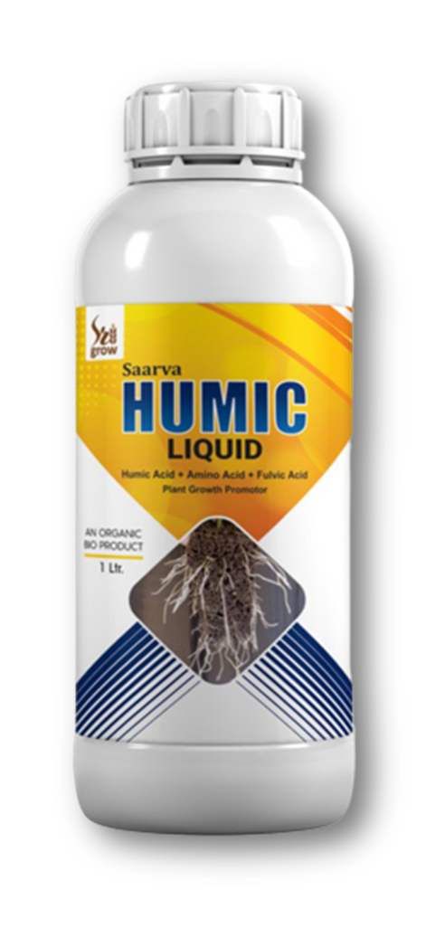
SAARVA HUMIC LIQUID
Saarva Humic Liquid is 100% Organic Liquid Fertilizer. It is an ideal additive to boost bio-activity and improve the performance of compost, soil structure and plant nutrients intake. Saarva Humic Liquid is designed with the best proportion of Humic Acids, Amino Acids and Fulvic Acids
BENEFITS
Increases health, quality and yield of crops, trees, turf,(grass/lawn) and garden plants.
Enhances growth of soil microorganisms, this helps to improve the soil structure, balance PH levels and protect crops against harmful toxins and metals.
Increases the amount of organic matter in the soil.
Stimulates root development, enhances phosphate utilization of plants.
Helps soil to retain water.
Can be used to accelerate decomposition of compost.
Improves the taste of fruits and vegetables, increases yields and improves quality.
https://myshpl.com/
Saarvasri Herbs Pvt.Ltd

Slide 11
DIRECTION OF USE
300-600 ml per acre for foliar spray and 1000 ml per acre for drenching or drip irrigation.
For seed dressing, mix 5 ml with 1 kg of seed thoroughly and sow.
During growth flowering and fruit formation stages use 2 ml per 1 ltr of water as a spray.
COBINATIONS RECOMMENDED
As soil application with NANO UREA.
BLACK MAGIC-100gms/acre
SOOPER GOLD- 60gms/acre
DOCTOR GOLD -60 gms/acre
1LTR -MRP-1100 BV-440 DP-880
500ML -MRP-600 BV-240 DP-480
https://myshpl.com/
Saarvasri Herbs Pvt.Ltd

Slide 12
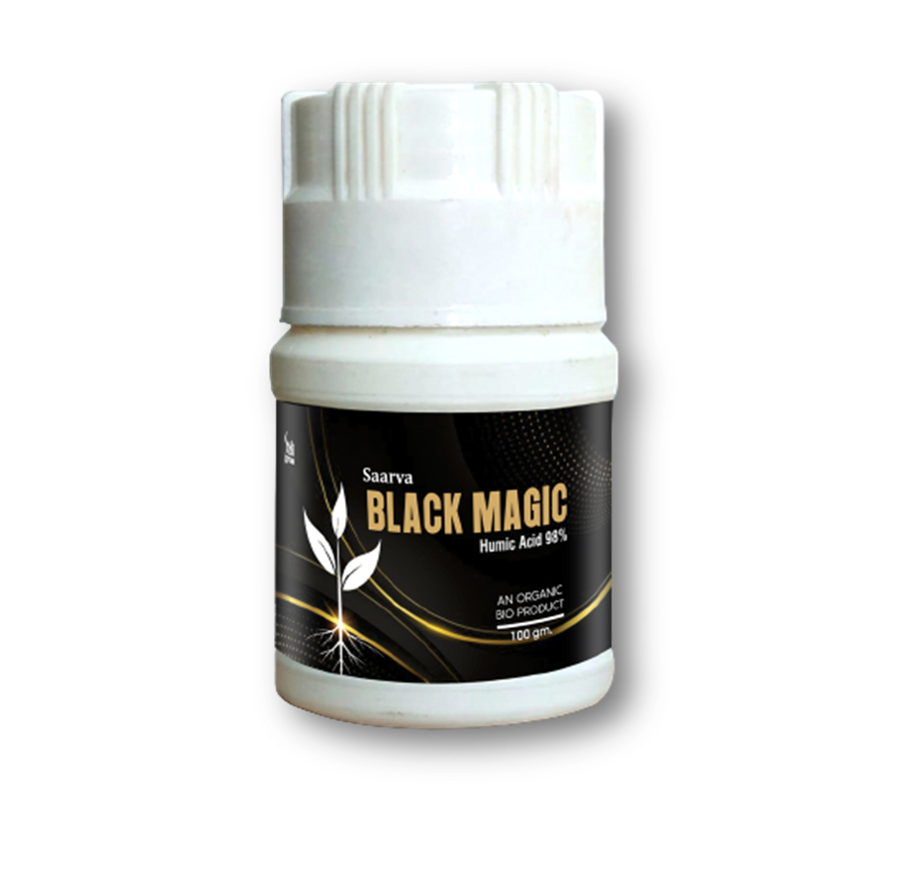
SAARVA BLACK MAGIC
Humic Acid-98% an other trace elements.
BENEFIT:
Used for plant growth & Development root growth in enhance, lateral root system is developed, soil airtation &photo synthetic increase
DIRECTION OF USE
10 to 15 gm for 15 liter water
mixed with cow dung, vermi-compost and fertilizer 250gm per acre
100GMS -MRP-350 BV-140 DP-280
50GMS -MRP-180 BV-72 DP-144
COBINATIONS RECOMMENDED
HUMIC GRANULES-5kg/acre
HUMIC LIQUID-600ml/acre
BLACK MAGIC-100gms/acre
SOOPER GOLD- 60gms/acre
DOCTOR GOLD -60 gms/acre
https://myshpl.com/
Saarvasri Herbs Pvt.Ltd

Slide 13
METHOD OF APPLICATION
DENCHING OR DRIP IRRIGATION
FOLIAR SPRAY
GRANULAR APPLICATION
1000 ml/acre
10 -15 gms /15 ltrs water mixed with cow dung
With vermi-compost and fertilizer 250gm per acre.
300-600 ml/acre
2.250 kg/acre with urea ,
dap,mop
5-8 kg per acre with
Fertilizer,fym,soil.
https://myshpl.com/
Saarvasri Herbs Pvt.Ltd

Slide 14
https://myshpl.com/
Saarvasri Herbs Pvt.Ltd

Slide 15
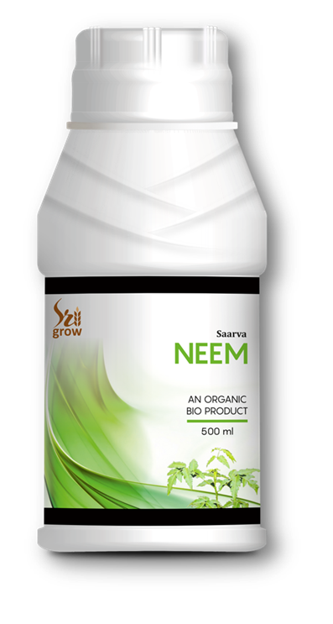
SAARVA NEEM
SAARVA NEEM is a spreader/sticker manufactured by using neem Compounds. Neem seeds hold the highest concentration of the insecticidal compound. The effective compound is azadirachin , which repels the insect pest. It breaks down quickly and leaves no lasting residue.
It is essentially non-phytotoxic even at a higher concentration.
With a low vapour pressure it reduces the evaporation losses of pesticides.
It reduces pesticides photodecomposition.
It gives added natural benefits of neem compounds to plants.
It is compatible with all commonly used insecticides, acaricides and fungicides.
It enhances activity of fungicides and insecticides.
It improves the efficacy of pesticides by uniform and better coverage on leaves and economizes the use of pesticides by avoiding wastage.
DIRECTION OF USE
25 to 30 ml for 15 liter or mixed with fertilizer 1L per acre. Use again after 10 day.
Seed dressing- soaking overnight or application of 5ml/kg seeds.
https://myshpl.com/
Saarvasri Herbs Pvt.Ltd

Slide 16
DIRECTION OF USE
25 to 30 ml for 15 liter or mixed with fertilizer 1L per acre.
Use again after 10 day.
Seed dressing- soaking overnight or application of 5ml/kg seeds.
COBINATIONS RECOMMENDED-Can be used in agriculture solution andapplication.
500ML -MRP-600 BV-180 DP-480
https://myshpl.com/
Saarvasri Herbs Pvt.Ltd

Slide 17
SAARVA GREEN
Humic Acid 12%, amino acid 5%, Fulvic Acid 5%, seaweed Extract 5%.
BENEFITS
Accelerating germination
Enhancing seeding
Vigour and root growth
Improving uptakes and translocation if micro and macro nutrients
Inducing early maturity, helping plants draught, resulting in higher yield and better quality of crop produces
Increase metabolism and nutrient levels
Increasing the formation of pollen and fruits in plants
https://myshpl.com/
Saarvasri Herbs Pvt.Ltd

Slide 18
DIRECTION OF USE AND COMBINATION PREFFERED
Seed Treatment: 5.0 to 10 ml./kg. seed in sufficient quantity of water.NEEM -15/ml.
Seeding/Root dip: 2.0ml/ltr of water. NEEM -30/ml
Foliar spray: 2 to 3 ml/ltr of water at actively growing and reproductive stages.With NEEM,CARBON,JACKPOT.
500ML -MRP-600 BV-180 DP-480
https://myshpl.com/
Saarvasri Herbs Pvt.Ltd

Slide 19
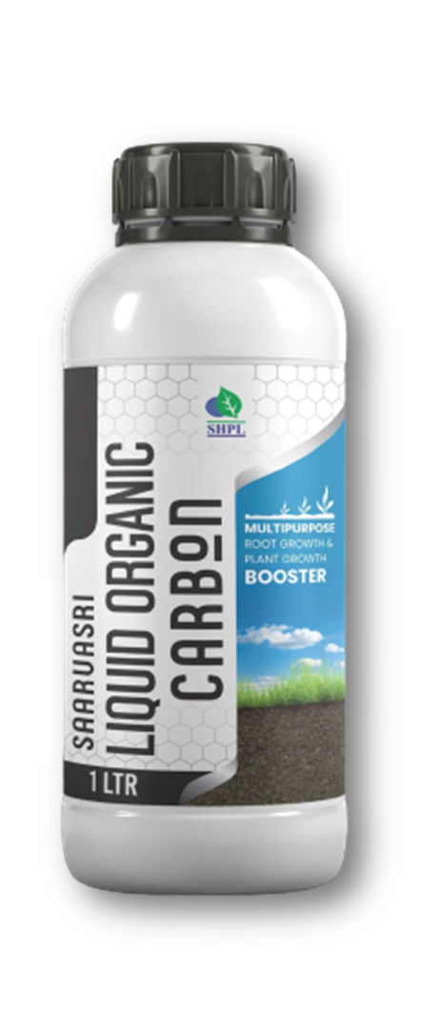
SAARVASRI LIQUID ORGANIC CARBON
MULTIPURPOSE ROOT GROWTH & PLANT GROWTH BOOSTER
BENEFITS
It increases nutrient availability by storing cations of calcium, magnesium, potassium, and trace elements as well as nitrogen, phosphate, and sulphur.
It stops nutrients from escaping and makes them accessible to plants.
Protects against sudden pH shifts in the soil. Encourages growth of soil microorganisms, which improves soil structure.
Promotes the growth of large-scale organisms that cause dirt pores.
Helps plant and microbial growth through growth stimulating compounds. Boosts crop production by 10% to 40%.
It enhances the vegetation's color, texture, and leaves. It guards against environmental stress on vegetation.
https://myshpl.com/
Saarvasri Herbs Pvt.Ltd

Slide 20
DIRECTION OF USE
Apply 1000 ml per acre through drip & drench method.
COBINATIONS RECOMENDED
VEGETATIVE GROWTH - SARVA GREEN
ROOT DEVELOPMENT - SAARVA HUMIC LIQUID ,
SAARVA BLACK MAGIC.
SEED TREATMENT - SAARVA NEEM.
MICROBIAL GROWTH - SAARVA SOOPER GOLD,
&PEST MANAGEMENT SAARVA DOCTOR GOLD.
1LTR -MRP-1259 BV-500 DP-1000
https://myshpl.com/
Saarvasri Herbs Pvt.Ltd

Slide 21
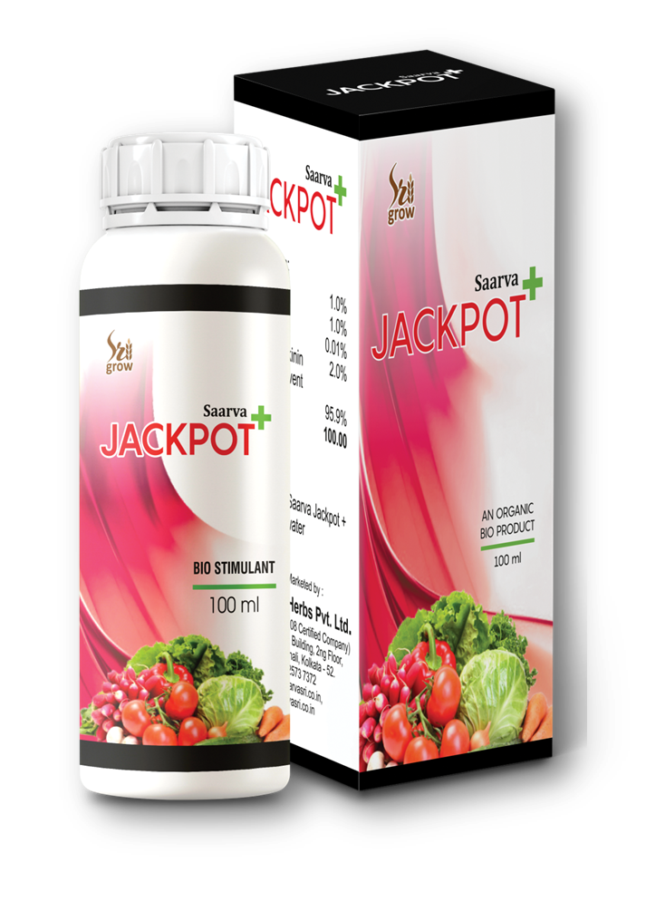
SAARVA JACKPOT+
Ginseng, Fulvic Acid, Natural Bacinollides, Natural Cytokinins, Amino Acids, Various Natural Enzymes.
BENEFITS
Effective for the production of more crops.
Helps grow root & root hair.
Prevents premature fall of the flower.
Increases the size of the fruit.
Prevents premature fall of the fruit.
Increases the quality of the fruit.
Accelerates the growth of the tree.
Prevents premature death of the tree.
Stops yellowing of the leaves.
DIRECTION OF USE
5-7 ml/ 15 liters of water
https://myshpl.com/
Saarvasri Herbs Pvt.Ltd

Slide 22
DIRECTION OF USE
5-7 ml/ 15 liters of water.
COBINATIONS RECOMMENDED
Foliar spray: 5 ml/lit of water at actively growing and reproductive stages.NEEM,CARBON,JACKPOT .
100ML-MRP-1000 BV-400 DP-800
50ML -MRP-600 BV-240 DP-480
https://myshpl.com/
Saarvasri Herbs Pvt.Ltd

Slide 23
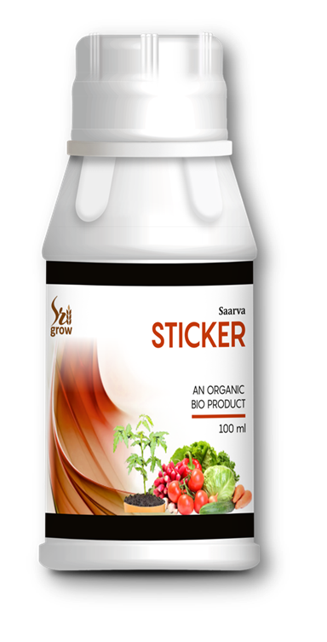
SAARVA STICKER
Saarva Sticker is a non-ionic, super spreading spray adjuvant based on a Trisiloxane Alkoxylate . It is most effective as a tank side adjuvant when spray mixtures are with in the PH range of 5-8 and are used 24 hours within preparation of the spray solution.
BENEFITS
Improves spray coverage & promotes spray volume reduction.
Promotes rapid uptake of agrochemicals into plants via stomata.
DIRECTION OF USE
5-7 ml per 15 litter of any agricultural solutions.
100ML-MRP-300 BV-84 DP-240
https://myshpl.com/
Saarvasri Herbs Pvt.Ltd

Slide 24
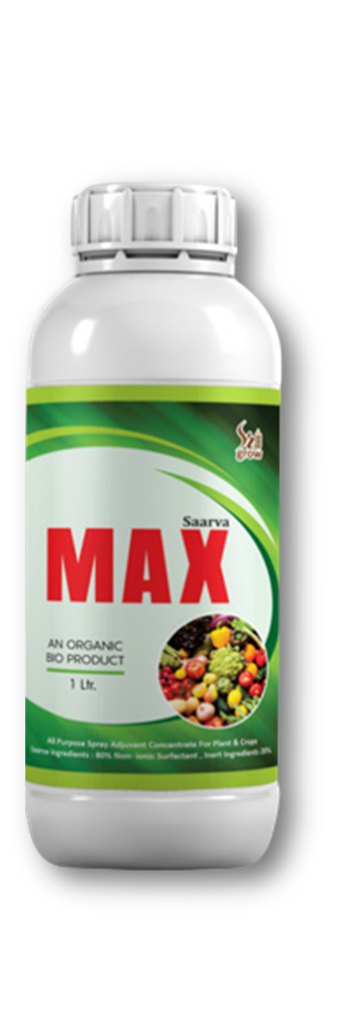
SAARVA MAX
BENEFITS
Increases yield by 25-30%
It is 100% water soluble
Saves 25-30% chemical fertilizer like Urea and D.A.P.
It is a plant growth promoter which promotes and enhances the fertility of the soil to produce distinguished crops.
Induces flowering and fruit setting.
Increases enzymic activity and encourage balanced hormonal synthesis.
Better root development ensures higher nutrients and water absorption.
Can provide more uniform spray deposit on plants.
Improves coverage of insecticide, herbicide, fungicide and foliar fertilizer sprays.
Increasing water penetration.
Helps improve performance of post-emergent herbicides, insecticides, and fungicides thorough wetting action.
As an Activator- 5 ML/15LTRS,Wetter-Spreader, it activates the spray fluid to moisten the plant surface & allows uniform spreading of spray deposit .
https://myshpl.com/
Saarvasri Herbs Pvt.Ltd

Slide 25
DIRECTION OF USE AND COMBINATION PREFFERED
As an Activator- 5 ML/15LTRS,Wetter-Spreader, it activates the spray fluid to moisten the plant surface allows uniform spreading of spray deposit
1L-MRP-1000 BV-400 DP-800
500ML -MRP-600 BV-240 DP-480
https://myshpl.com/
Saarvasri Herbs Pvt.Ltd

Slide 26
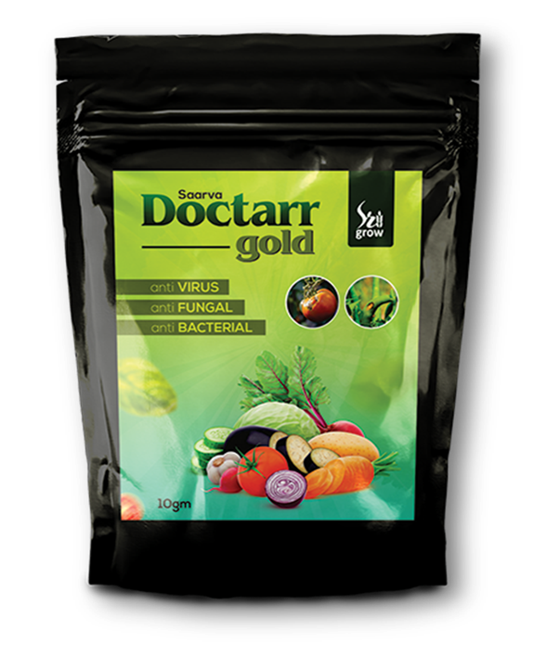
SAARVA DOCTARR GOLD
SAARVA DOCTARR GOLD is the result of many years of hard labour and research. It is a unique formulation of Saarvasri. It is the combination of Antivirus, Antifungal, Antibacterial, Microbicide & Germicide. It is 100% organic, residue free and harm free to crops.
BENEFITS
Inhibits most fungal infection.
Effective against soil borne fungal and bacterial infection.
Resulting sudden death of target bacteria and Virus spores
Effective against disastrous strains.
Stimulates cytokinin synthesis resulting in excellent plant growth after viral and bacterial attack.
DIRECTION OF USE
10 gms in 15 ltrs of water.
For better result repeat spray within a week.
100GMS-MRP-750 BV-300 DP-600
https://myshpl.com/
Saarvasri Herbs Pvt.Ltd

Slide 27
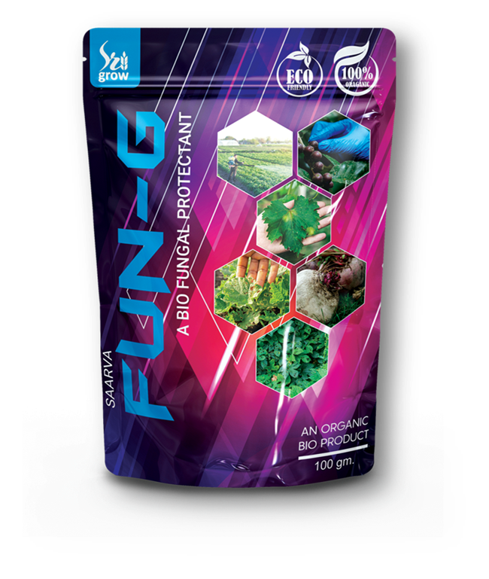
SAARVA FUN-G
BENEFITS
FUN-G inhibits most of the fungal infections of the plants.
It prevents Leaf Spot, Blast disease and Rust disease in all vegetable plants.
It protects the plants for lengthy period of time.
It is a bio-fungicide which destroys or prevent fungal growth and their spores.
It kills fungal cell membranes and interrupt energy production within fungal cells.
DIRECTION OF USE
1-2gm mixed with 1 litter of water and spray.
100ML-MRP-350 BV-140 DP-280
https://myshpl.com/
Saarvasri Herbs Pvt.Ltd

