Slide 1
WELCOME TO THE
FASCINATING WORLD
OF SAARVASRI HERBS (SHPL)
GHAR GHAR SAARVASRI - HAR GHAR SAARVASRI

Slide 2
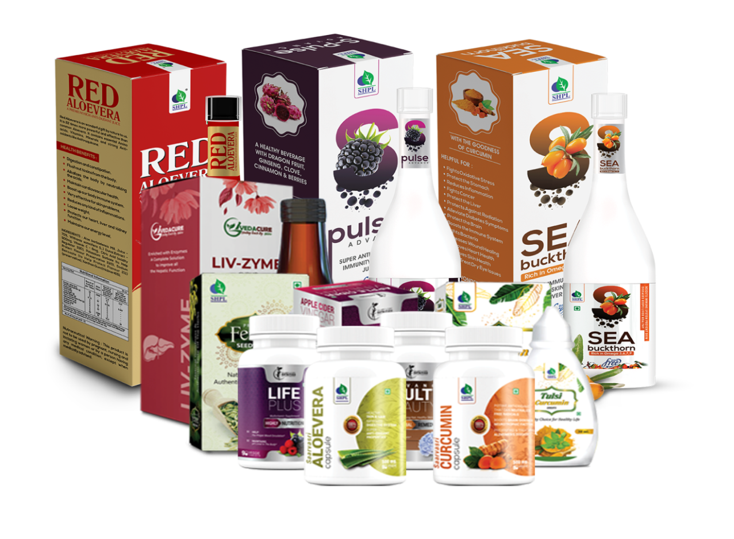
1. HEALTH & WELLNESS
Curated from the Reservoir of Mother Nature
Wellness Capsules
Wellness Tablets
Wellness Juices
Wellness Syrups
Wellness Drops
Wellness Powders
Wellness Soft Gels
Wellness Gummies
Wellness Candies
Ayurvedic Tablets
Herbal Tea
Health Oils & Balms

Slide 3
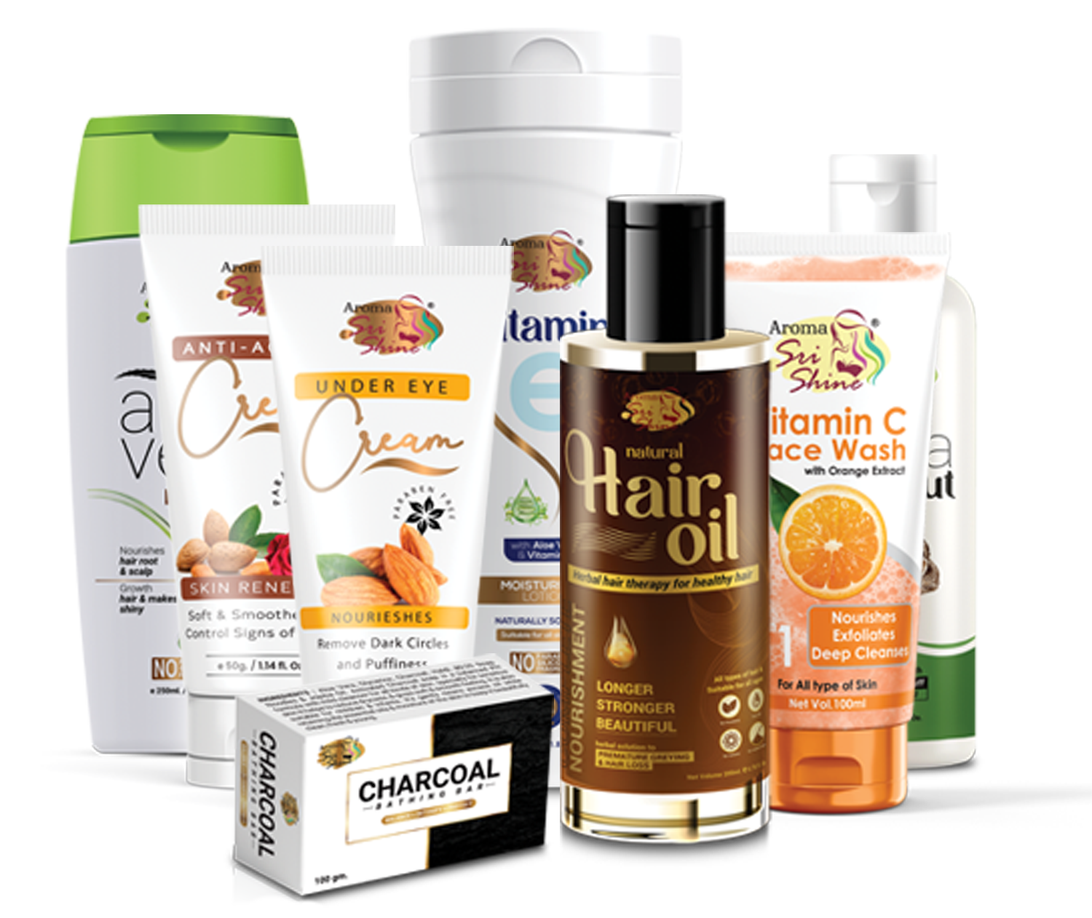
2. PERSONAL CARE
Indulge in Grace and
Gorgeous Glow
Hair Care
Oral Care
Skin Care
Body Spray
Personal Hygiene
Colour Cosmetics

Slide 4
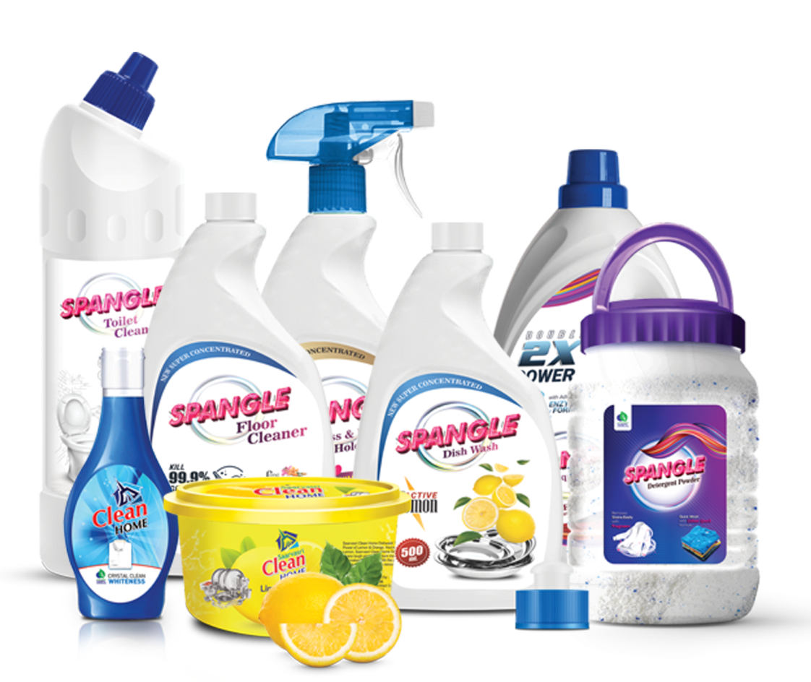
3. HOME CARE
For a Neat, Clean & Tidy Home

Slide 5
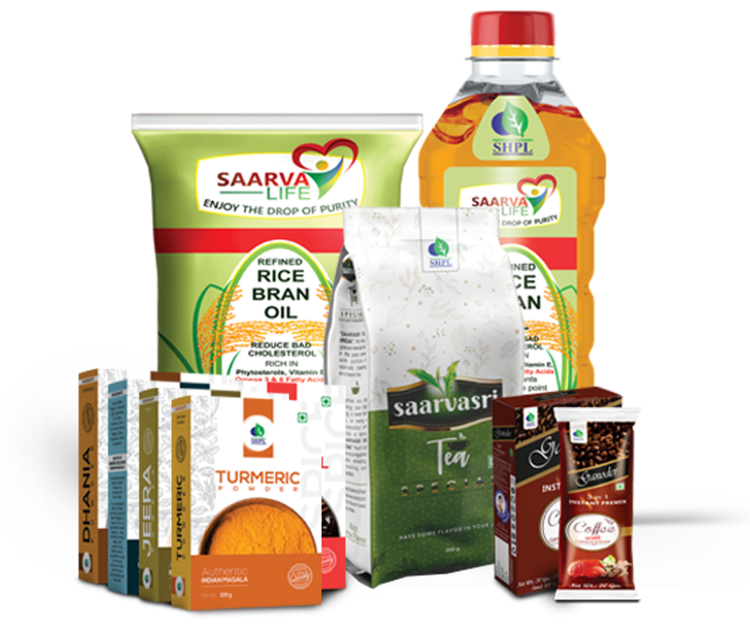
4. KITCHEN CARE
Healthy Essential at
Your Fingertips

Slide 6
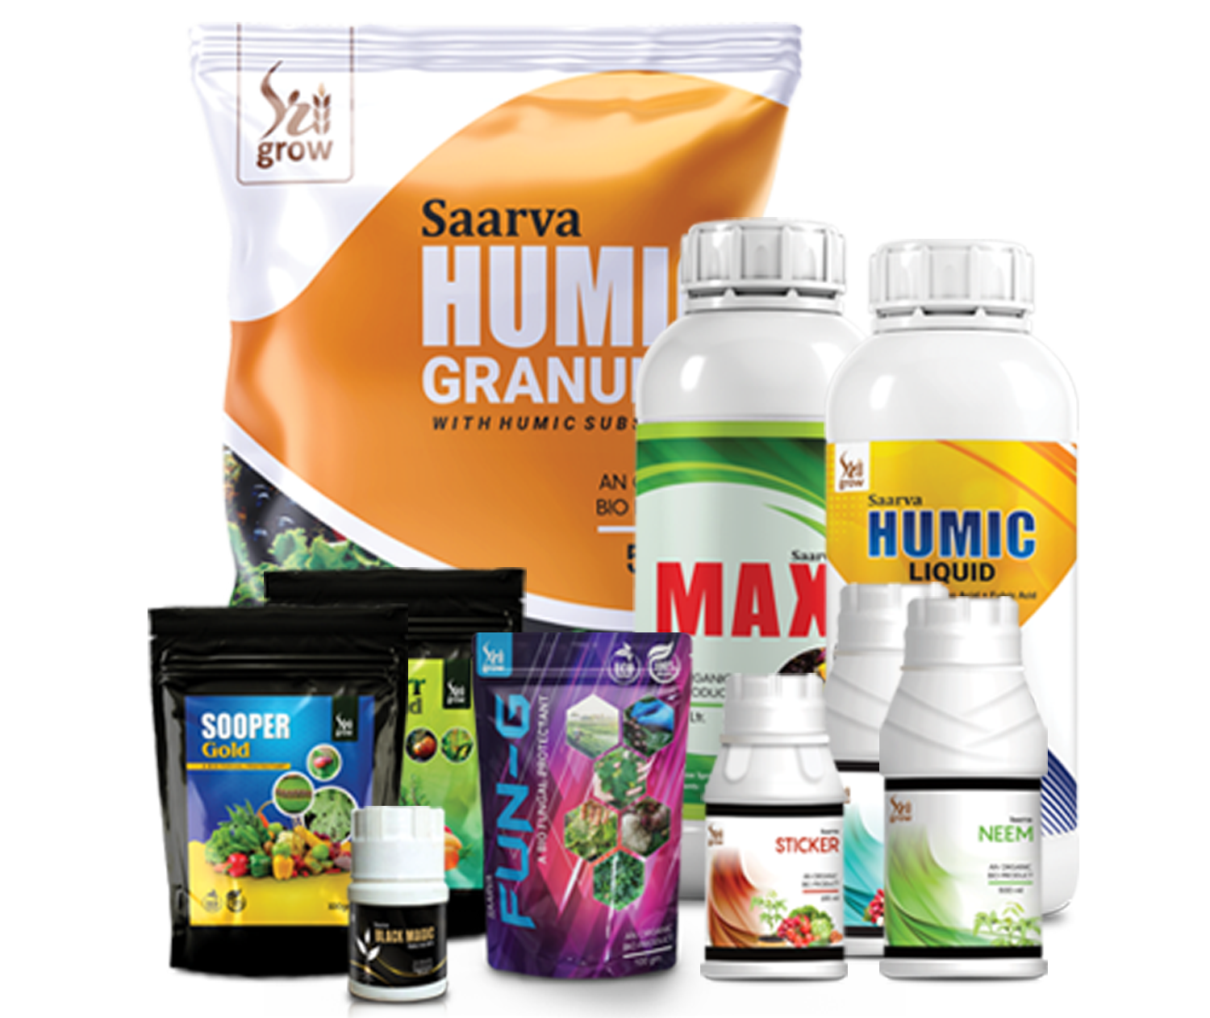
5. AGRO CARE
For Fertile Crop with
Golden Harvest

Slide 7
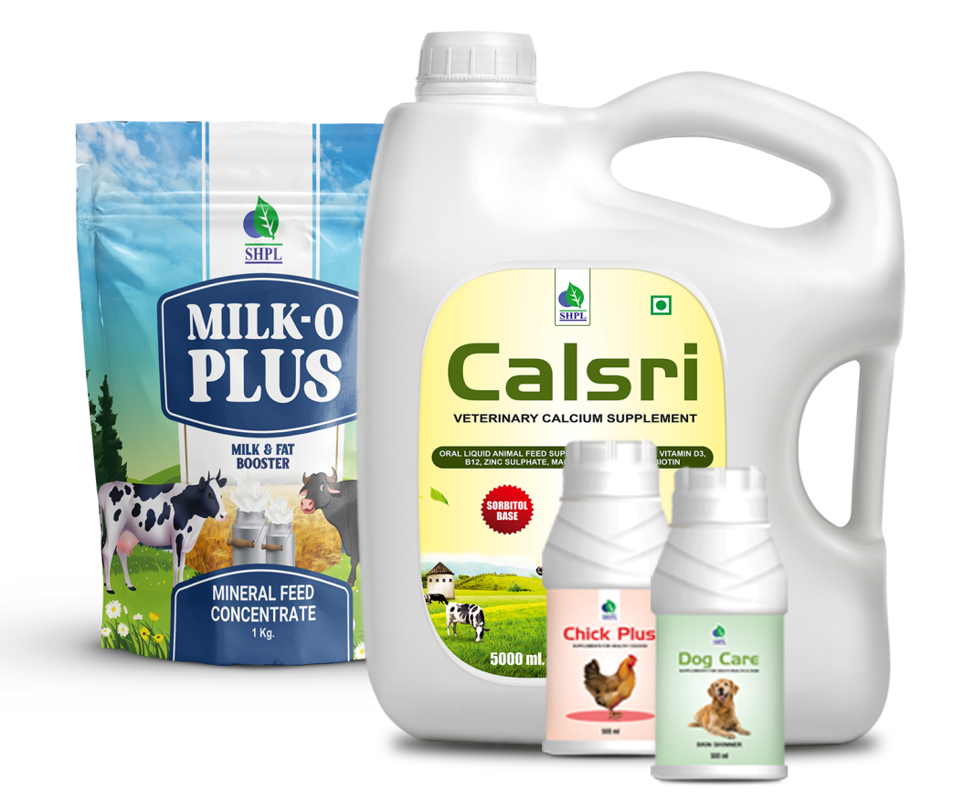
6. ANIMAL CARE
Finest Solutions With
Human Touch

Slide 8
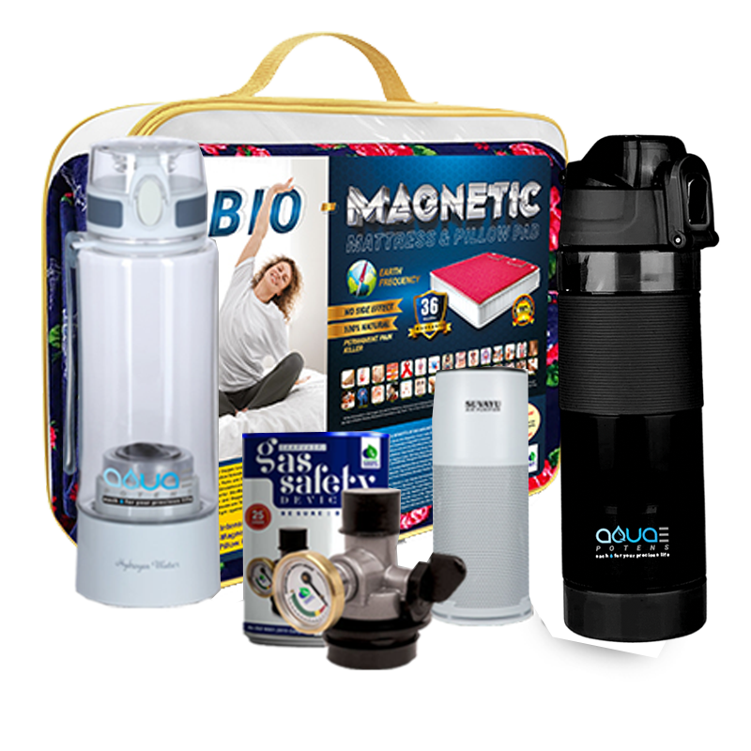
7. LIFESTYLE PRODUCTS
Thoughtful lifestyle
for a new YOU

Slide 10
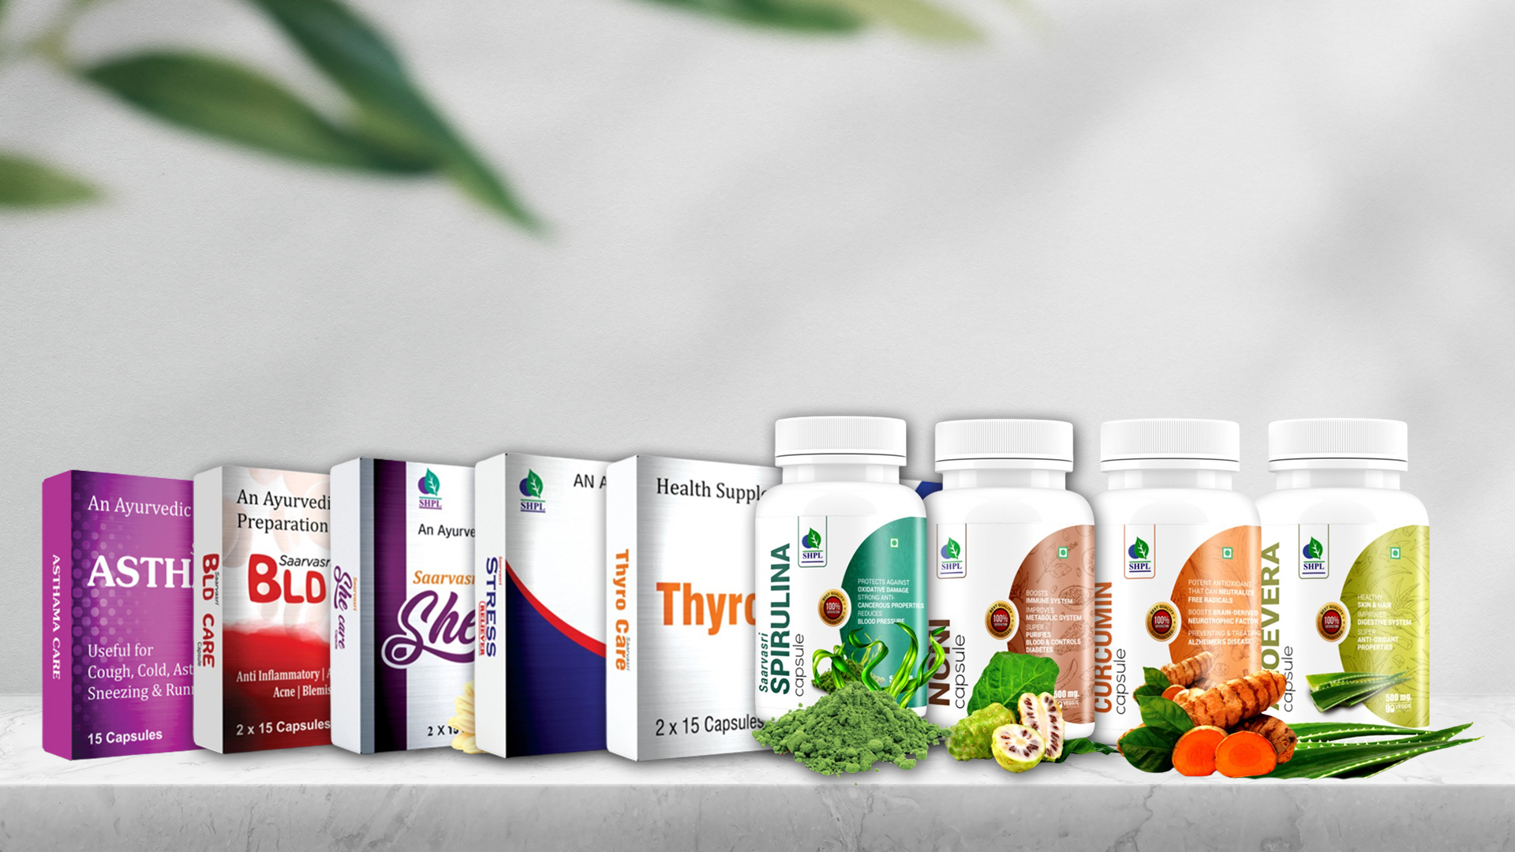
WELLNESS CAPSULES
Herbal Formulations (a combination of various herbs)
Single ingredient capsules.
Recommended for disease management.

Slide 11
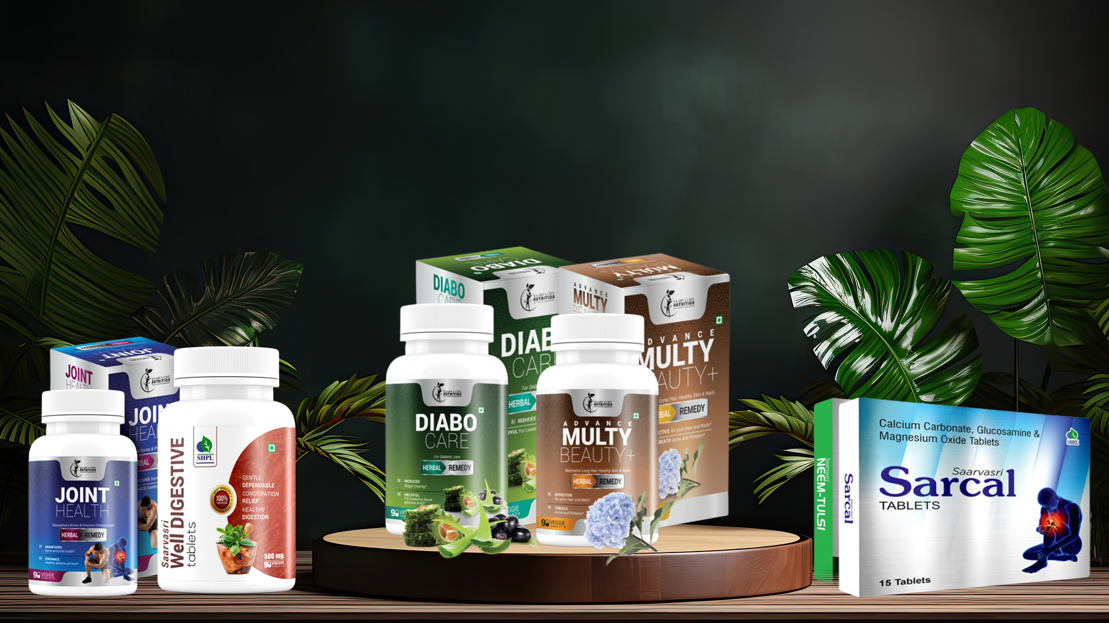
WELLNESS TABLETS
Available in Blister Pack of 15 tablets, and in bottle of 90 tablets.
Contains bioactive compounds to help you manage disease effectively.

Slide 12
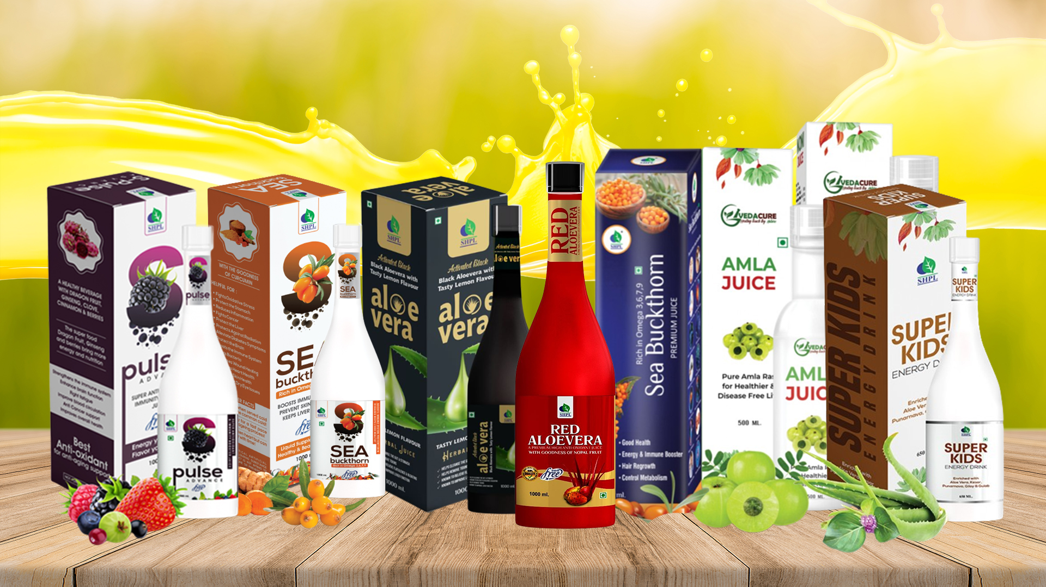
WELLNESS JUICES
Contains superfoods and their bioactive compounds to help you prevent disease, manage existing health issues and heal at the cellular level.

Slide 13
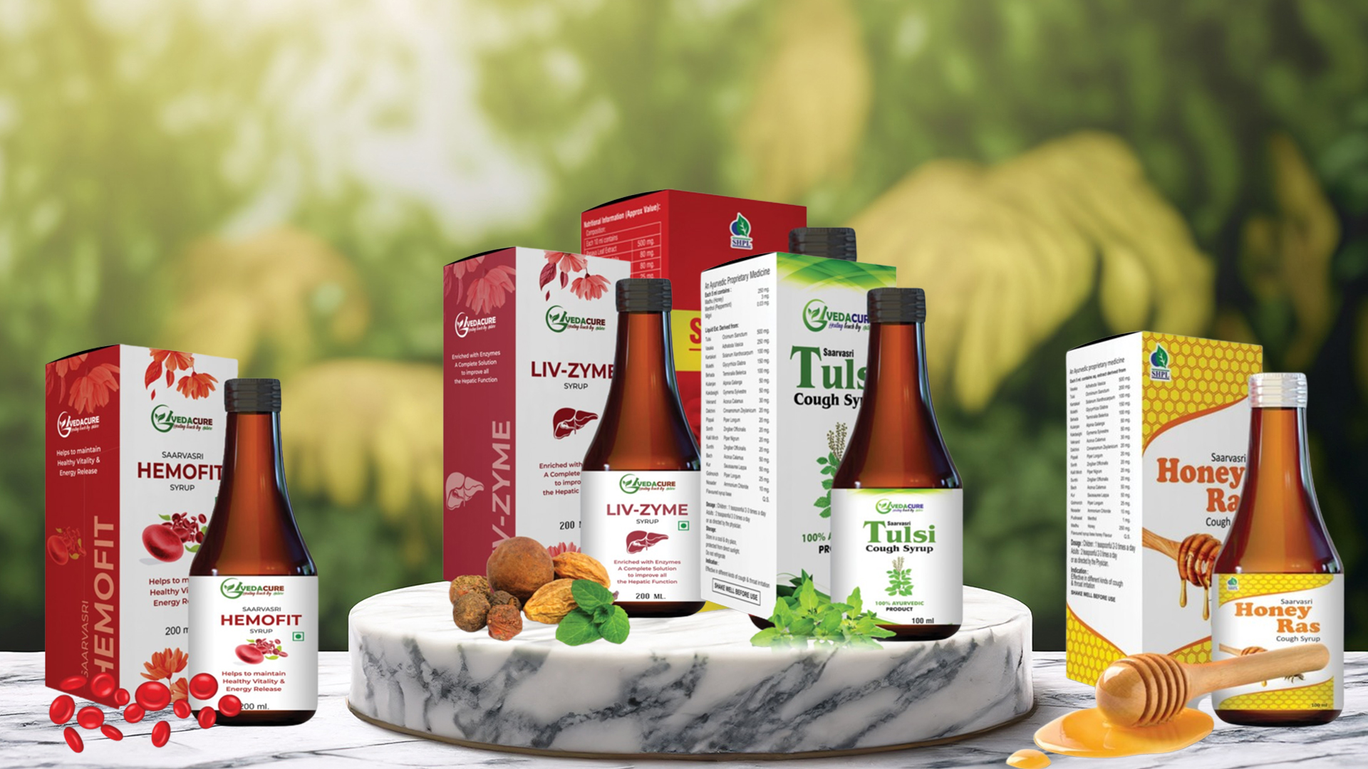
WELLNESS SYRUPS
Contains ayurvedic herbs that help you manage chronic and acute diseases.

Slide 14
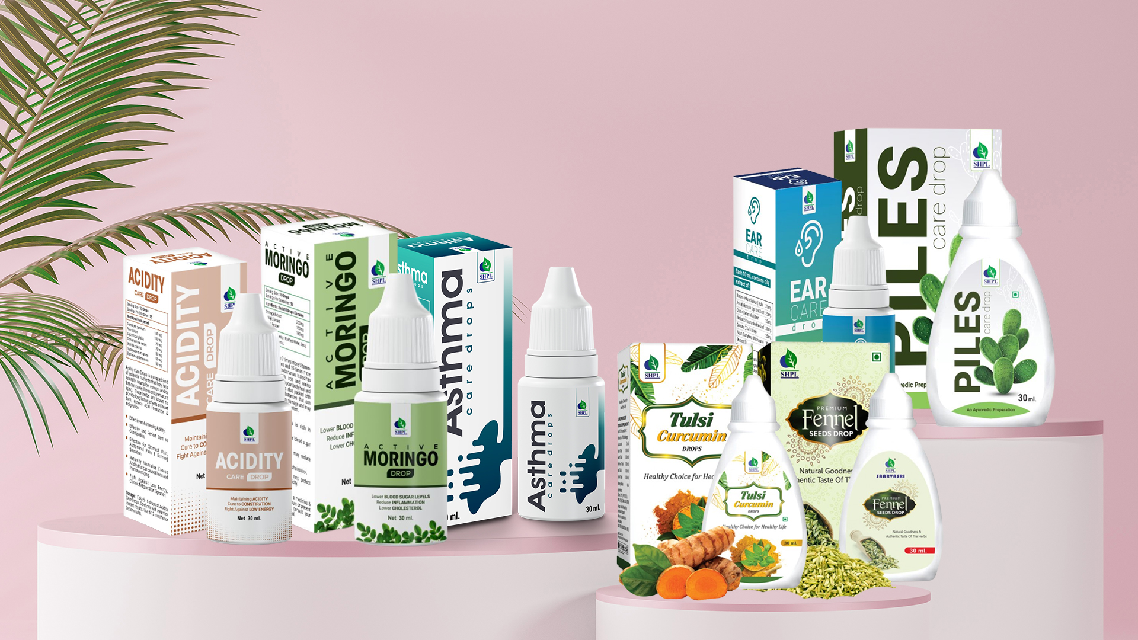
WELLNESS DROPS
Contains concentrated bioactive compounds to help support disease management, rejuvenate the tissues and organs and provide vitality.

Slide 15
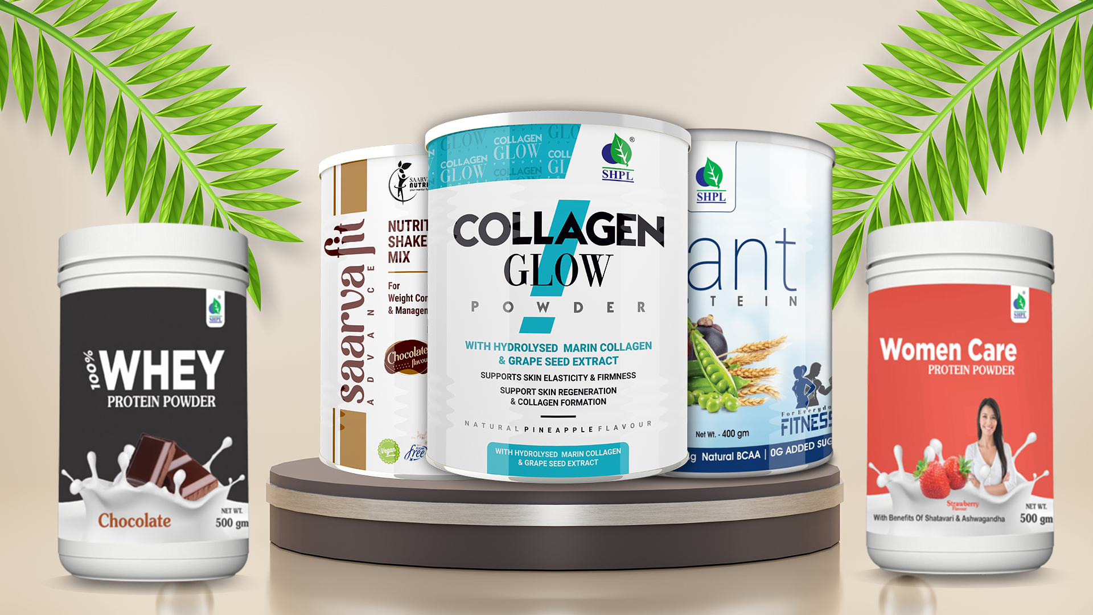
WELLNESS POWDERS
Contains bioactive compounds such as protein, collagen and other essential nutrients to support the growth and development process.

Slide 16
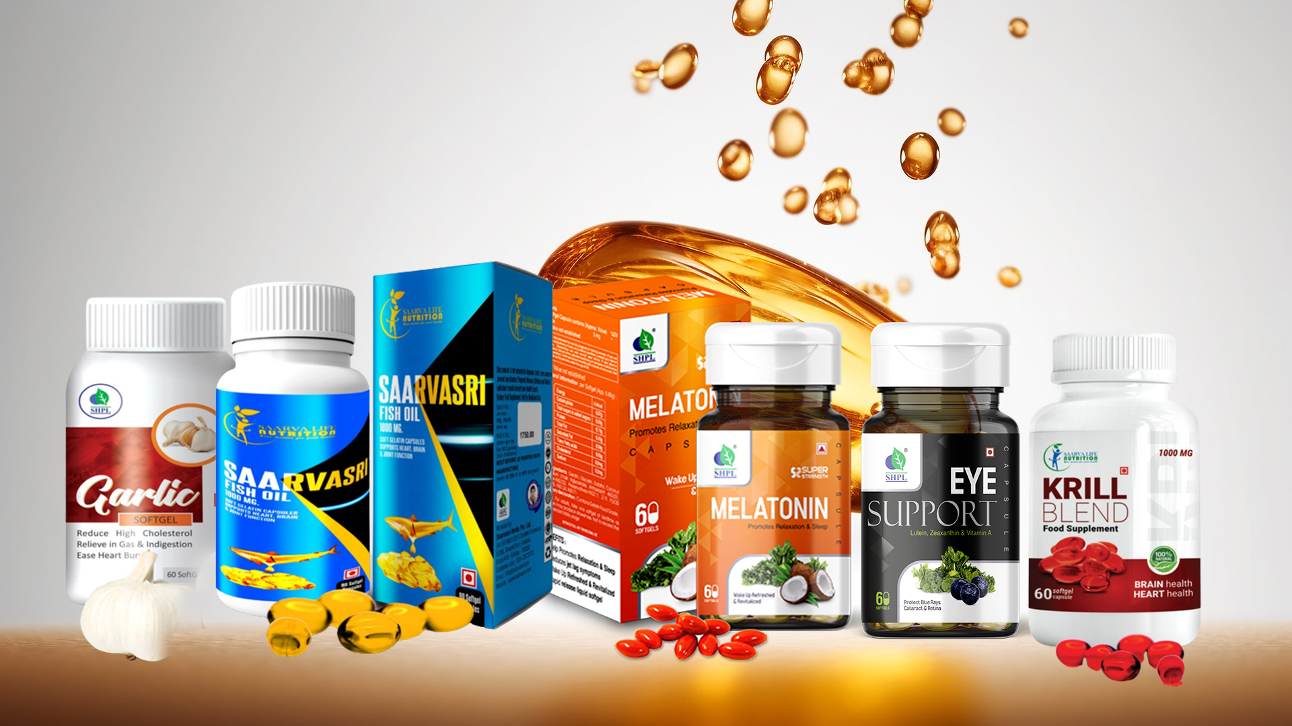
WELLNESS SOFTGELS
Contains bioactive compounds to help you prevent disease, manage existing health issues and heal at the cellular level.

Slide 17
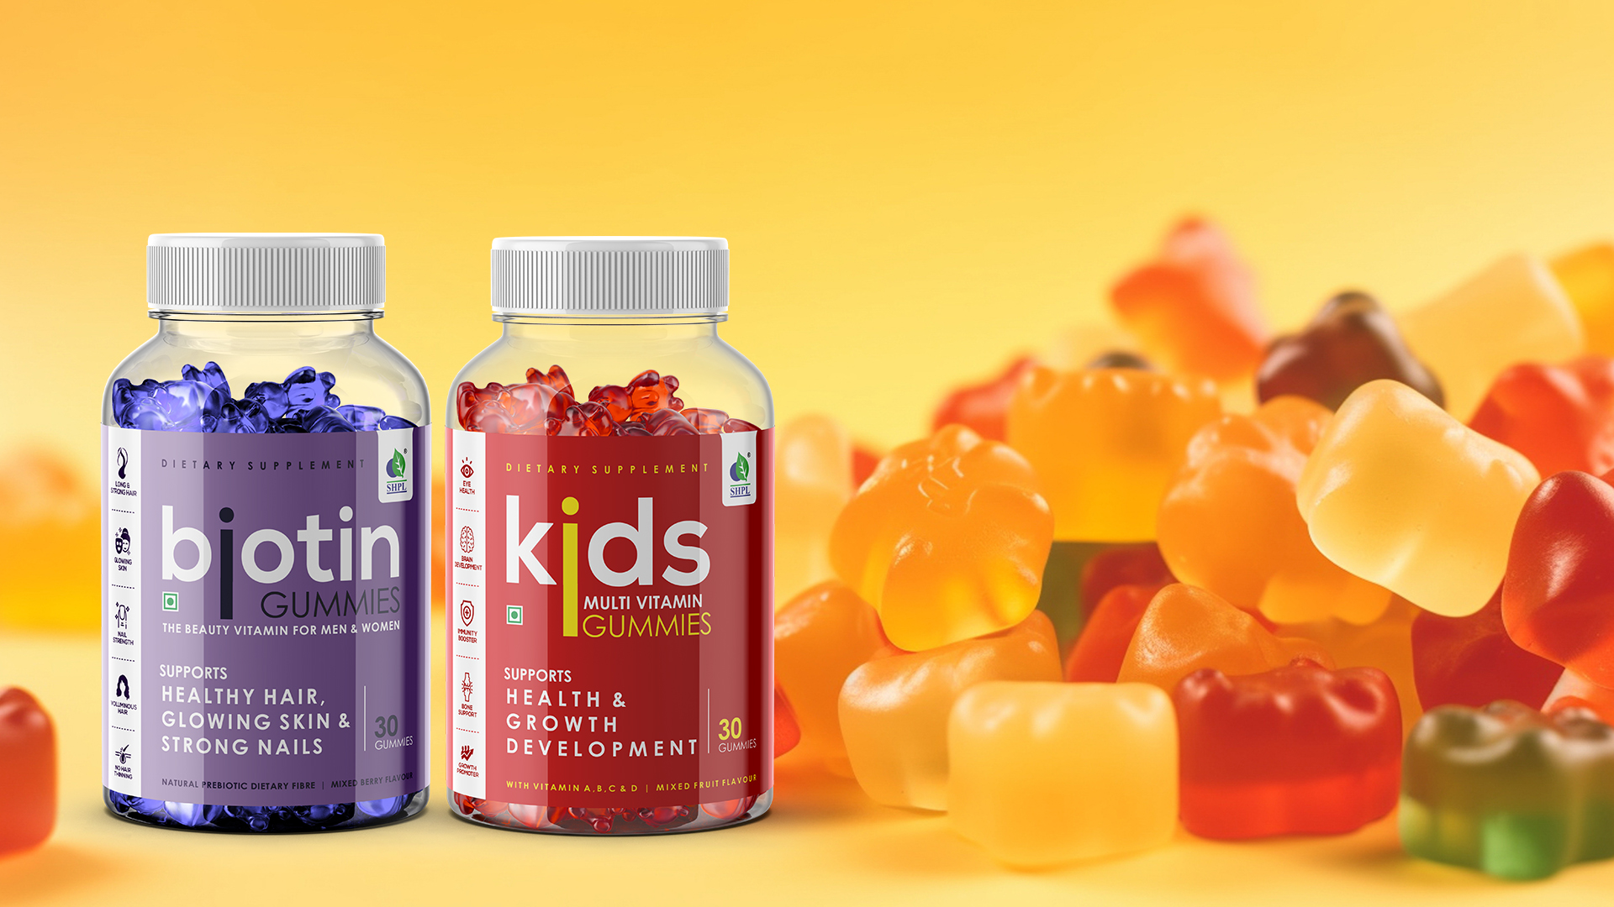
WELLNESS GUMMIES
Essential multi-nutrients packed in a chewable gummy form, to support the growth and development, and improve cellular functions.

Slide 18
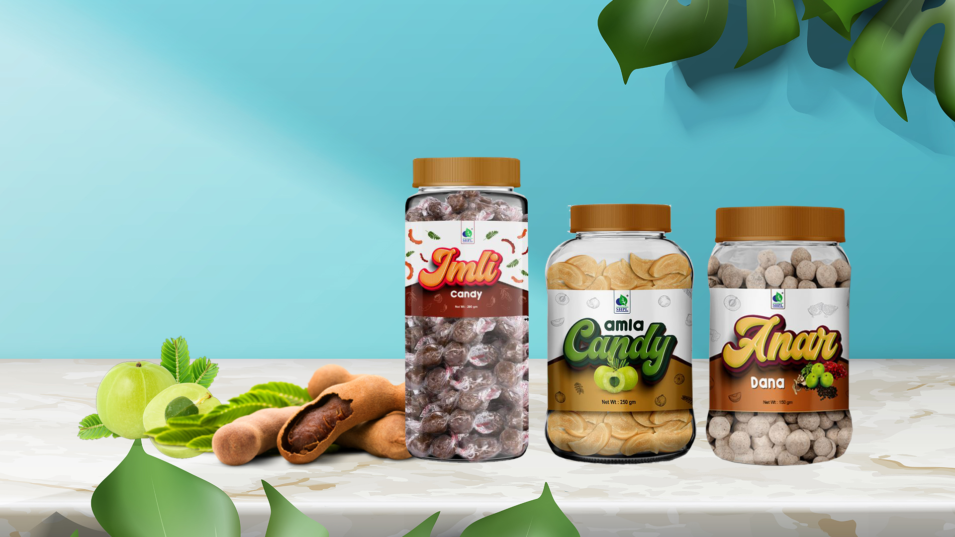
WELLNESS CANDIES
Digestive foods packed in a chewable gummy form, to improve gut health.

Slide 19
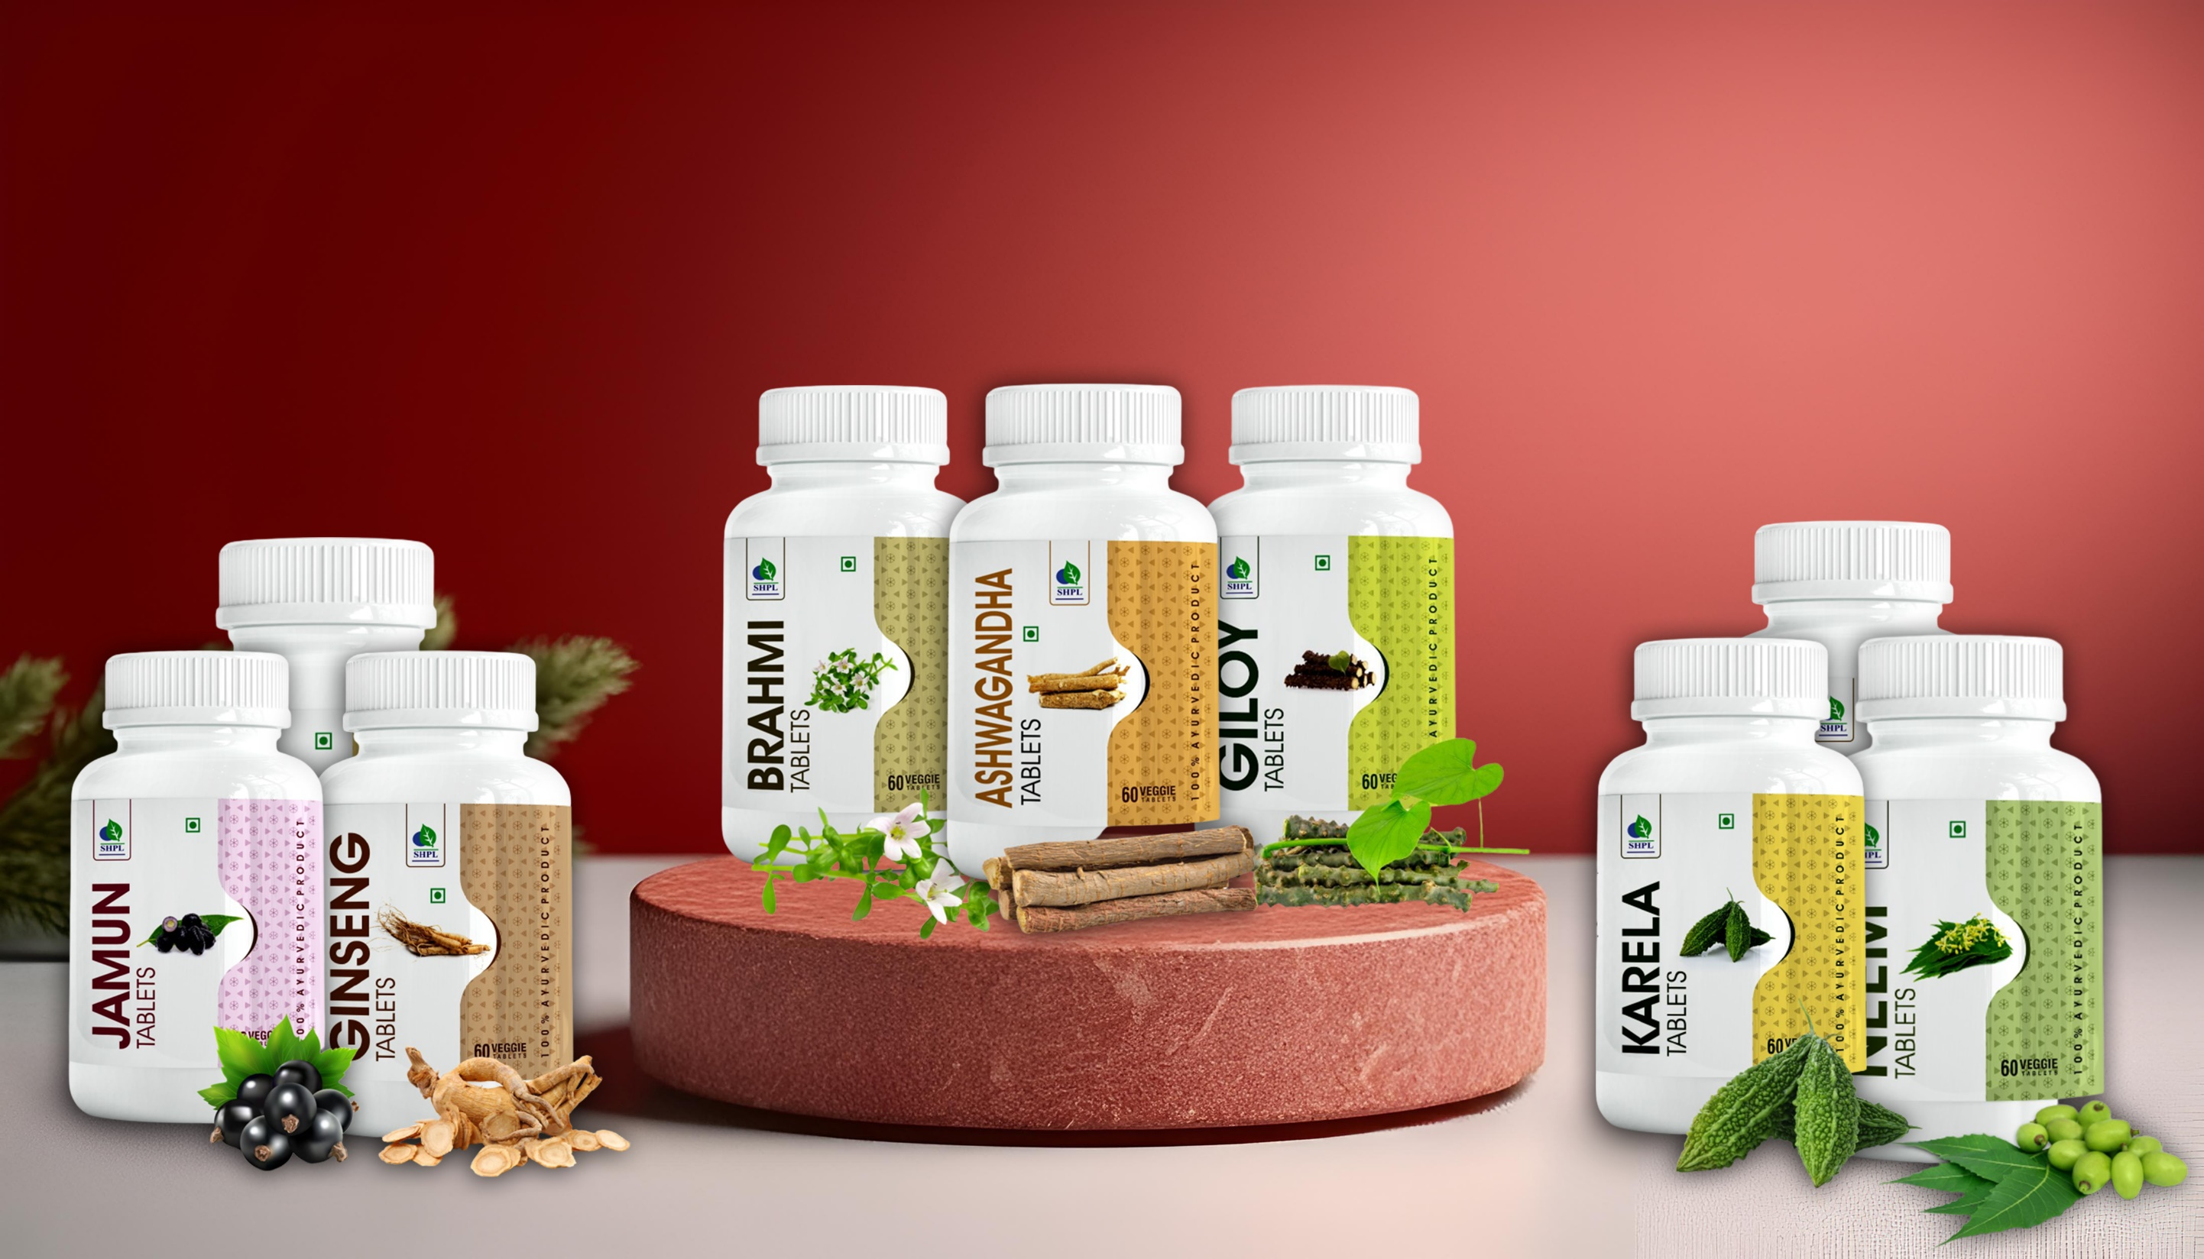
AYURVEDIC TABLETS
Single-herb tablets to enhance body functions and promote wellbeing.
Recommended for disease management.

Slide 20
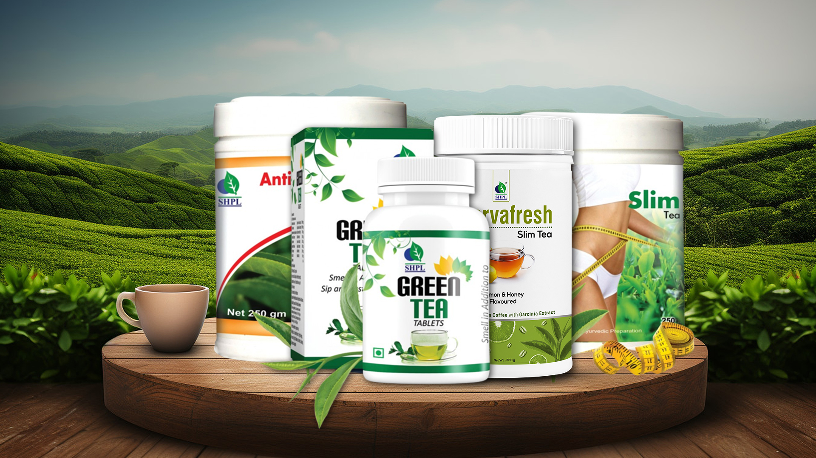
HERBAL TEAS
Refreshing formulations to boost metabolism, support weight loss, and enhance health and wellbeing.

Slide 21
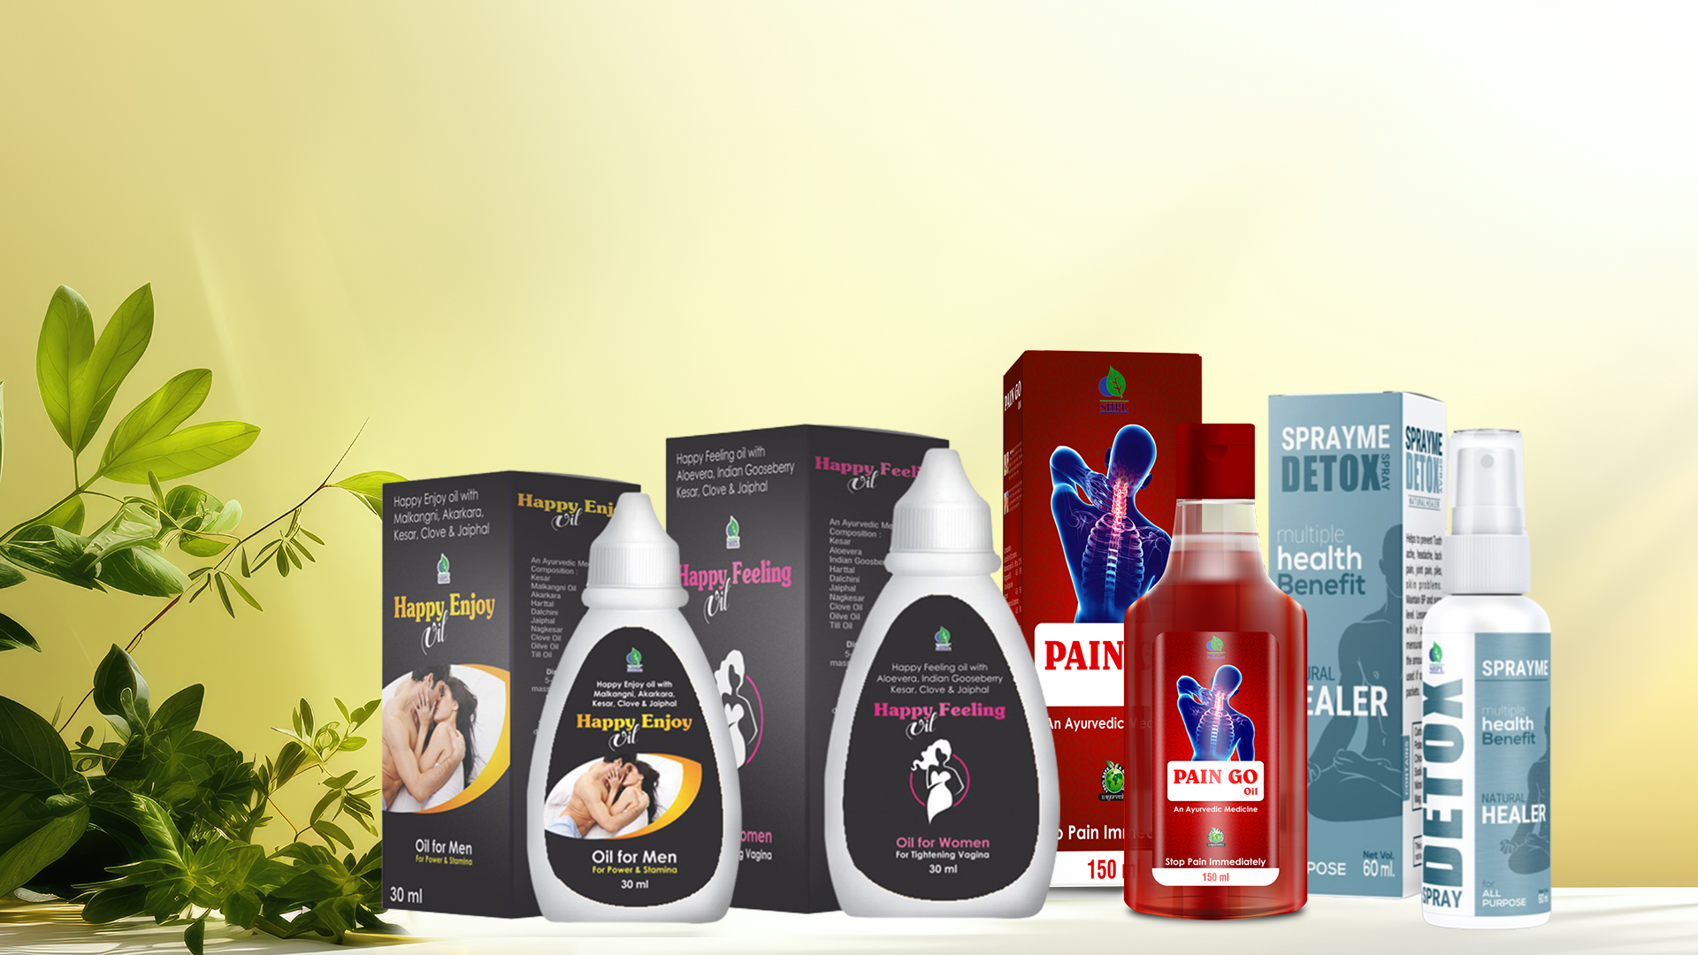
HEALTH OILS AND BALMS
Powerful herb-infused oils and balms to reduce pain, enhance vitality, detoxify the body and improve overall wellness.

Slide 22
SHPL HEALTH AND WELLNESS PRODUCTS for common health conditions
Diabetes
Heart Health
Weight Management
Digestive Health
Liver Health
Kidney Health
Asthma and Respiratory Issues
Women’s Health
Bone, Joint and Muscle Health
Immune Health
Nutrient deficiencies
Thyroid Health
Brain Health
Men’s Health
Kids Health
Skin and Hair care
Other health issues

Slide 23
If you listen to your body when it whispers….
you won't have to hear it scream.

Slide 24
Thank You!

