Slide 1
WELCOME TO THE
FASCINATING WORLD
OF SAARVASRI HERBS (SHPL)
GHAR GHAR SAARVASRI - HAR GHAR SAARVASRI

Slide 2
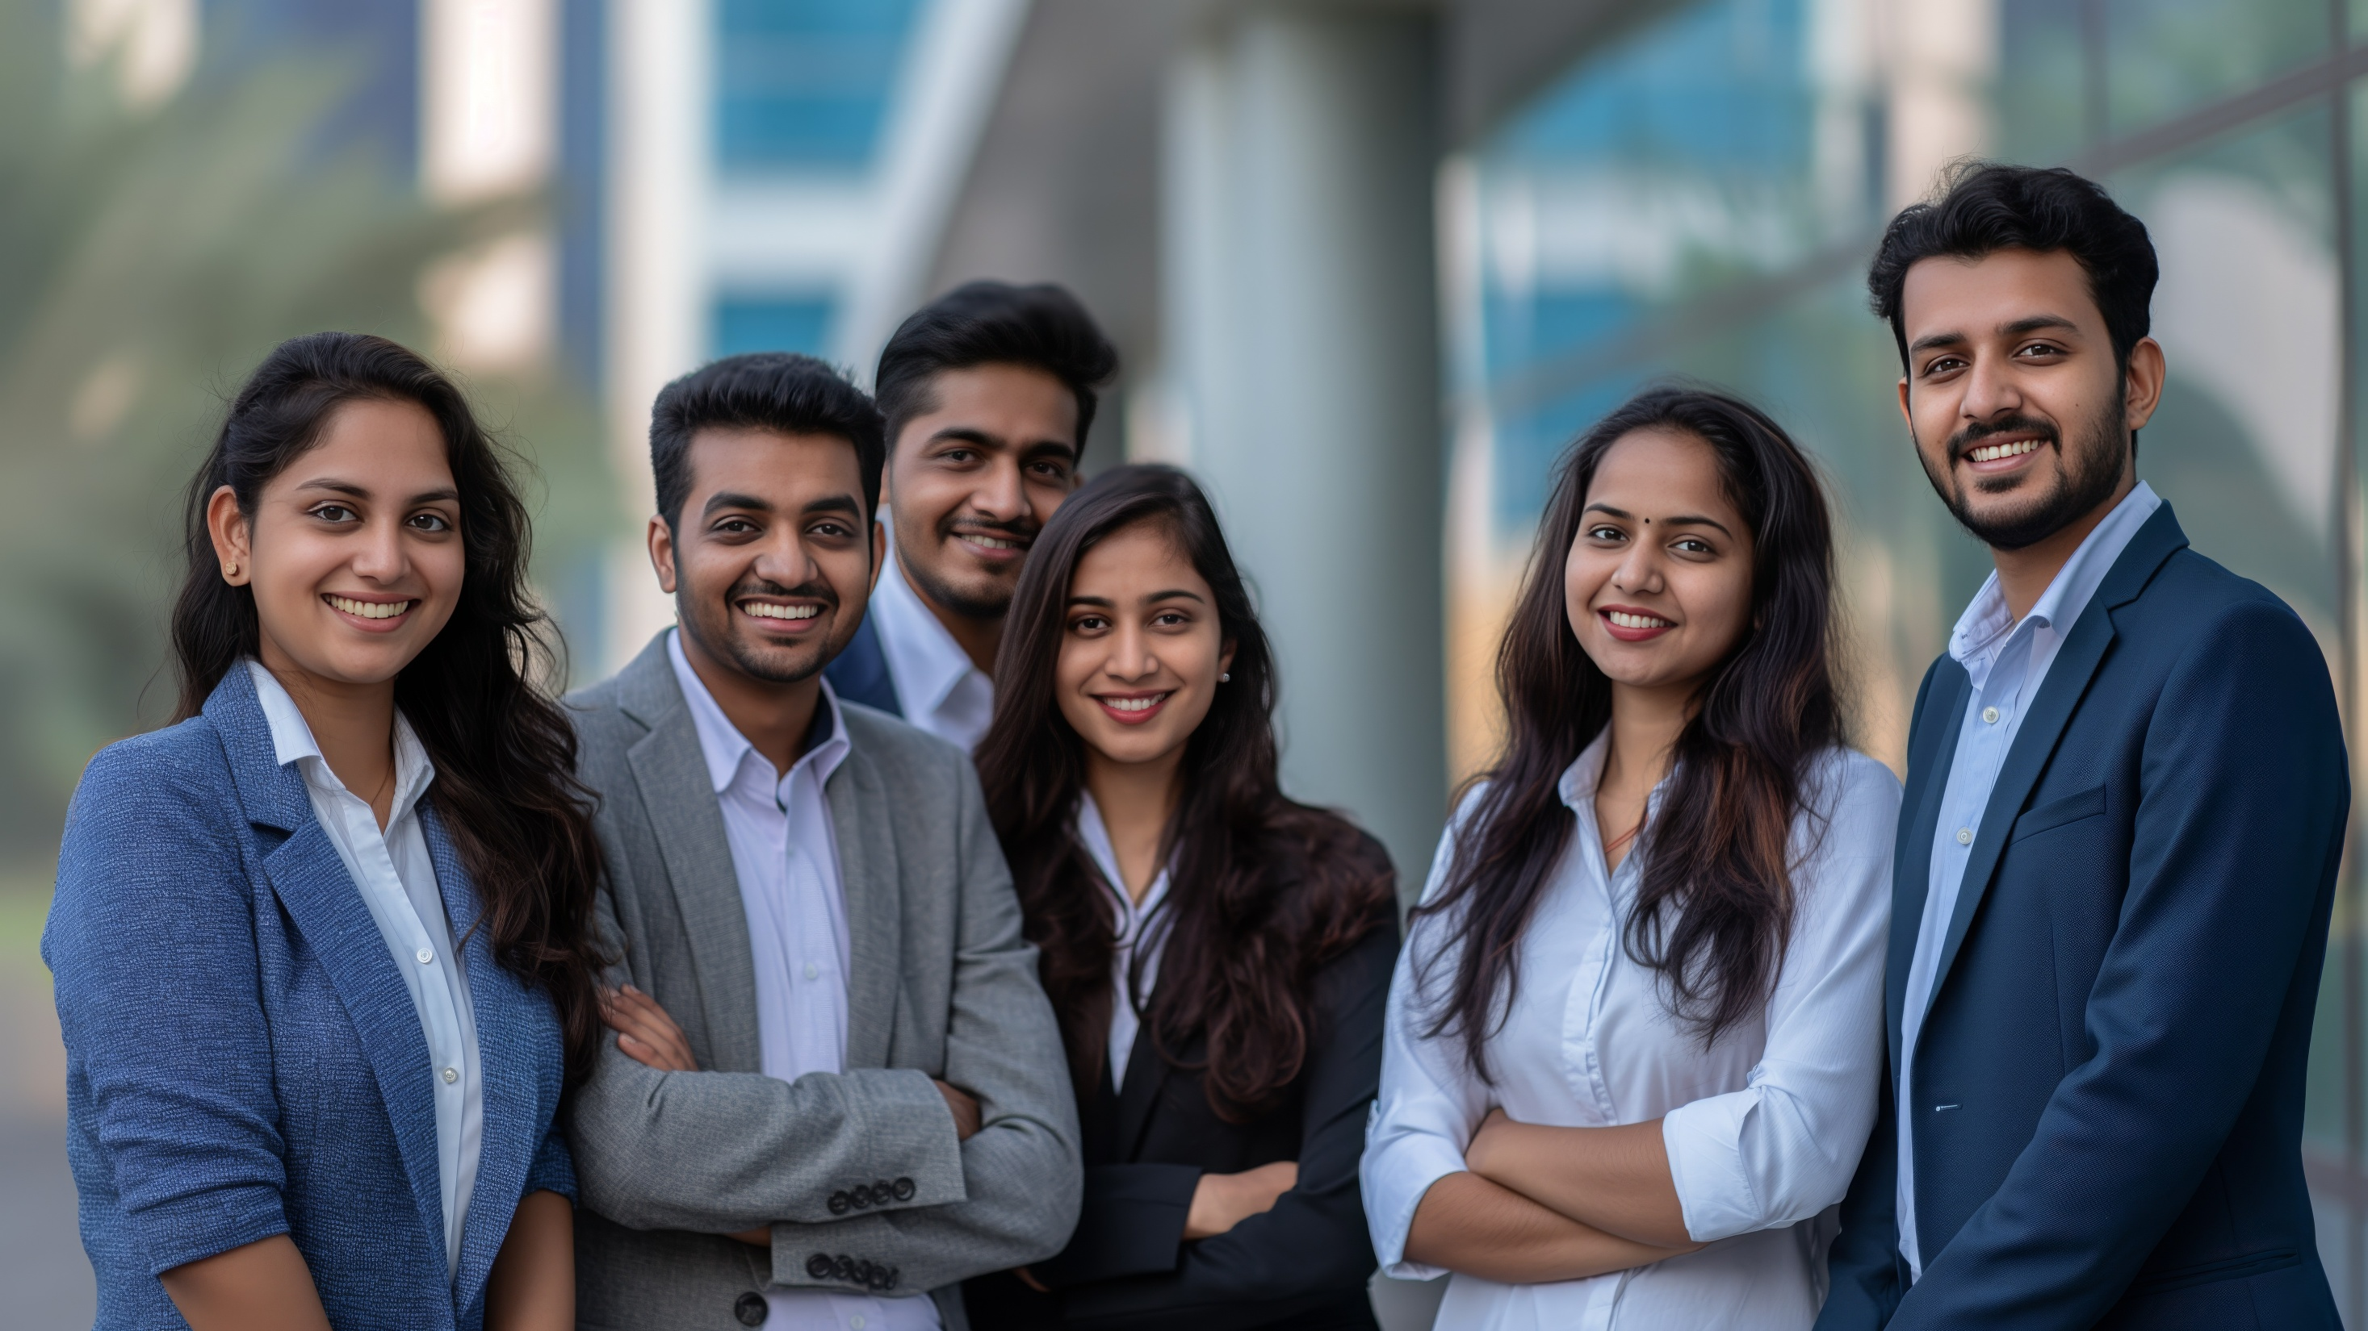
WE OFFER AN AMAZING OPPORTUNITY FOR ORDINARY PEOPLE TO
BECOME EXTRA-ORDINARY

Slide 3
ASSOCIATE WITH THE MARKET LEADER
WELCOME TO INDIA’S
FASTEST GROWING
DIRECT SELLING COMPANY
BE A PART OF THE 3 MAJOR TRENDS
1. Health & Wellness
2. Consumer Network
3. Direct Selling Business
BUILD A LEGITIMATE CAREER WITH SHPL TO FULFIL YOUR DREAMS & ASPIRATIONS

Slide 4
SAARVASRI STORY
PHASE 1
Incorporated on 20 Sept 2013 with a Humble Beginning
Operated from its Headquarters in Kolkata, West Bengal
Engaged in Contract Manufacturing of Wellness Products
Marketed through Traditional Sales Network in East India
Quality Products, Affordable Prices with Amazing Results
PHASE 2
Entered into Direct Selling Business Model on 20 May 2018
Now, the Fastest Growing Vibrant Consumer Network in India
Over 8 Lakhs Independent Business Owners (IBOs) & Growing
Over 330 World-Class Products across 8 Product Categories
Stepped into the 7th Year of Spectacular Presence & Growth

Slide 5
SAARVASRI VISION
To offer a wide range of
World-Class Quality Products
To Our Esteemed Customers
At An Affordable Price
and offer a
Legitimate Entrepreneurship Opportunity to
Awaken The Giant Within You
and Support You to
Explore Life To The Fullest

Slide 6
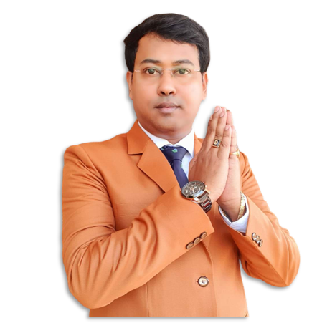
SAARVASRI MISSION
To be one amongst the
Top 5 Direct Selling Companies
of India by 2030
Be the Most Respected Leading Direct Selling Company
With Professional, Clean and Transparent Management
Offering Finest Quality Products with Affordable Pricing
Committed to Adhere to The CP Direct Selling Rules 2021
SHPL Education: World-Class Training & Support System

Slide 7
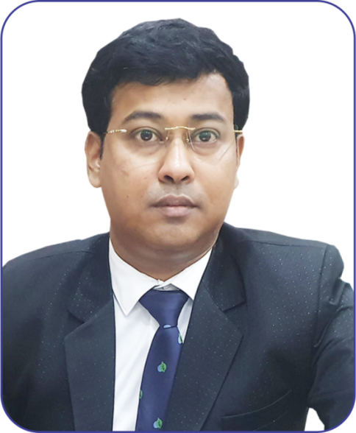
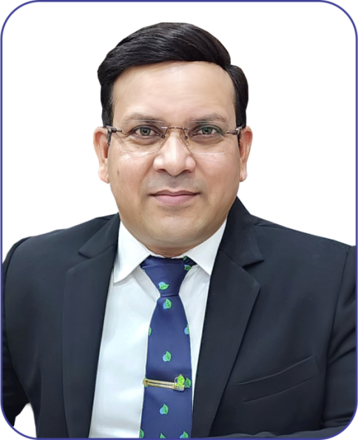
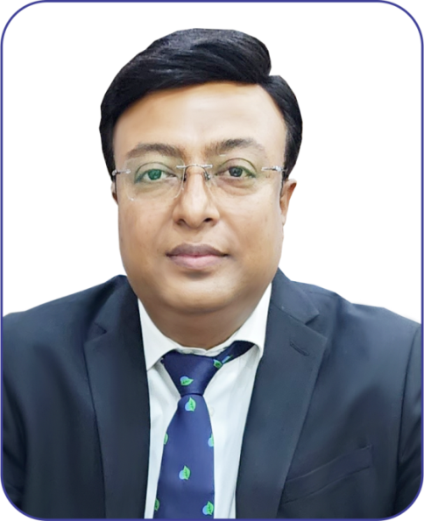
SAARVASRI PROMOTERS
PROFESSIONAL ADVISORS
(CS / CA / LAWYER)
DEDICATED & PROFESSIONAL
TEAM OF YOUNGSTERS
IN-HOUSE WEB SITE AND
SOFTWARE DESIGNING TEAM
GOPAL KUNDU, CMD
MULTILINGUIL TRAINERS
PRODUCT & BUSINESS TRAINING
EFFICIENT LOGISTIC SERVICES
CUSTOMER SUPPORT SERVICES
SUBASH SAHU, CFO
PRASANTA KUNDU, COO

Slide 8
STATUTORY COMPLIANCE
CERTIFICATE OF INCORPORATION
PAN (PERMANENT ACCOUNT NUMBER)
GST (GOODS & SERVICES TAX) CERTIFICATE
ISO 22000-2005 (FOOD SAFETY MANAGEMENT)
ISO 9001-2015
(QUALITY MANAGEMENT)
ORGANIC CERTIFICATE
IEC (IMPORT EXPORT CERTIFICATE)
WHO-GMP (GOOD MANUFACTURING PRACTICES)
FSSAI (FOOD SAFETY & STANDARDS AUTHORITY OF INDIA)
ISO 13485: 2016 (MEDICAL DEVICES SAFTEY CERTIFICATE)
FDA (FOOD & DRUG ADMINISTRATION)
KOSHER (FOOD QUALITY UNDER KASHRUT)

Slide 9
For 3 consecutive years, The Ministry of Finance, Department of Revenue, Central Board of Direct Taxes, Government of India has awarded the Certificate of Appreciation to Saarvasri Herbs Pvt Ltd (SHPL) for paying GST on time, month after month.

Slide 10
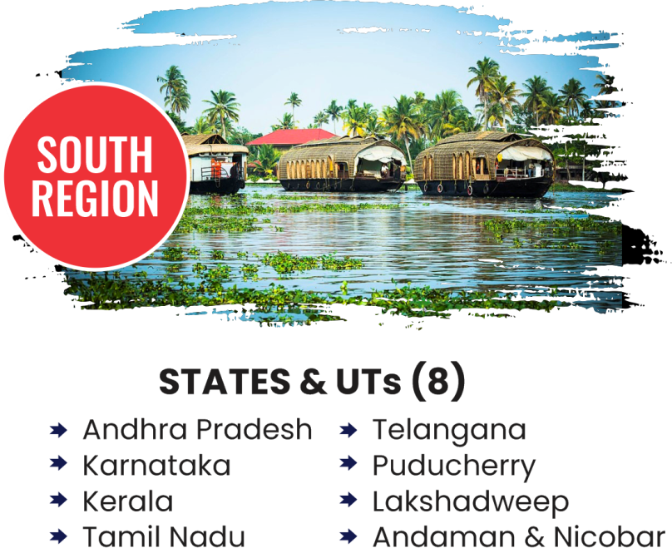
PAN INDIA PRESENCE – 5 REGIONS

Slide 13
NUTRILIFE: OWN MANUFACTURING FACILITY
Vast Experience of the Latest Manufacturing Trends
Manufacturing Finest Quality Premium SHPL Products
Manufacturing Dietary Supplements & Ayurveda
Juices, Syrups, Capsules, Tablets, Ointments etc.
Over 50 Professional & Dedicated Full Time Employees
Better Quality Control and Self Manufacturing Speed

Slide 14
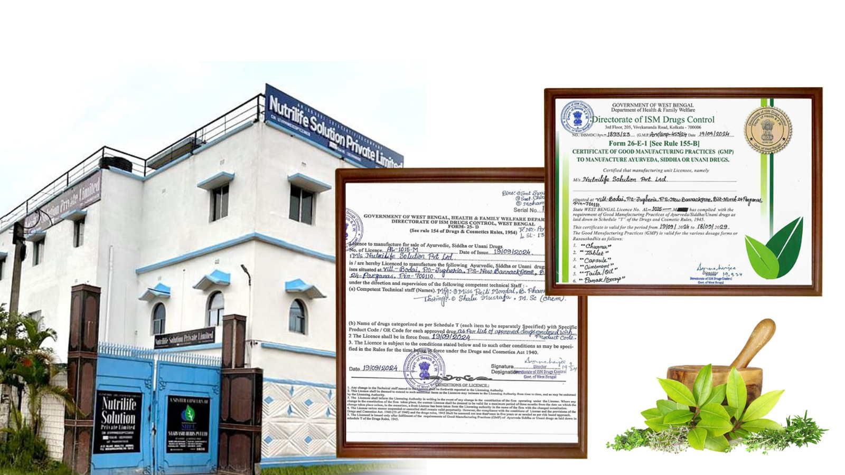
ENTER AYURVEDA MANUFACTURING

Slide 15
1. HEALTH & WELLNESS
Curated from the
Reservoir of Mother Nature
167 PRODUCTS
Wellness Capsules
Wellness Tablets
Wellness Juices
Wellness Syrups
Wellness Drops
Wellness Powders
Wellness Soft Gels
Wellness Gummies
Wellness Candies
Ayurvedic Tablets
Herbal Tea
Health Oils & Balms

Slide 16
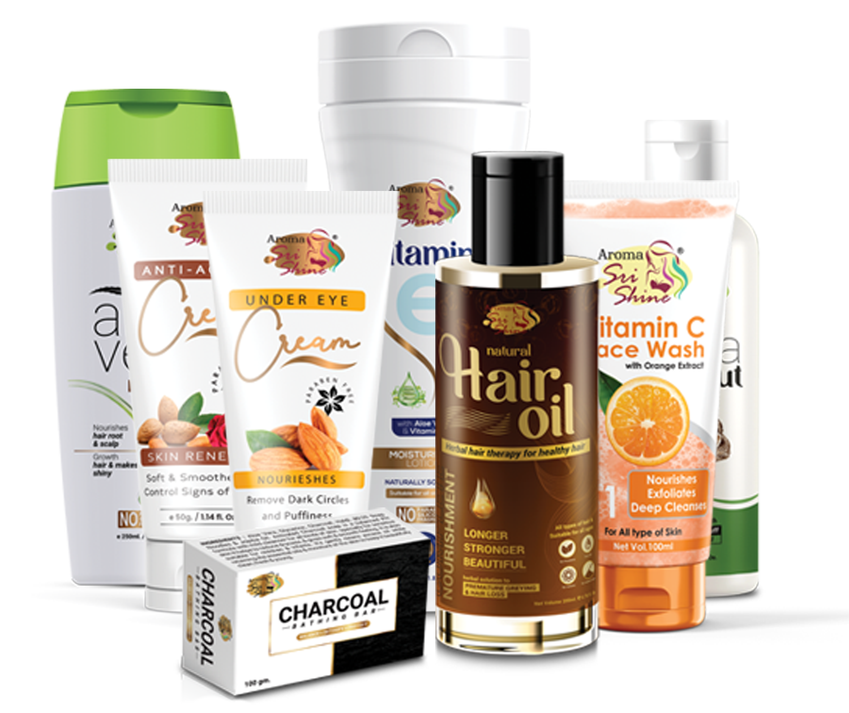
2. PERSONAL CARE
Indulge in Grace and
Gorgeous Glow
Hair Care
Oral Care
Skin Care
Body Spray
Personal Hygiene
Colour Cosmetics
101
PRODUCTS

Slide 17
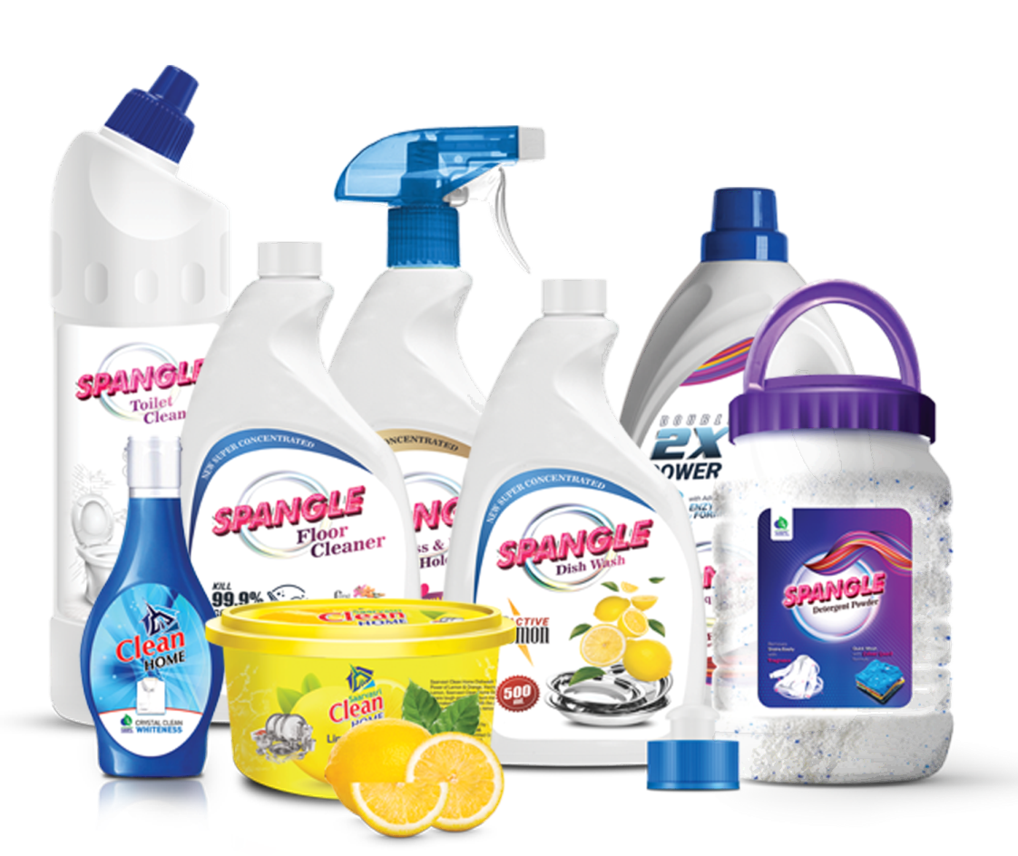
3. HOME CARE
For a Neat, Clean & Tidy Home
13
PRODUCTS

Slide 18
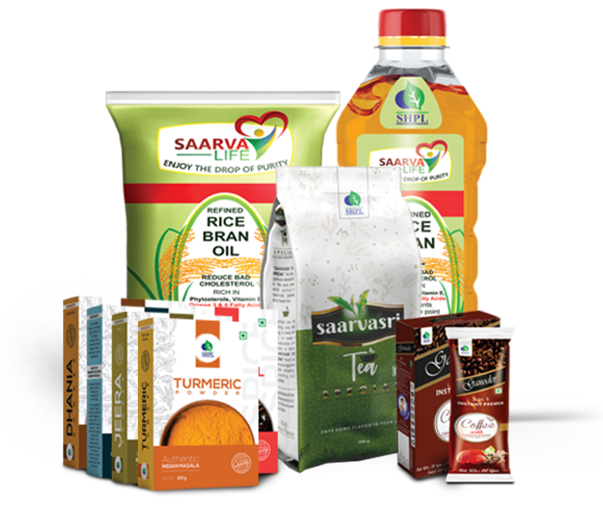
4. KITCHEN CARE
Healthy Essential at
Your Fingertips
29
PRODUCTS

Slide 19
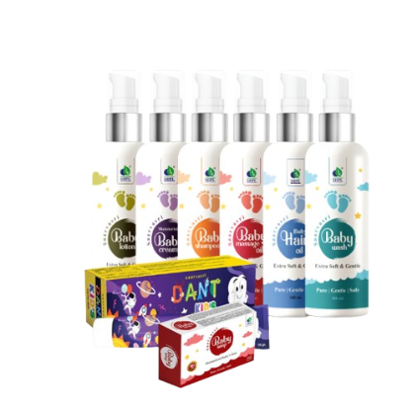
5. BABY CARE
Healthy Essential at
Your Fingertips
8
PRODUCTS

Slide 20
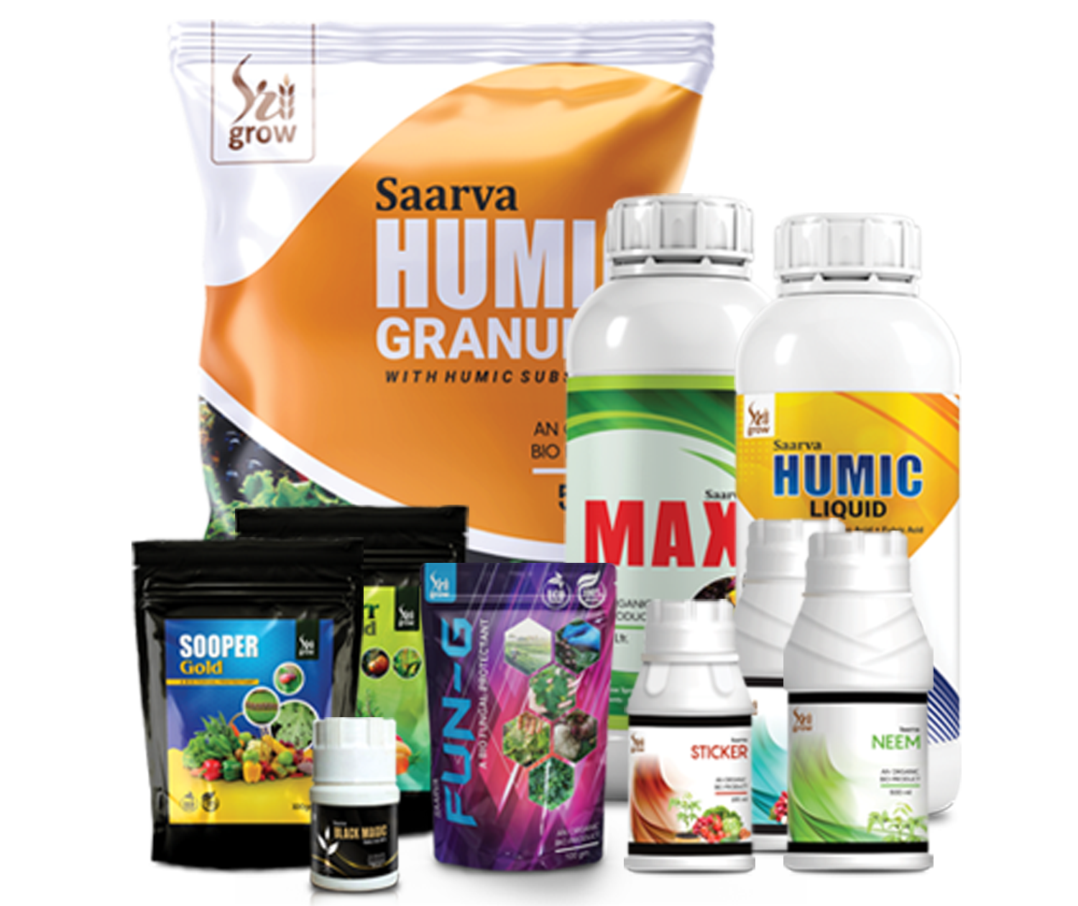
6. AGRO CARE
For Fertile Crop with
Golden Harvest
20
PRODUCTS

Slide 21
7. ANIMAL CARE
Finest Solutions With
Human Touch
05
PRODUCTS

Slide 22
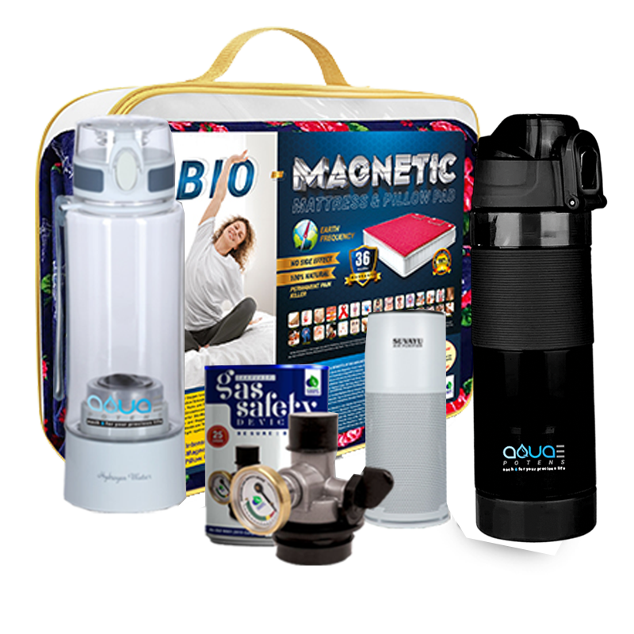
8. LIFESTYLE PRODUCTS
Thoughtful lifestyle
for a new YOU
09
PRODUCTS

Slide 23
SHPL FREEDOM PLAN
CREATING MASSIVE WAVES PAN INDIA WITH 12 EXCITING INCOME TYPES

Slide 24
HOW TO ASSOCIATE WITH SHPL?
STEP 1 : REGISTER ONLINE FOR ABSOLUTELY FREE
Register Online as a Preferred Customer (PC)
Registration is Absolutely Free; 1 PAN = 1 Registration Only
Furnish Personal Details, Delivery Address & GST Number (Optional)
Get SHPL User ID and Password to access Online Back Office (OBO)
STEP 2 : ACTIVATE YOUR ID WITH FIRST PURCHASE
Buy SHPL Products; It Activates Your Lifetime SHPL Distributorship
Buy Products of your Choice – No Fixed Packages or Fixed Amount
Buy SHPL Products under Various FBV Slabs for Amazing Benefits
Complete Your KYC Compliance to Earn Sales Bonuses & Commission
STEP 3 : KEEP BUYING PRODUCTS WITH RE-PURCHASE
Change Your Shop - Change Your Brand; Bring Home SHPL Products
Keep Buying SHPL Products for Personal Use and for Retailing
Make Attractive Personal Savings and Earn Huge Retail Profits
Join the Consumer Revolution by being an Informed Customer

Slide 25
LUCRATIVE PAY-OUT
12 EXCITING INCOMES
Instant Retail Profit (IRP) : 100% on MRP
# Consistency Offer Benefits (CNC) : 01% of BV
Team Matching Bonus (TMB) : 40% of BV
Team Building Bonus (TBB) : 04% of BV
Team Mentoring Bonus (TMEB) : 20% of BV
Business Development Bonus (BDB) : 03% of BV
Child Education Bonus (CEB) : 03% of BV
Family Travel Bonus (FTB) : 03% of BV
Luxury Car Bonus (LCB) : 03% of BV
Dream House Bonus (DHB) : 03% of BV
Royalty Club Bonus (RCB) : 03% of BV
Super Performance Bonus (SPB) : 02% of BV
Ranks, Rewards & Recognition (RRR) : 10% of BV
95% PAY-OUT DISTRIBUTION

Slide 26
1. INSTANT RETAIL PROFIT (IRP)
BUY FINEST QUALITY SHPL PRODUCTS AT MRP
MAKE 50% PERSONAL SAVING
EARN 100% RETAIL PROFIT
ILLUSTRATION
BUY 1 S-PULSE @ MRP Rs.2500
GET 2 S-PULSE of MRP Rs.5000
PERSONAL SAVING: 50%
RETAIL PROFIT: 100%
When you have Hundreds and Thousands of People in your Sales Network Buying SHPL Products through First Purchase or Re-Purchase, month after month, for their Personal Use or for Genuine Retailing, you accumulate Huge BV (Business Volume) Giving you Exciting Networking Income on a Weekly and Monthly basis.

Slide 27
CONSISTENCY (CNC) OFFER
Buy Minimum 1,000 Personal RBV worth of any SHPL Products of your choice in multiple invoices, in multiples of 1,000 RBV, between 1 – 14 of Every Month and stand a chance to win Exciting Prizes amongst 25 / 50 Lucky Winners through an Online Lucky Draw
OFFER VALID FOR 3, 6 AND 12 ROLLING MONTHS
3-MONTH CHALLENGE
6-MONTH CHALLENGE
12-MONTH CHALLENGE
Purchase 1,000 Self RBV worth of SHPL Products before 14th of each month in multiple invoices for 3 consecutive months
Purchase 1,000 Self RBV worth of SHPL Products before 14th of each month in multiple invoices for 6 consecutive months
Purchase 1,000 Self RBV worth of SHPL Products before 14th of each month in
multiple invoices for 12 consecutive months
GET SHPL PRODUCTS WORTH
MRP. 1500/-
ABSOLUTELY FREE
GET SHPL PRODUCTS WORTH
MRP. 5000/-
ABSOLUTELY FREE
GET SHPL PRODUCTS WORTH
MRP. 15000/-
ABSOLUTELY FREE
Multiple invoices totaling above 1,000 Personal RBV must be dated before 14th of a specific calendar month for existing IBOs # For New IBOs, the Consistency Offer Purchase in the first month is valid up to the last day of the calendar month of the activation with 1,000 Personal FBV & above; However, they will NOT be considered for the Online Lucky Draw in the month of Activation # Invoices with Business Tools will NOT be considered # Invoices comprising of any other Promotional Offers including any kind of Combo Packs bill will NOT be considered # The discretion to decide which products will be issued FREE under CNC offer lies with the Company Management # No BV will be awarded against Free Products # Regular Mandatory Self Purchase requirement of ‘Leadership Bonus’ from Crown Ambassador will be considered for Consistency Offer # Only Highest Achievement will be Awarded.

Slide 28
2. TEAM MATCHING BONUS (TMB)
Buy Any SHPL Products of your Choice for Personal Use or for Retailing, which Activates your ID, making you an SHPL IBO. Earn 10% Team Matching Bonus per week with a weekly cap of
up to Rs.3 Lakhs based on your One-time Personal First Purchase BV slab
BUY 1 GET 1 FREE
2 DIRECT MANDATORY
3000 : 3000 BV = 1 PAIR
NO UPGRADE OPTION
SL.NO.
FIRST PURCHASE SLAB
WEEKLY CAP
MONTHLY EARNING POTENTIAL
YOUR PERSONAL BV
FROM
TO
1
500
2,999
Rs.1,25,000
Rs.05,00,000
2
3,000
5,999
Rs.1,50,000
Rs.06,00,000
3
6,000
8,999
Rs.2,00,000
Rs.08,00,000
4
9,000
>>>
Rs.3,00,000
Rs.12,00,000
3000 BV : 3000 BV = 1 PAIR
TERMS & CONDITIONS: By default, existing IBOs are eligible for 10% TMB slab with Rs.1.25 Lakhs weekly cap # The First Billing of every new PC will be considered as First Purchase (FBV) # All subsequent orders will be counted as Re-Purchase (RBV) # No Upgrade option in FBV is available # Effective 1 Aug 2024, two Direct Referrals, irrespective of their Personal FBV are mandatory to Qualify for TMB # The placement of Direct Referrals is immaterial; they can be in any level or in the same Leg # Weekly sales closing will be on every 7th, 14th, 21st & last day of the month # No minimum Payout or Wallet Concept # PAN Linked to Aadhar KYC is mandatory # 2% TDS applicable # Unmatched BVs will be carried forward in both legs, up to 3,000 BV in any one leg & Beyond 3,000 in the other leg # TMB will be paid on 40% Max. Payout Policy # Trimming is applicable, if need be. # Self Re-purchase will be considered in the weaker leg.
CLOSING: 7, 14, 21 & LAST DAY OF MONTH

Slide 29
3. TEAM BUILDING BONUS (TBB)
U
10%
10%
10%
10%
10%
A
B
C
D
E
25,000
50,000
1,00,000
5,00,000
12,00,000
EARN 10%
OF THE TEAM MATCHING BONUS (TMB)
OF ALL YOUR DIRECT REFERRALS IN L1

Slide 30
EARN LEADERSHIP BONUS (LSB)
4). ACHIEVE MONTHLY
15,000 MATCHING BV
5). ACHIEVE MONTHLY
30,000 MATCHING BV
6). ACHIEVE MONTHLY
50,000 MATCHING BV
PLATINUM
Achiever
SILVER
Achiever
GOLD
Achiever
EARN AN EXCITING
5% TEAM
MENTORING BONUS
GET PAID MONTHLY
3% TMEB
3% BUSINESS DEVELOPMENT BONUS
YOU ARE NOW AT 6% LEVEL
3% TMEB + 3% BDB
3% CHILD
EDUCATION BONUS
YOU ARE NOW AT 9% LEVEL

Slide 31
LEADERSHIP BONUS (LSB)
7). ACHIEVE MONTHLY
75,000 MATCHING BV
8). ACHIEVE MONTHLY
1,50,000 MATCHING BV
9). ACHIEVE MONTHLY
2,50,000 MATCHING BV
EXECUTIVE DIAMOND
Achiever
DIAMOND
Achiever
ROYAL DIAMOND
Achiever
3% TMEB + 3% BDB + 3% CEB
3% FAMILY
TRAVEL BONUS
YOU ARE NOW AT 12% LEVEL
3% TMEB + 3% BDB + 3% CEB + 3% FTB
3% LUXURY
CAR BONUS
YOU ARE NOW AT 15% LEVEL
3% TMEB + 3% BDB + 3% CEB + 3% FTB +3% LCB
3% DREAM
HOUSE BONUS
YOU ARE NOW AT 18% LEVEL

Slide 32
LEADERSHIP BONUS (LSB) SUMMARY
35% of the Monthly Total Company BV will be allocated to Distribute Leadership Bonus (LSB)
LSB is paid amongst IBOs who achieve Silver (15K BV) to Royal Diamond (2.5L BV) in a Single Calendar Month
RANK
SELF
RBV
TEAM BV MATCHING
SILVER
5%
GOLD
6%
PLATINUM
9%
DIAMOND
12%
EXE. DIAMOND
15%
ROYAL DIAMOND
18%
TMEB (20%)
Team Mentoring Bonus
-
15,000
5%
3%
3%
3%
3%
3% *
BDB (3%)
Business Development
-
30,000
-
3%
3%
3%
3%
3%
CEC (3%)
Child Education Bonus
-
50,000
-
-
3%
3%
3%
3%
FTB (3%)
Family Travel Bonus
-
75,000
-
-
-
3%
3%
3%
LCB (3%)
Luxury Car Bonus
-
1,50,000
-
-
-
-
3%
3%
DHB (3%)
Dream House Bonus
1000
2,50,000
-
-
-
-
-
3%
Team Mentoring Bonus for Monthly Rank of Royal Diamond & Above Achieves will be paid up to a maximum of 10,00,000 MBV Only
When Your Monthly Rank is Royal Diamond or Royal Diamond+, You Must Mandatorily Make a Personal (Self) Repurchase of 1,000 RBV

Slide 33
10. ROYALTY CLUB BONUS (RCB)
U
9 Points
A 4 Point B
1 Point C
1 Point
D
1 Point
E
1 Point
Get 3% of the Company’s Total Monthly BV distributed proportionately amongst all IBO's who achieve Royal Diamond (i.e. 2,50,000 matching BV in a single calendar month) based on the number of such Qualified IBO's in 3 compressed levels.
A1
1 Point
A2
1 Point
A3
1 Point
FOB UNIT VALUE CALCULATION
Total Company BV of the Month X 3%
1 RCB Unit Value =
_____________________________________________
Total RCB Units Per Month

Slide 34
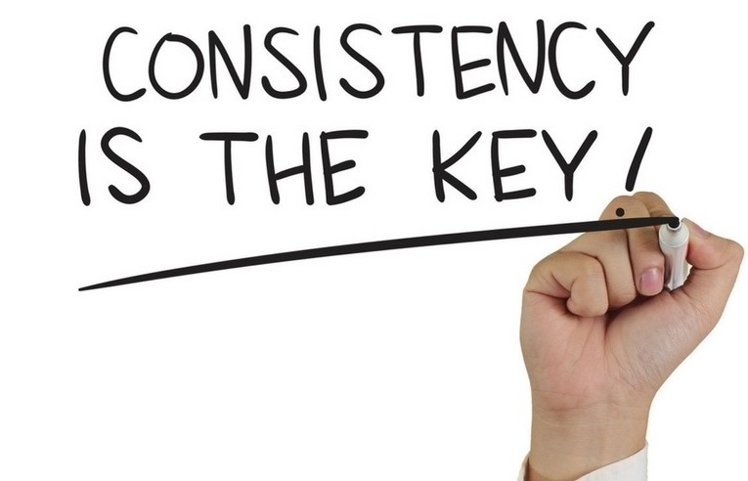
11. SUPER PERFORMANCE BONUS (SPB)
2% of Company’s Total BV Per Month will be allocated for SPB, to be paid Monthly
Eligibility: 25,00,000 Fresh BV & multiples thereof in a single month will be considered as 1 SPB
SPB UNIT VALUE CALCULATION
Total Company BV of the Month X 2%
1 SPB Unit Value =
_________________________________________
Total SPB Units Per Month

Slide 35
ALL SHPL RANKS ARE NOW CUMMULATIVE
THERE IS ABSOLUTELY NO TIME-LIMIT
ALL SHPL RANKS HAVE EXCITING REWARDS

Slide 36
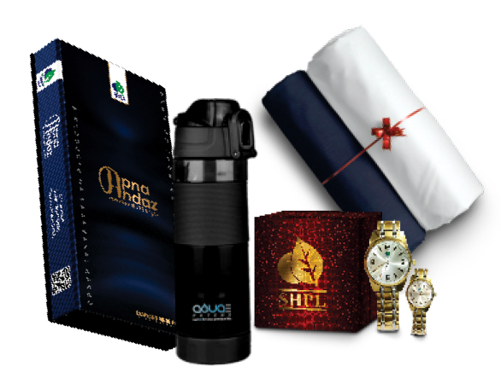
EARN LEADERSHIP BONUS (LSB)
12. RANKS, REWARDS & RECOGITION (RRR)
ACHIEVE 75,000 CUMMULATIVE MATCHING BV
ACHIEVE 1,50,000 CUMMULATIVE MATCHING BV
ACHIEVE 2,50,000 CUMMULATIVE MATCHING BV
DIAMOND ACHIEVER
EXECUTIVE DIAMOND
ROYAL DIAMOND
SHPL GET STARTED TOOL KIT
SHPL Back Pack + SHPL T-Shirt + SHPL Cap + SHPL Tie with Tie Pin + SHPL Lapel Pin + SHPL Business Tools
SHPL PREMIUM GIFT HAMPER
SHPL Gold-Plated Bio-Magnetic Couple
Wrist Watch + Suit Length + Shirt Piece
+ Pant Piece + Alkaline Water Bottle
2N/3D LDP cum- DOMESTIC TOUR
@ Various Locations with Rewards &
Rank Recognition (Trophy + Certificate)

Slide 37
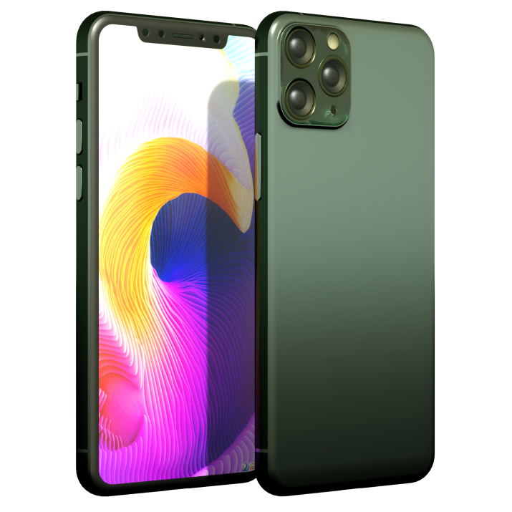
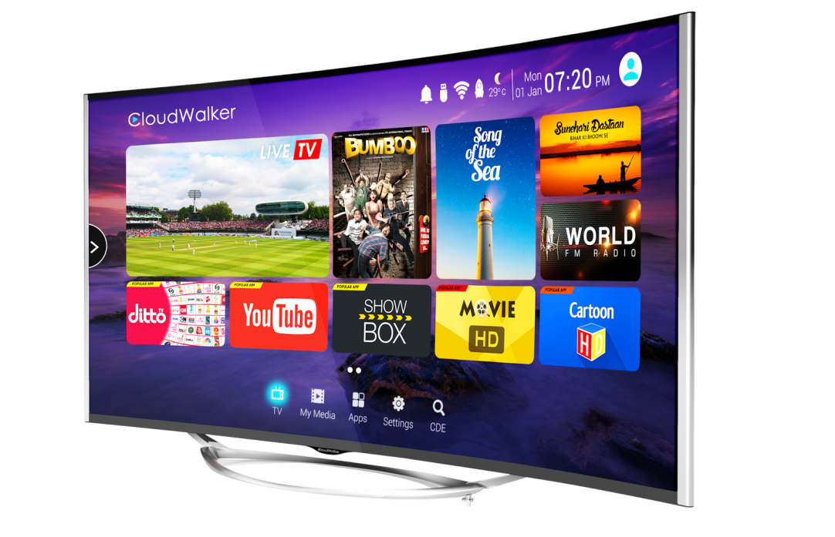
EARN LEADERSHIP BONUS (LSB)
LIFETIME REWARDS WITH NO TIME LIMIT
ACHIEVE 3,75,000 CUMMULATIVE MATCHING BV
ACHIEVE 7,50,000 CUMMULATIVE MATCHING BV
ACHIEVE 12,50,000
CUMMULATIVE MATCHING BV
CROWN DIAMOND
EXECUTIVE CR. DIAMOND
CROWN AMBASSADOR
BRANDED SMARTPHONE
BRANDED LED TV
BRANDED LAPTOP

Slide 38
ENJOY THE LUXURY AT YOUR OWN SPEED
4N/5D
THAILAND TOUR
ACHIEVE 25,00,000
CUMMULATIVE MATCHING BV
ACHIEVE 50,00,000 CUMMULATIVE MATCHING BV
DOUBLE CROWN AMBASSADOR
TRIPLE
CROWN
AMBASSADOR
4N/5D DUBAI TOUR
Rs.25,000/- TOUR BONUS
PAID IN LESS 2% TDS
Rs.66,000/- TOUR BONUS PAID IN LESS 2% TDS

Slide 39
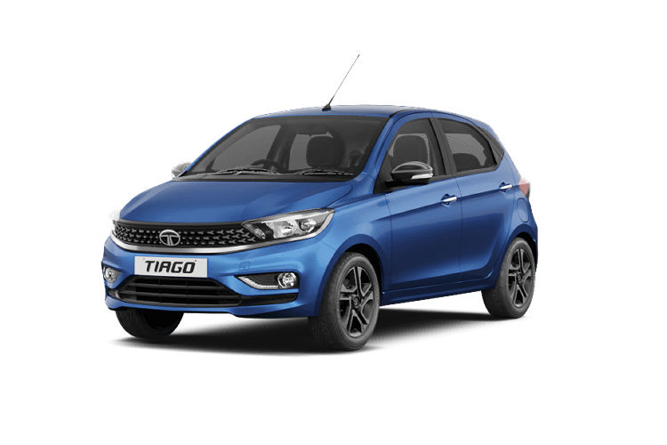
CREATE YOUR SUCCESS STORY WITH PRIDE
ACHIEVE 1,25,00,000
CUMMULATIVE MATCHING BV
ACHIEVE 2,50,00,000
CUMMULATIVE MATCHING BV
UNIVERSAL
CROWN AMBASSADOR
DOUBLE UNIVERSL
CROWN AMBASSADOR
4N/5D SWITZERLAND TOUR
3N/4D CRUISE TOUR
CRUISE TOUR BONUS OF
Rs.2,50,000/-
PAID IN LESS 2% TDS
CAR BONUS OF
Rs.5,00,000/-
PAID IN LESS 2% TDS

Slide 40
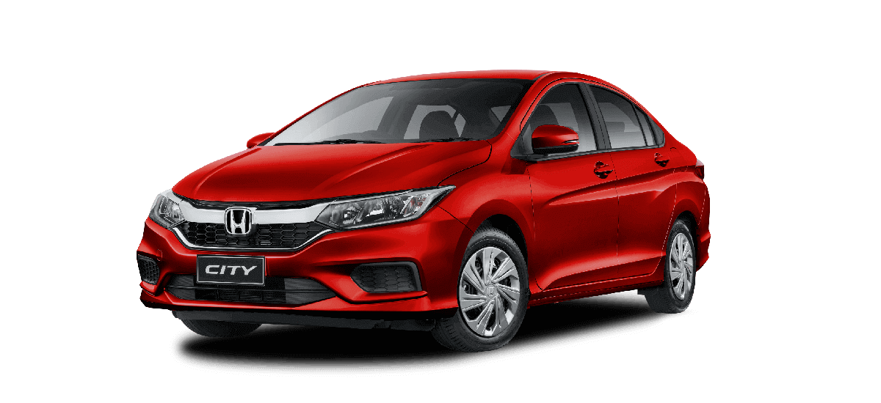
EXPLORE THE WORLD IN JOSH & STYLE
ACHIEVE 5,00,00,000
CUMMULATIVE MATCHING BV
ACHIEVE 10,00,00,000
CUMMULATIVE MATCHING BV
PRESIDENTIAL
CLUB DIRECTOR
ROYAL PRESIDENTIAL
CLUB DIRECTOR
7N/8D
EUROPE TOUR
CAR BONUS OF
Rs.12,50,000/-
PAID IN LESS 2% TDS
CAR BONUS OF
Rs.25,00,000/-
PAID IN LESS 2% TDS
7N/8D
USA OR AUS TOUR

Slide 41
REACH THE PINACCLE OF SUCCESS
ACHIEVE 20,00,00,000
CUMMULATIVE MATCHING BV
SHPL BRAND AMBASSADOR
WITH
12N/13D WORLD TOUR
CAR BONUS OF Rs. 50,00,000/-
PAID IN LESS 2% TDS

Slide 42
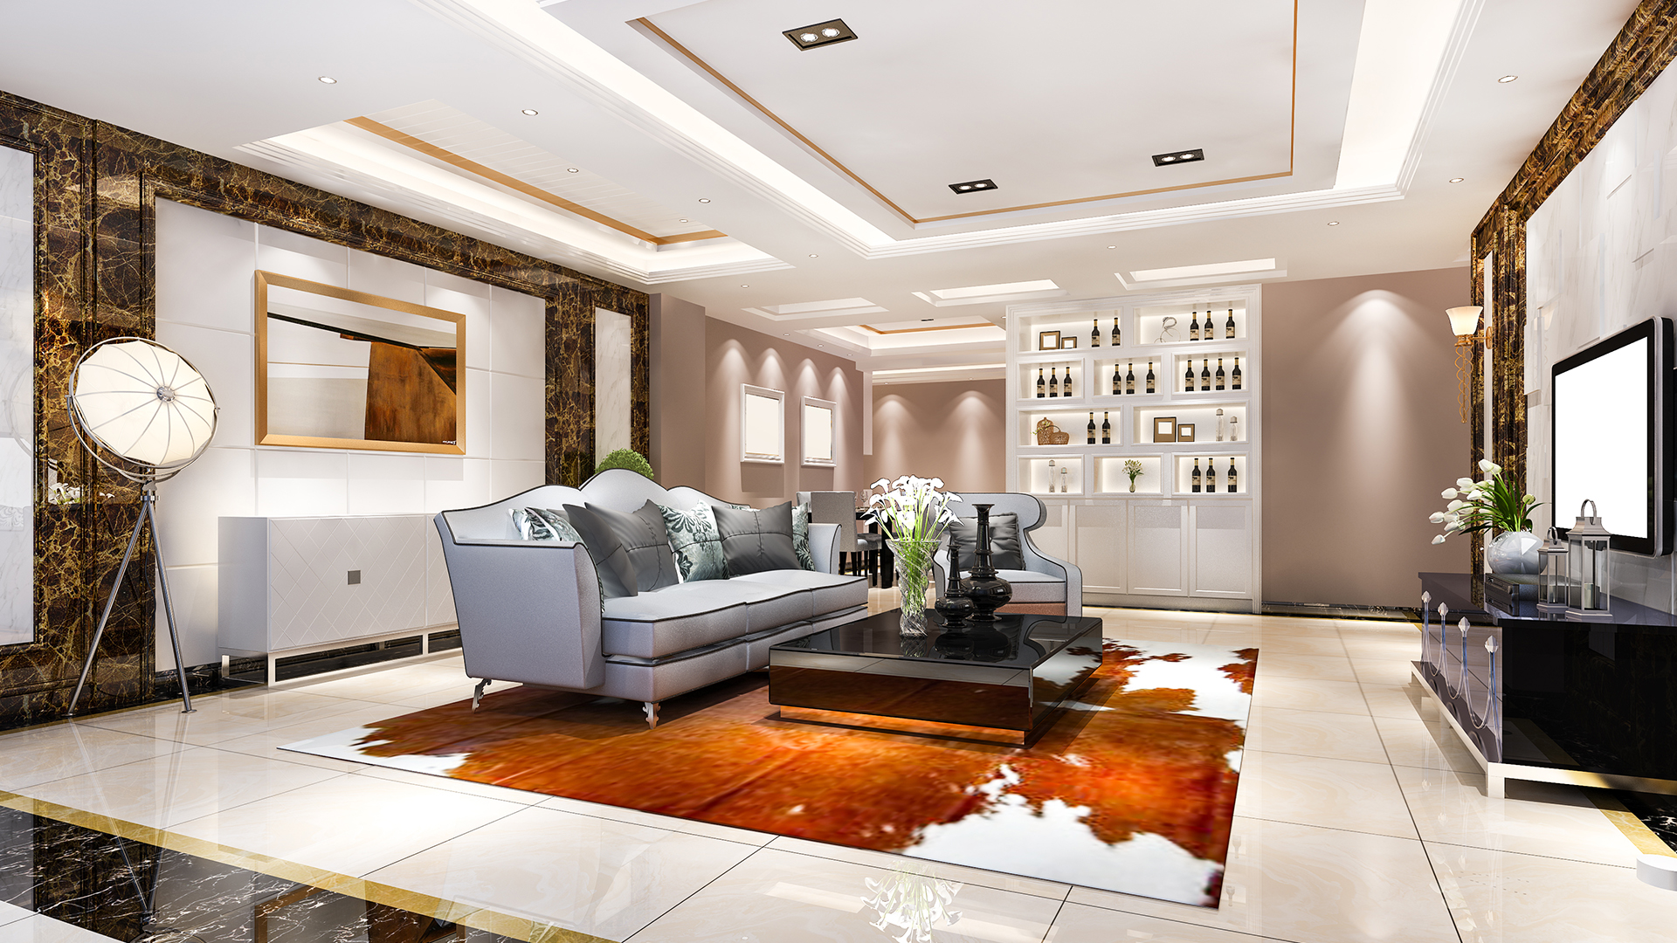
REDEFINE SUCCESS WITH QUALITY LIVING
ACHIEVE 50,00,00,000
CUMMULATIVE MATCHING BV
CHAIRMAN’S CLUB DIRECTOR
LUXURY FLAT BONUS OF Rs. 1,25,00,000/-
PAID IN LESS 2% TDS

Slide 43
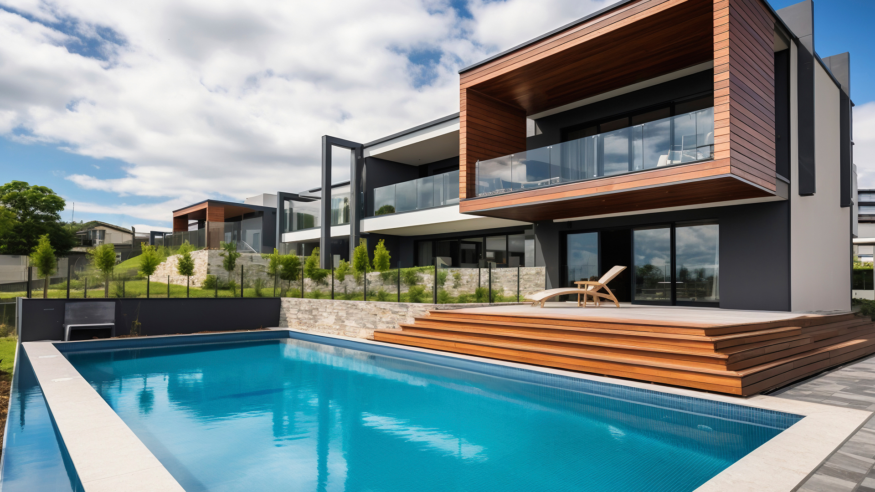
INDULGE IN LUXURIOUS LIFESTYLE
ACHIEVE 100,00,00,000
CUMMULATIVE MATCHING BV
ROYAL CHAIRMAN’S CLUB DIRECTOR
ULTRA- LUXURY VILLA BONUS OF Rs. 2,50,00,000/-
PAID IN LESS 5% TDS

Slide 44
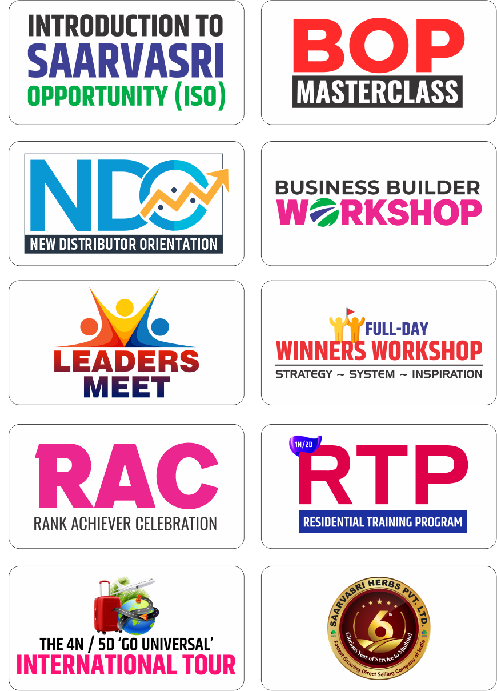
SHPL EDUCATION : TRAINING SYSTEM

Slide 45
ONLY SHPL
BUSINESS SUMMARY

