Slide 1
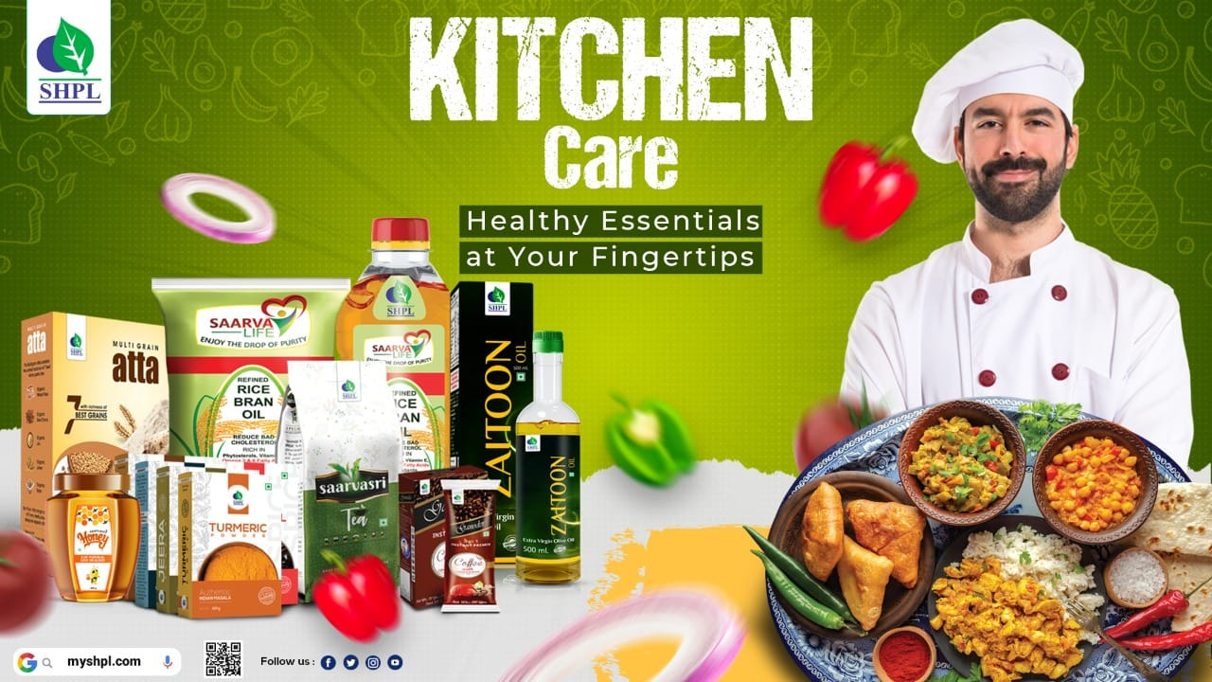

Slide 2
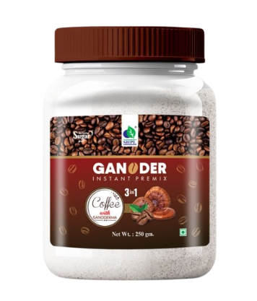
Ganoder
Instant Premix Coffee
BENEFITS
Boost immunity
Fight fatigue
Improve memory
Increase energy stamina
Lower cholesterol
Reduce inflammation
Relieve stress
Reverse the aging process
Stimulate circulation
Source of antioxidants
HOW TO USE
Pour 1 spoon Ganoder Insta Premix Coffee into a cup of hot water(not boiling) and stir well and enjoy your healthy coffee.

Slide 3
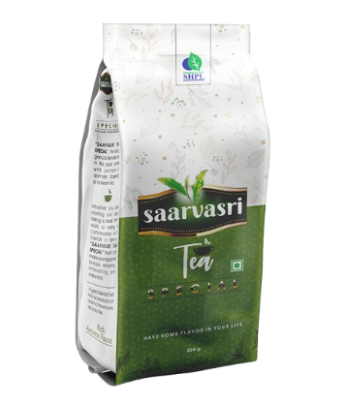
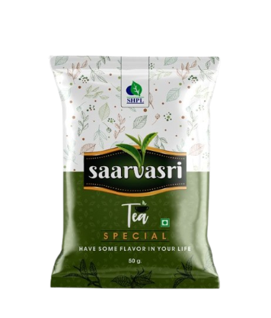
SAARVASRI TEA
Special
Saarvasri Special Tea is a blended CTC tea with the best quality leaves; Processed in high quality technology. Each cup of this tea is made with the best selected tea leaves; Which ensures the strength, rich color and fresh taste of your tea.
HOW TO USE
Use Saarvasri Tea as your regular tea.

Slide 4
ZAITOON OIL
Extra Virgin Olive Oil
BENEFITS
Large amount of antioxidants
Rich in healthy monounsaturated fats
Anti-inflammatory properties
Help reduce the risk of strokes
Protection against heart disease
Improve bone health
Assists in weight loss
Protection against specific cancers
Antibacterial properties
Reduced risk of alzheimer’s
Reduced risk of arthritis
Supports A healthy gut microbiome
HOW TO USE
In salads as dressings
Light sautéing
You can drink a tablespoon of extra virgin olive oil as soon as you wake up on an empty stomach
You can leave olive oil on your face overnight

Slide 5
RICE BRAN OIL
Enjoy the drop of Purity
BENEFITS
Rich in vitamin E, MUFA & PUFA
Contains the right amount of oryzanol (1500 mg)
Lowers cholesterol
Maintains blood sugar levels
Contains good fats
Heart friendly
Prevents gas/acidity
Supports digestion
Aids weight loss
Good for the skin
Anti-inflammatory properties
HOW TO USE
Use SHPL Rice bran oil as your regular cooking oil.

Slide 6
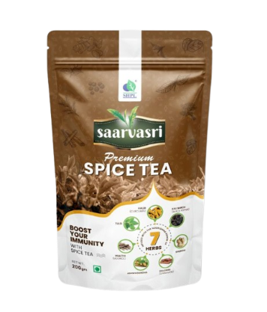
Saarvasri
Premium
SPICE TEA
Favourite to a maximum number of households, Spice tea, riched in 7 natural & powerful herbs and spices, is a unique variant that provides additional aroma, taste, flavours and health benefits. Saarvasri Premium Spice Tea is usually a strong tea and is consumed normally as a milk tea variant. Get refreshed and boost your energy with our Premium Spice Tea for refreshing mood & better health.
INGREDIENTS
Dalchini, Mulethi, Ashwagandha, Kali Mirch, Sunthi, Haldi & Tulsi
BENEFITS
Rich in vitamin E, MUFA & PUFA
Reduces Inflammation
Boosts Immunity
Aids Digestion
Contains Antioxidants
Increases Your Energy Levels
Reduces stress
Refreshes mood
Increases Metabolism
HOW TO USE
Use as your regular tea.

Slide 7
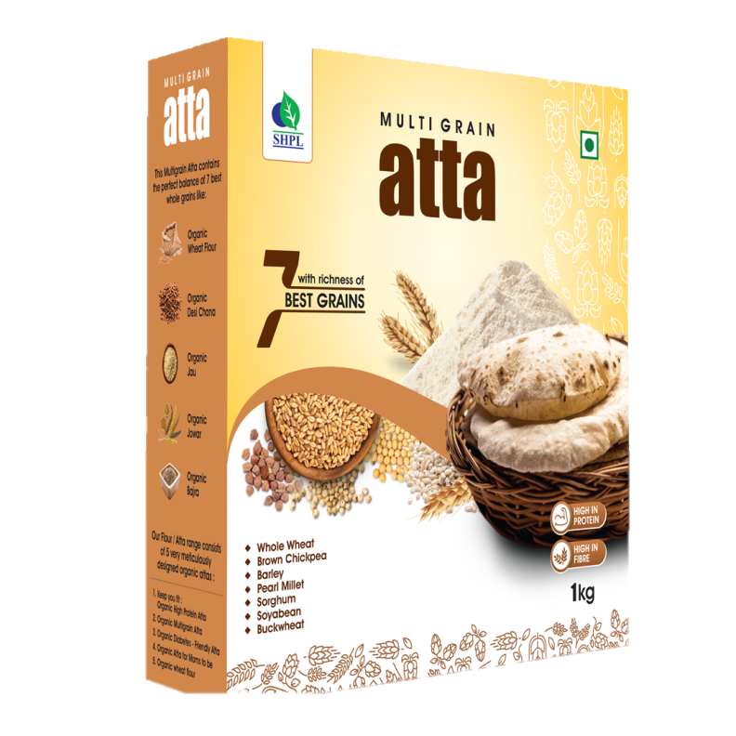
BENEFITS
Fibre-rich and wholegrain foods
Multigrain flour contains a lower glycemic index
Contains whole wheat, brown chickpea, barley, pearl millet, sorghum, soyabean & buckwheat
Contains insoluble dietary fibres and prebiotics that improve gut health
Can reduce risk of colon cancer
Promote the feeling of fullness
Helps in weight loss and weight management
High fibre content also improves digestion
Recommended for diabetics, expectant mothers, growing children, cardiac patients, weight-watchers and the aged

Slide 8
Saarvasri
BENEFITS
Contains many important bioactive plant compounds and antioxidants, such as flavonoids and phenolic acids
Actives immune response to infection
Have strong bactericidal properties
May increase levels of adiponectin, a hormone that reduces inflammation and improves blood sugar regulation
May help lower blood pressure, improve blood fat levels, regulate your heartbeat, and prevent the death of healthy cells
Contains propolis, that may improve cholesterol and triglyceride levels
Has been used to heal wounds and burns
Can act as a natural and safe cough suppressant

Slide 9
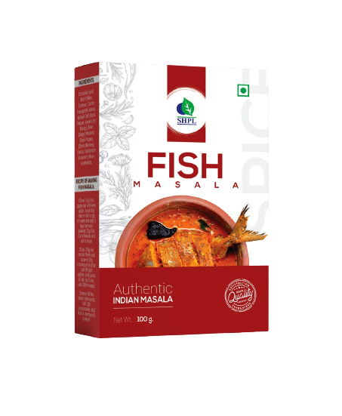
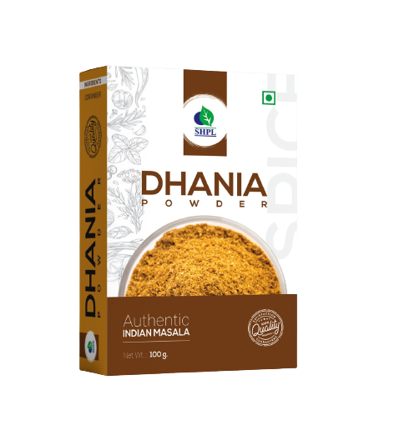
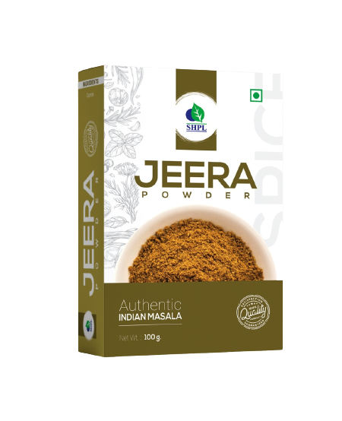
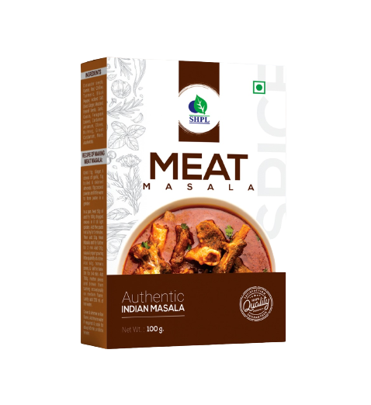
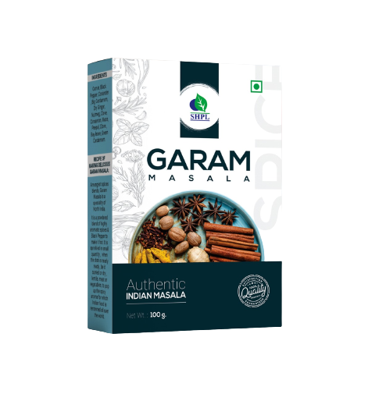
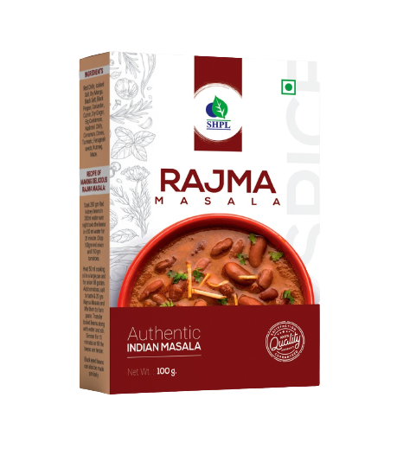
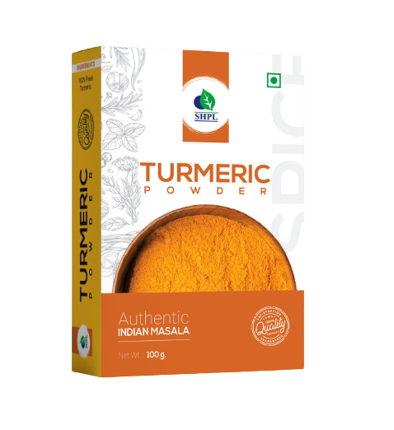
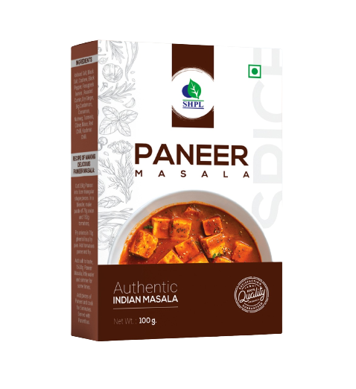
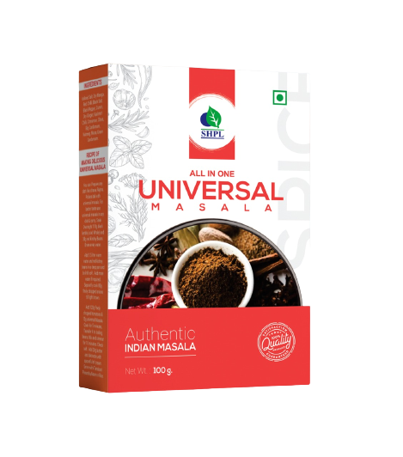
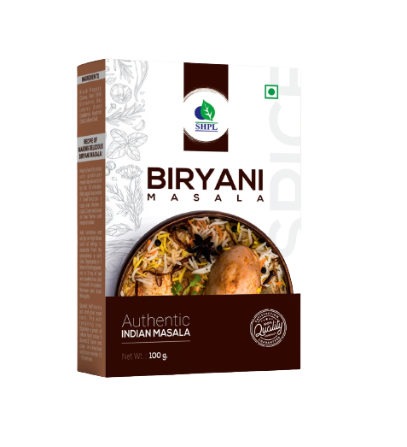
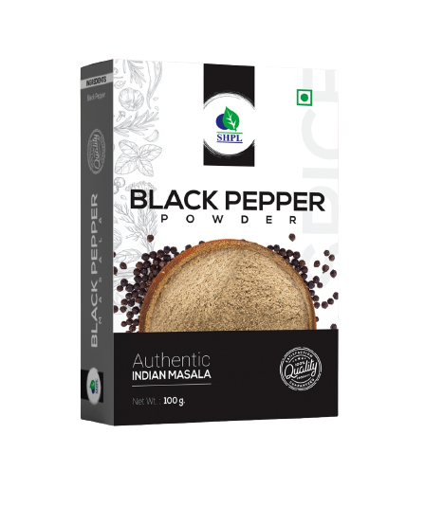
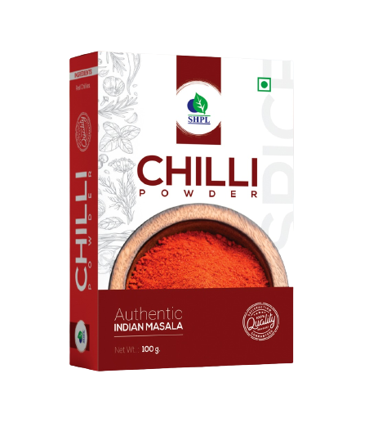
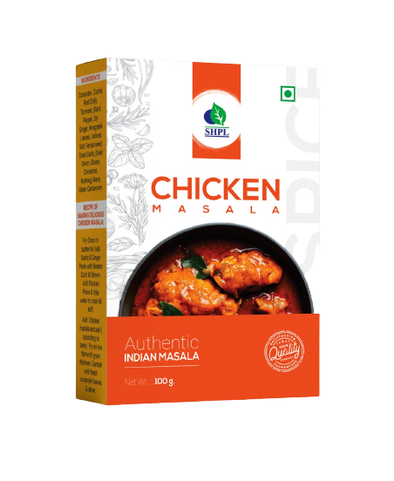
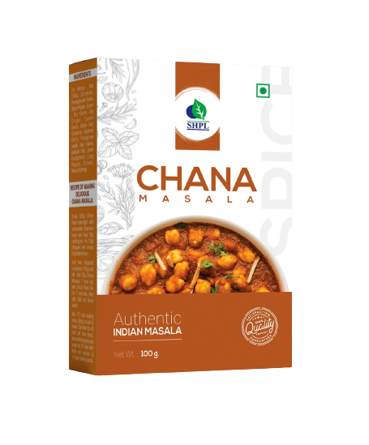
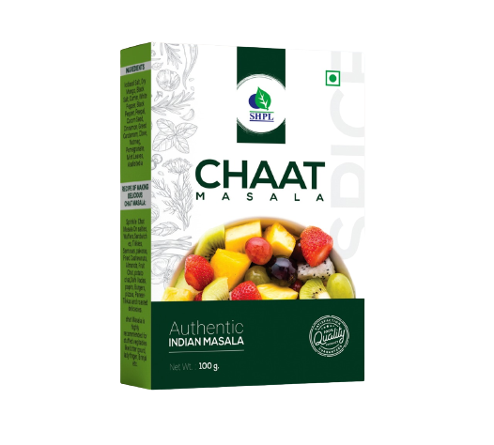
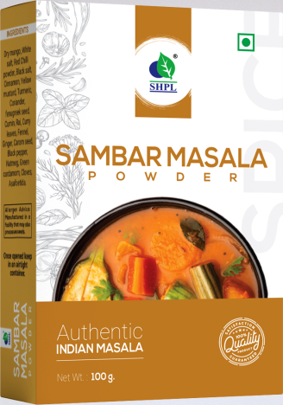
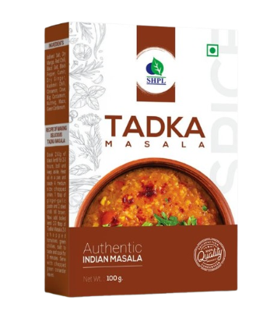
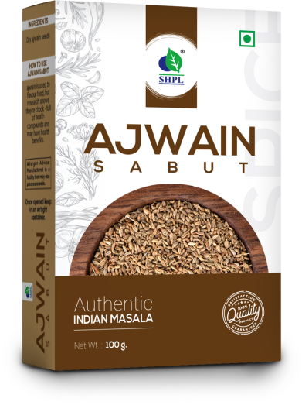
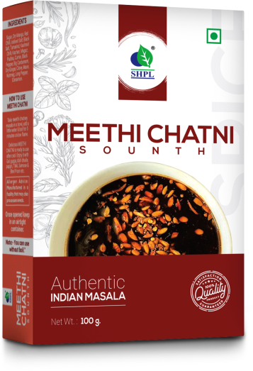
MASALA
Test The Taste…Find The Best

