Slide 2
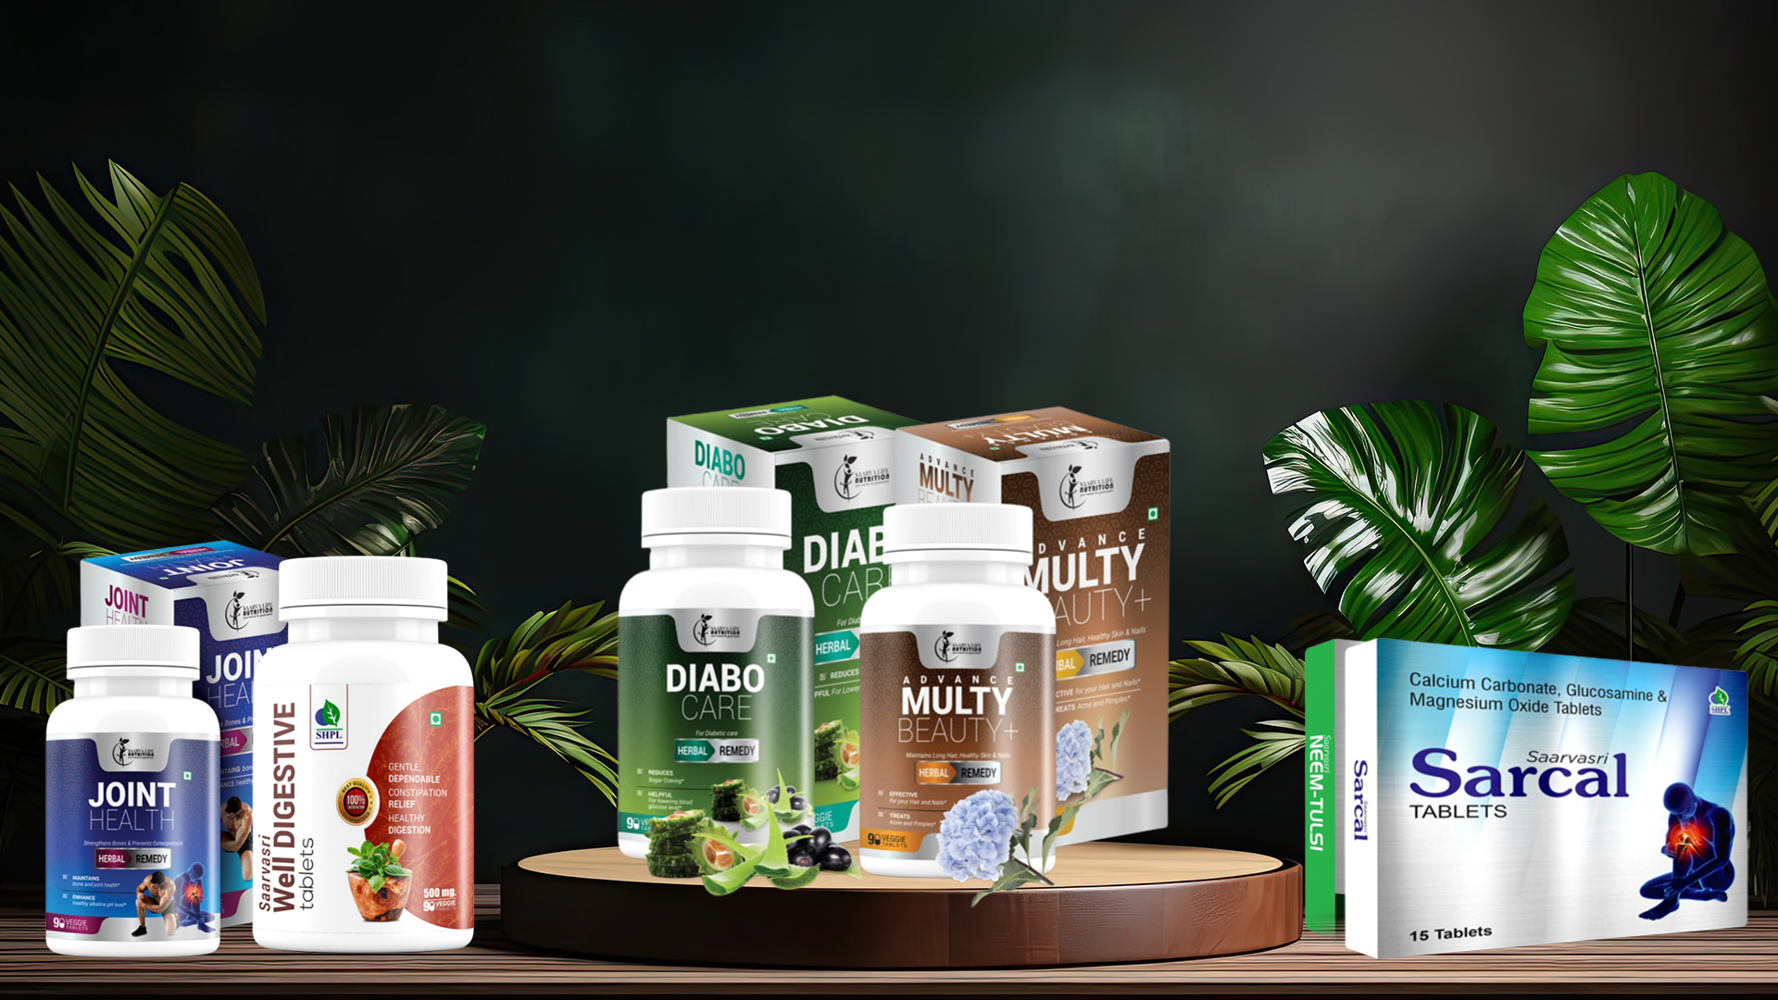
WELLNESS TABLETS

Slide 3
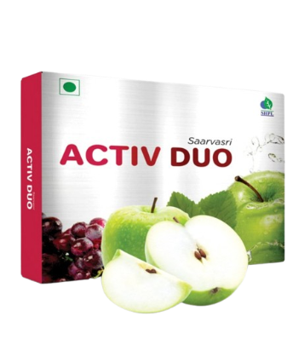
ACTIV DUO TABLETS
DESCRIPTION
Saarvasri Activ Duo Tablet nourishes your skin from the inner level to give you a significant and effective result. It also rejuvenates and activates body cells to raise energy and improve vitality. It is a safe, natural and convenient product for both women and men.
INGREDIENTS
Vitis Vinifera Ext., Malus Domestica Ext., Plygonum Multiforum Ext., Argan Fruit Ext., Acai Berry Ext., Blue Berry Ext., Astragali Radix Ext., Angelica Sinensis Ext.
BENEFITS
It is very helpful in Spinal cord injury.
It controls Diabetes.
It prevents Heart disease.
It treats Parkinson's and Alzheimer's disease.
It is very helpful in Lung disorders.
It boosts our immune power.
It maintains our daily energy level.
It rejuvenates damaged cells and tissues.
DOSAGE
1 to 2 tablets two times a day or as directed by the Experts.

Slide 4
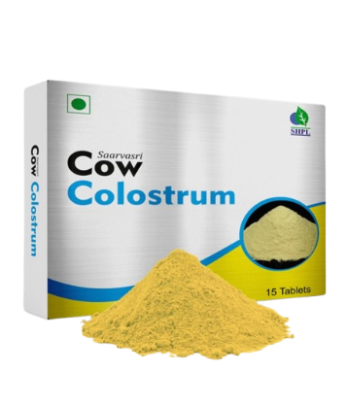
COW COLOSTRUM TABLETS
DESCRIPTION
Saarvasri Herbs Cow Cholostrum is made of Cholostrum which is a milky fluid that comes from the breasts of humans, cows, and other mammals the first few days after giving birth, before true milk appears. It contains proteins, carbohydrates, fats, vitamins, minerals, and proteins (antibodies) that fight disease-causing agents such as bacteria and viruses.
INGREDIENTS
Bovine Cholostrum
BENEFITS
It helps to protect the gastrointestinal tract from damage.
It helps to heal from chronic conditions, such as colitis.
It helps to improve physical performance.
It helps to build lean body mass.
It protects from flu.
It strengthens our immune system.
DOSAGE
1 to 2 tablets two times a day or as directed by the Experts.

Slide 5
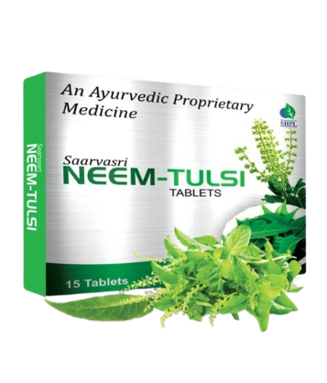
NEEM-TULSI TABLETS
DESCRIPTION
Saarvasri Herbs Neem-Tulsi Tablet is an anti-bacterial, Anti-viral and anti-fungal product to boost our immunity power. It is a perfect blend of nature’s two wonderful herbs Neem and Tulsi for protecting us from environmental hazards and toxinated pollutants to keep us healthy. By using this product we can lead a quality healthy life.
INGREDIENTS
Neem Extract & Tulsi Extract
BENEFITS
Helps to fight acne by inhibiting the bacteria that causes acne growth.
Supports restoration of functional pancreatic beta cells that secrete insulin in the body, and helps maintain healthy glucose levels.
Helps suppress cough and aids the mobilization of mucus. Assists in calming and dilating the lung's airways, thus relieving chest congestion.
It is very effective for any kind of skin infections and skin related disorders.
Very helpful for allergies.
It is an anti-bacterial, anti-viral and anti-fungal product to control disease.
It boosts our immunity power.
It is able to tackle stress, anxiety, and inflammation
DOSAGE
1 to 2 tablets two times a day or as directed by the Experts.

Slide 6
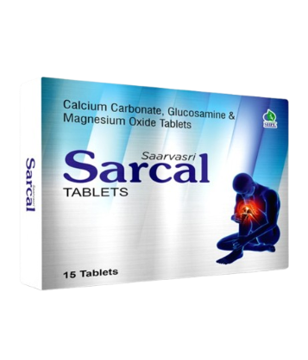
SARCAL TABLETS
DESCRIPTION
Saarvasri Sarcal Tablet is used to prevent or treat low blood calcium levels in people who do not get enough calcium from their diets. Calcium plays a very important role in the body. It is necessary for normal functioning of nerves, cells, muscle, and bone. If there is not enough calcium in the blood, then the body will take calcium from bones, thereby weakening bones. Glucosamine helps to maintain healthy joints and synovial fluid between bone joints.
INGREDIENTS
Calcium Carbonate, Glucosamine, Magnesium Oxide.
BENEFITS
It strengthens bones and prevents Osteoporosis.
Maintains bone and joint health.
Maintains healthy synovial fluid level between joints.
Ensures healthy alkaline pH level.
Helps to maintain optimal body weight.
DOSAGE
1 to 2 tablets two times a day or as directed by the Experts.

Slide 7
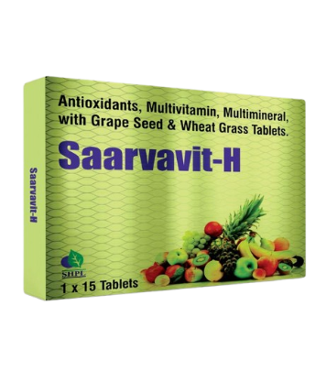
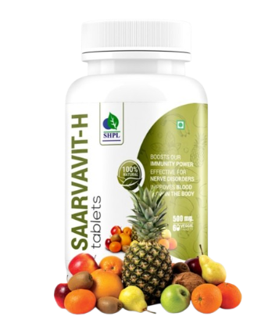
SAARVAVIT-H TABLETS
DESCRIPTION
Saarvasri Herbs Saarvavit-H Tablet is a multi vitamin and multi mineral product to provide sufficient vitamins and minerals to the body. It is enriched with many natural herbs to maintain our daily energy and vitality. It is a supportive product for our general health and can be used to everybody for a quality healthy life.
INGREDIENTS
Wheat Grass, Grape Seed, Ashwagandha, Tulsi, Curcumin, Moringa, Neem.
BENEFITS
Supports healthy heart, liver, kidney & lungs function.
It is rich in super anti-oxidants to detoxify our body.
Maintains general health and energy.
Maintains healthy skin.
Beneficial for hair problems.
Effective for nerve disorders.
Improves blood flow in the body.
Supports eye health.
Boosts our immunity power.
DOSAGE
1 to 2 tablets two times a day or as directed by the Experts.

Slide 8
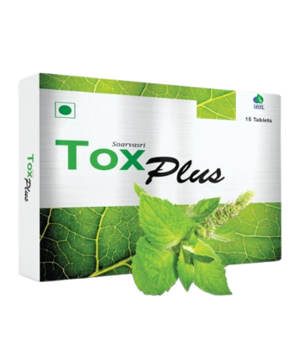
TOX PLUS TABLETS
DESCRIPTION
Saarvasri Herbs Tox Plus Tablet is the herbal formulation that may help to cleanse or detoxify the body by eliminating the free radicals. We all know that in today’s life we all consume lots of toxins through our foods and by our unhealthy lifestyle. Our lifestyle disorder is the main cause of all diseases. Because of this, so many toxins are deposited in our body. So it is important to clean or detoxify our body regularly. Tox Plus can make this detoxifying process more easier.
INGREDIENTS
Fenugreek Fibers, Neem Leaf, Picrorhiza Kurroa, Lactobacillus Sporogenes, Pepperment Oil
BENEFITS
By detoxifying your body you help the vital organs cleanse themselves of the toxins
Enable the liver to function appropriately in excreting them.
Help in weight loss.
Improves digestion.
Improves liver function.
Reduces inflammation.
Improves skin.
Boosts energy
DOSAGE
1 to 2 tablets two times a day or as directed by the Experts.

Slide 9
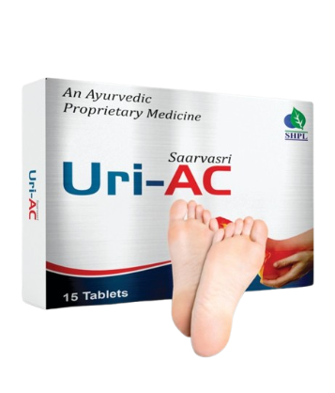
URI-AC TABLETS
DESCRIPTION
Saarvasri Herbs Uri-AC Capsules are known to control the Uric Acid formation in the body and prevent from increased uric acid level complications. It is a blend of many wonderful herbs to control excessive uric acid formation in the body.
INGREDIENTS
Tart Cherry, Bromelain from Pineapple, Curcuma Longa, Celery Seed.
BENEFITS
Lessen uric acid
Has an Anti-inflammatory
Increase cleansing of uric acid
Detoxify purines
Stimulate calcium carbonate and neutralizes the acids in the body
Stabilize uric acid levels
Prevent the formation of uric acid crystals
Help to keep the urine diluted
Prevent damage caused by free radicals
DOSAGE
1 to 2 tablets two times a day or as directed by the Experts.

Slide 10
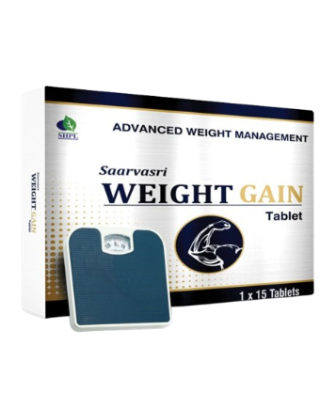
WEIGHT GAIN TABLETS
DESCRIPTION
Saarvasri Herbs Weight Gain Tablets are made of some wonderful 100% natural herbs to gain your expected body weight naturally. It helps to increase your appetite level and metabolism. It is a complete solution to maintain the body weight naturally.
INGREDIENTS
Amla, Ajwain, Kalmegh, Ashwagandha, Punarnava, Bhuiamla, Himsra, Spirulina, Taraxacum Alfalfa, Milk Thistle.
BENEFITS
Helps to gain our body weight naturally.
Increases our healthy appetite level.
Increases our body metabolism.
Helps to control digestive problems.
Maintains healthy liver function.
Controls healthy pH balance in the body.
DOSAGE
1 to 2 tablets two times a day or as directed by the Experts.

Slide 11
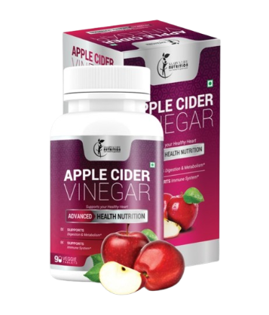
APPLE CIDER VINEGAR TABLETS
DESCRIPTION
Embrace the wellness benefits of Apple Cider Vinegar Tablets. Harnessing the power of this age-old elixir, these tablets support digestion, metabolism, and overall vitality, offering a convenient way to incorporate its benefits into your daily routine.
INGREDIENTS
Apple Cider Vinegar Powder, Apple Peclin, Alfa Alfa, Ginger Root, Spirulina, Wheat Grass, Lecithin, Coconut Water Powder, Lactic Acid Bacilus, Cayenne.
BENEFITS
It is very effective for your Skin and Hair problems.
It can lose your weight naturally.
It reduces belly fat.
It can reduce cholesterol level and supports your heart health.
It can normalize high blood pressure level.
It improves insulin sensitivity and thus lowers high blood sugar level.
It is a natural laxative and it can improve digestion.
It protects you from external virus and bacteria.
It gives you the daily energy and stamina.
DOSAGE
1 to 2 tablets two times a day or as directed by the Experts.

Slide 12
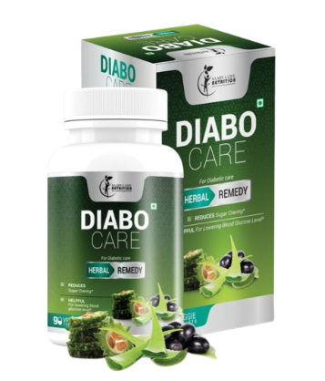
DIABO CARE TABLETS
DESCRIPTION
Manage diabetes naturally with Diabo Care Tablets. Crafted with a blend of time-honored botanicals known for their blood sugar-balancing properties, these tablets offer holistic support for healthy glucose metabolism, empowering you to take control of your well-being.
INGREDIENTS
Neem, Karela, Jamun, Aloevera, Vijaysar, Gurmar, Chiraita, Methi, Triphala.
BENEFITS
Helpful for lowering blood glucose level.
Detoxifies the Pancreas and activates the beta-cells.
Increasing the secretion rate of Insulin.
Karela provides polypeptide-p or p-insulin which helps to activate our body insulin.
Reduces sugar craving.
Reduces the symptoms of Diabetes like frequent thirst and urination.
Maintains general body health.
Reduces weakness.
Block receptors at intestine to reduce Glucose Absorptions.
DOSAGE
1 to 2 tablets two times a day or as directed by the Experts.

Slide 13
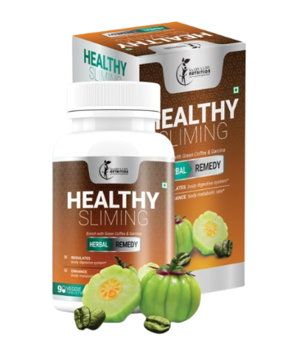
HEALTHY SLIMING TABLETS
DESCRIPTION
Saarvasri Herbs Healthy Sliming Tablet is completely herbs based product which can effectively & naturally remove fat especially from the belly, Ankles and Arms. Thus help you to get in good shape in merely few days of use and in a natural way. It has similar results on men & women. Specially this product is designed to enhance the body metabolic rate to optimum level so that body can break down the extra fats and reduces the further fat deposition in the body.
INGREDIENTS
Garcinia Combogia, Green Coffee Bean, Green Tea Leaf, Caffeine.
BENEFITS
Enhance body metabolic rate.
Regulates body digestive system.
Helps in reducing the unnecessary fat deposition.
Aids in Fat burning from Ankles, Arms and Belly.
Help you to get in shape.
Maintains the energy level throughout day.
Naturally detoxifying the body.
DOSAGE
1 to 2 tablets two times a day or as directed by the Experts.

Slide 14
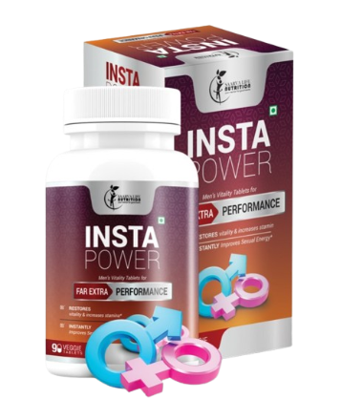
INSTA POWER TABLETS
DESCRIPTION
Saarvasri Herbs Insta Power Tablet is a premium natural formulation for general sexual health enhancement for men. It is formulated and designed to enhance sexual performance without unwanted side effects of prescription drugs. Also it provides daily endurance, vitality and energy.
INGREDIENTS
Ashwagandha, Safed Musli, Satawari, Kaunch Beej, Vidarikhand, Akarkara, Jaiphal, Salimpanja, Swarna Bhasma.
BENEFITS
It instantly improves sexual energy, fights against sexual debility & sexual weakness.
It restores vitality and increases the stamina.
This product increases natural excitement, response to stimulation and give fantastic staying Energy and stamina for extended sexual performance.
It also significantly increases sex drive!
DOSAGE
1 to 2 tablets two times a day or as directed by the Experts.

Slide 15
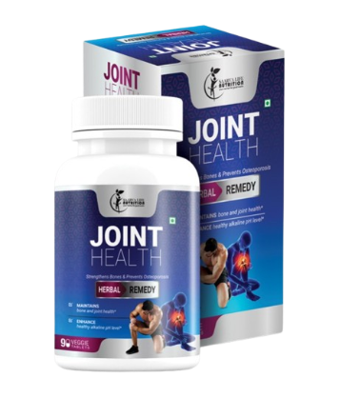
JOINT HEALTH TABLETS
DESCRIPTION
Saarvasri Joint Health Tablet is used to prevent or treat low blood calcium levels in people who do not get enough calcium from their diets. Calcium plays a very important role in the body. It is necessary for normal functioning of nerves, cells, muscle, and bone. If there is not enough calcium in the blood, then the body will take calcium from bones, thereby weakening bones. Glucosamine helps to maintain healthy joints and synovial fluid between bone joints.
INGREDIENTS
Calcium Carbonate, Glucosamine, Magnesium Oxide.
BENEFITS
It strengthens bones and prevents Osteoporosis.
Maintains bone and joint health.
Maintains healthy synovial fluid level between joints.
Ensures healthy alkaline pH level.
Helps to maintain optimal body weight.
DOSAGE
1 to 2 tablets two times a day or as directed by the Experts.

Slide 16
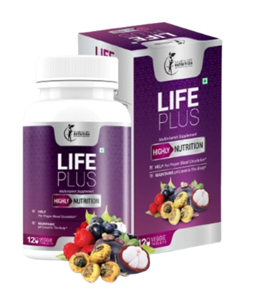
LIFE PLUS TABLETS
DESCRIPTION
Saarvasri Herbs Life Plus Tablets are made with 100% natural ingredients to boost your immunity power as well as to boost your daily energy level to live healthily. It has many health benefits. With other ingredients, this product is enriched with Mangosteen which is a miraculous fruit with lots of health benefits. In one sentence, Saarvasri Life Plus is your daily need.
INGREDIENTS
Mangosteen, Ashwagandha, Maca Root, Elderberry, Black Current, Ginseng, Sour Cherry, Ganoderma, Shigru, Curcumin, Alfa Alfa.
BENEFITS
May neutralize the damaging effects of free radicals
May reduce your risk of inflammatory diseases
May boost your metabolism and burns excessive fats
May boost your immunity power naturally
Helps to maintain your daily energy level
May reduce heart disease risk factors
Very effective to maintain healthy hair and skin
Helpful for nerve problems, such as, parkinson, alzheimer
DOSAGE
1 to 2 tablets two times a day or as directed by the Experts.

Slide 17
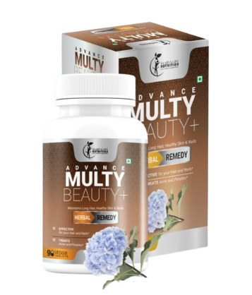
ADVANCE MULTY BEAUTY PLUS TABLETS
DESCRIPTION
Advance Multy Beauty Plus Tablets are the complete solution for you ultimate beautification. we believe that, beautification is not to make fair your skin tone, but to clean you internally and only then the glow on your skin comes from inside your body.
INGREDIENTS
Mangosteen, Ashwagandha, Maca Root, Elderberry, Black Current, Ginseng, Sour Cherry, Ganoderma, Shigru, Curcumin, Alfa Alfa.
BENEFITS
May neutralize the damaging effects of free radicals
May reduce your risk of inflammatory diseases
May boost your metabolism and burns excessive fats
May boost your immunity power naturally
Helps to maintain your daily energy level
May reduce heart disease risk factors
Very effective to maintain healthy hair and skin
Helpful for nerve problems, such as, parkinson, alzheimer
DOSAGE
1 to 2 tablets two times a day or as directed by the Experts.

Slide 18
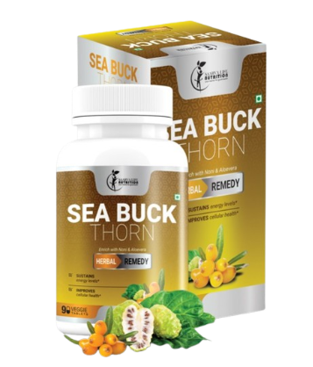
SEA BUCKTHORN TABLETS
DESCRIPTION
Saarvasri Herbs Sea Buckthorn Tablet is made with mainly Sea Buckthorn which is a wonderful berry with 1300 years of traditional uses. With over 190 bioactive compounds, sea berry (sea buckthorn) is an unsurpassed source of Omega 3, 6, and 9. And it is the world's richest source of the elusive essential fatty acid, omega-7, a fatty acid vital to collagen production and healthy skin, hair and nails. It is enriched with Noni and Aloevera, which make this product more effective.
INGREDIENTS
Sea Buckthorn, Noni, Aloevera.
BENEFITS
Sustains energy levels.
Beneficial for Cardiovascular support.
Relieves pain & inflammation.
Supports Joint health.
Lowers bad cholesterol level.
Moisturizes dry and damaged skin.
Improves immune health.
Reduces the symptoms of eczema.
DOSAGE
1 to 2 tablets two times a day or as directed by the Experts.

Slide 19
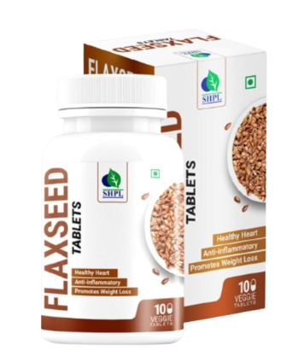
FLAXSEED TABLETS
DESCRIPTION
Saarvasri Herbs introduces Flaxseed Tablets which are made from Flaxseeds or Linseeds, a rich source of healthy fat, antioxidants, and fiber. According to the United States Department of Agriculture (USDA), the seeds contain protein, lignans, and the essential fatty acid alpha-linolenic acid, also known as ALA or omega-3. Flaxseeds have been consumed for at least 6,000 years, making them one of the world’s first cultivated Super Food. Although flaxseed has been used for a long time – Hippocrates ate and wrote about it in 500 B.C. – it’s only been in the past 10 years that researchers have focused on flaxseed’s health benefit.
INGREDIENTS
Flax Seeds extract
BENEFITS
Lowers the bad cholesterol.
Protects the heart.
Controls diabetes.
Very helpful for arthritis and joint pain.
Effective for improper digestion and constipation.
Maintains skin and hair health.
Helps to loose weight.
Very effective for brain and neural health.
Detoxifies our body.
Reduces weakness and depression.
DOSAGE
1 to 2 tablets two times a day or as directed by the Experts.

Slide 20
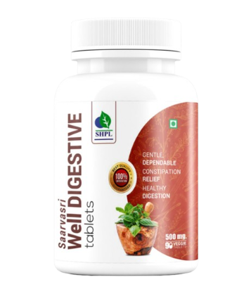
WELL DIGESTIVE TABLETS
DESCRIPTION
Well digestive Tablet is strengthen the digestion and assimilation with a natural digestive stimulant. It splits the large, complex molecules mainly proteins, carbohydrates, and fats into smaller ones, allowing to be easily absorbed into the bloodstream and carried throughout the body. It speeds up the breakdown (hydrolysis) of food molecules into their ‘building block’ components.
INGREDIENTS
Amlaki, Sonamukhi, Nasotar, Haritaki, Aragvadh, Ajma, Nvsadar, Kala Namak, Hing, Erand.
BENEFITS
• Effective in maintaining gas & acidity.
• Effective and perfect cure to constipation.
• Effective for stomach pain, abdominal pain & burning sensation.
• Naturally neutralize excess acidity that can cause illness and premature aging.
• Fight against low energy, chronic fatigue, slow digestion.
• Increase metabolism in your body.
DOSAGE
1 to 2 tablets two times a day or as directed by the Experts.

Slide 21
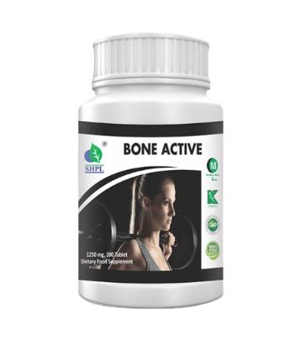
BONE ACTIVE TABLETS
DESCRIPTION
Saarvasri Herbs Bone Active Tablet is used to prevent or treat low blood calcium levels in people who do not get enough calcium from their diets. Calcium plays a very important role in the body. It is necessary for normal functioning of nerves, cells, muscle, and bone. If there is not enough calcium in the blood, then the body will take calcium from bones, thereby weakening bones. Vitamin D3 helps your body absorb calcium. Having the right amounts of vitamin D3, calcium is important for building and keeping strong bones.
INGREDIENTS
Vitamin D3, Calcium Carbonate.
BENEFITS
It strengthens bones and prevents Osteoporosis.
Maintains bone and joint health.
Protects cardiac muscles.
Ensures healthy alkaline pH level.
Helps to maintain optimal body weight.
DOSAGE
1 to 2 tablets two times a day or as directed by the Experts.

Slide 22
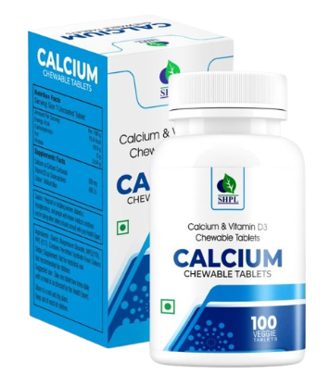
CALCIUM & VITAMIN D3 CHEWABLE TABLETS
DESCRIPTION
Lack of Calcium & Vitamin D3 in the body shows up through symptoms like feeling tired easily; constant pain in the legs, back & joints & muscle weakness. Adequate calcium intake is required to prevent calcium loss from bones. But your regular diet may not be enough to fulfill your daily calcium requirement. Prolonged Calcium deficiency may cause Osteoporosis leading to the weakening of bones later on. SHPL Calcium & Vitamin D3 tablets contain Calcium and Vitamin D3 which helps maintain bone strength and allows you to lead an active lifestyle.
INGREDIENTS
Vitamin D3, Calcium Carbonate.
BENEFITS
Essential for critical metabolic functions.
Required for building and maintaining healthy bones and teeth.
Plays crucial role in nerve transmission, muscle function, cellular signaling and hormone secretion.
Important for maintaining the balance of breaking down and building up of bones.
Supports flexible movements and mobility of muscles and bones.
Maintains body pH level.
DOSAGE
1 to 2 tablets two times a day or as directed by the Experts.

Slide 23
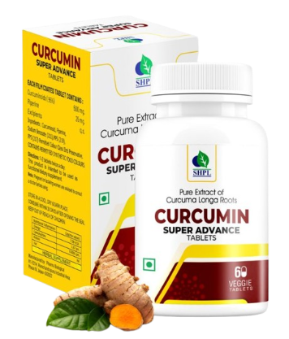
CURCUMIN SUPER ADVANCE TABLETS
DESCRIPTION
Saarvasri Herbs Curcumin Super Advance Tablet is a wonderful product made of 95% of curcumin. Curcumin is a yellow-orange dye obtained from tumeric, the powdered root of Curcuma Longa or Turmeric. Curcumin is a natural component of the rhizome of turmeric (Curcuma longa) and one of the most powerful chemopreventive agents. Its biological effects range from antioxidant, anti-inflammatory to inhibition of angiogenesis and is also shown to possess specific antitumoral activity.
INGREDIENTS
Curcuminoids & Piperine.
BENEFITS
Helps your body fight foreign invaders and also has a role in repairing damaGE.
Can neutralize free radicals.
Boosts brain-derived neurotrophic factor.
Can lower your risk of heart disease.
Beneficial for cancer treatment.
Useful in preventing and treating Alzheimer's disease.
Incredible benefits against Depression.
Help delay Aging and fight age-related chronic diseases.
DOSAGE
1 to 2 tablets two times a day or as directed by the Experts.

Slide 24
WITH THE REGULAR USE OF SOME SHPL HEALTH CARE PRODUCTS
TAKE CARE
OF YOURSELF

