Slide 2
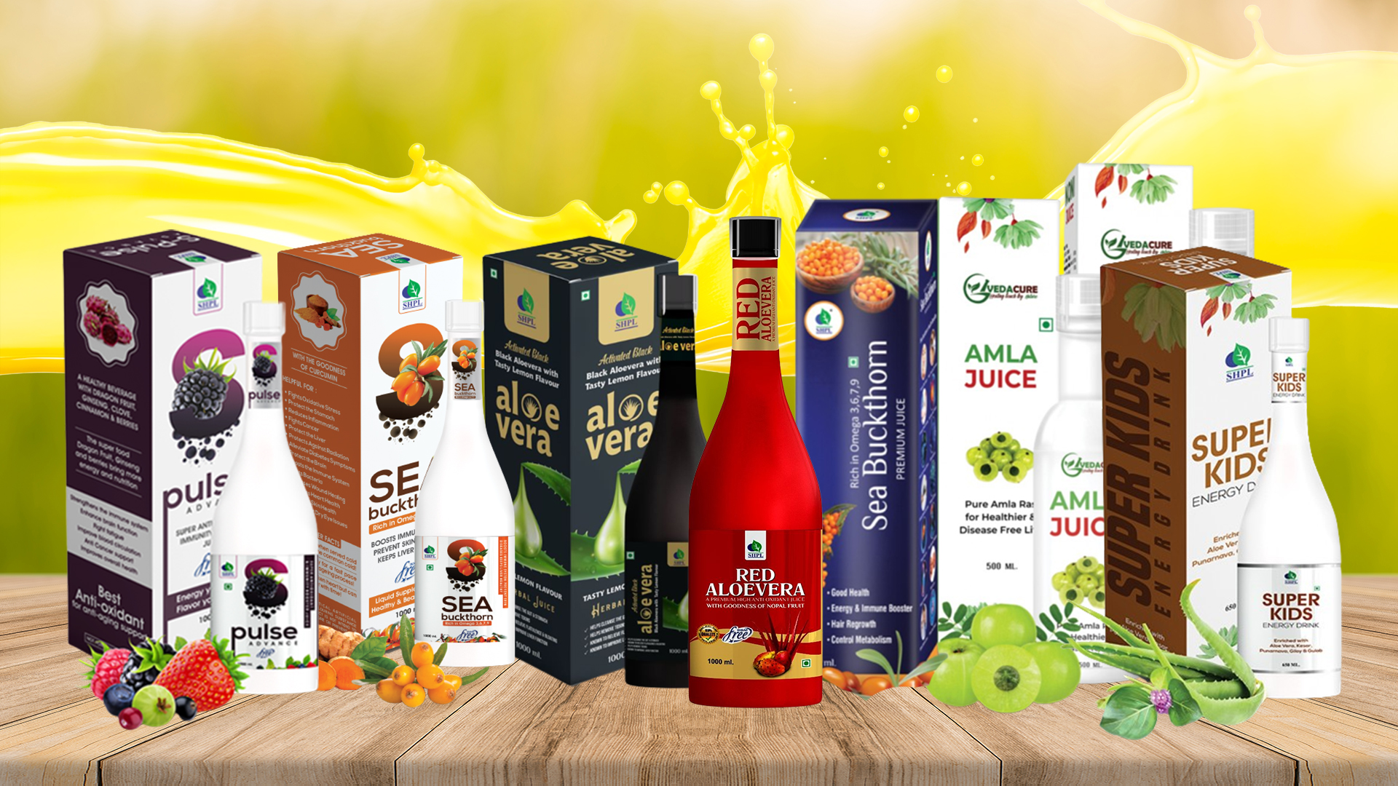
WELLNESS JUICES

Slide 3
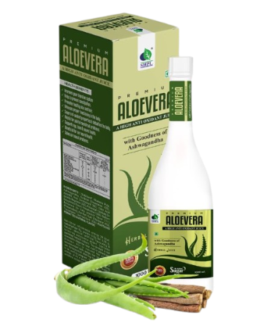
ALOEVERA WITH ASHWAGANDHA JUICE
DESCRIPTION
Saarvasri Herbs Aloevera with Ashwagandha Juice is a wonderful product. It is rich in Aloevera Barbadensis, the best type found in the world. Aloevera, “the plant of immortality”, has its own medicinal value from centuries. Aloe Vera contains many vitamins including A, C, E, folic acid, B1, B2, B3 (niacin), B6. Aloe Vera is also one of the few plants that contains vitamin B12. Minerals found in Aloevera include: calcium, magnesium, zinc, chromium, selenium, sodium, iron, potassium, copper, manganese. It is also rich in Ashwagandha, a miraculous plant found in nature.
INGREDIENTS
Aloe Barbadensis, Ashwagandha.
BENEFITS
It improves your digestive system and helps to prevent constipation.
It heals wounds fast.
It promotes healthy skin and hair.
It enhances proper functioning in the body.
It has super anti-oxidant properties and detoxifies the body.
It supports eye, bone and neural health.
It is very beneficial for our neural health.
It can solve our sexual problems.
DOSAGE
Mix 15ml of this juice with half glass of water & take two times a day or as directed by the Experts.

Slide 4
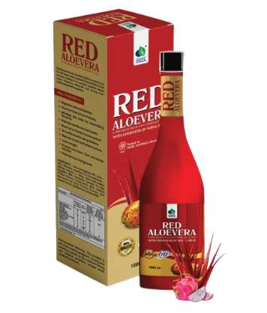
RED ALOEVERA JUICE
DESCRIPTION
Red Aloevera is an wonderful gift by nature to us. It is 22 times more powerful and effective than common Aloevera. It contains essential Amino acids, Vitamins, Minerals and strong Anti-oxidants like Anthraquinone.
INGREDIENTS
Red Aloevera Pulp, Honey, Ashwagandha.
BENEFITS
It enhances proper functioning in the body.
It helps in digestion and constipation.
It helps to flush out toxins from the body.
It alkalizes the body by neutralizing the acids.
It helps to boost up our body immune system.
It is very effective for skin problems.
It helps to loose weight.
It protects our heart, liver and kidney function.
It maintains our energy level.
DOSAGE
Mix 15ml of this juice with half glass of water & take two times a day or as directed by the Experts.

Slide 5
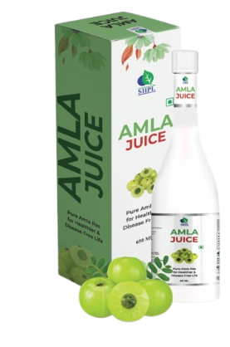
AMLA JUICE
DESCRIPTION
Amla or Indian Gooseberry is a small and highly nutritious fruit and has many health benefits. Amla is low in calories and fat but packed with nutrients. It contains Vitamin C, B5, B6, E; Minerals like Copper, Magnesium and Potassium; Fiber, Antioxidants, Phyto-nutrients like Flavonoids, Anthocyanins, Aromatic Acids, Organic Acids.
INGREDIENTS
Amla Extract
BENEFITS
It is very good for our skin and hair health.
It delays ageing process.
It maintains our heart health and reduces bad cholesterol level.
It can improve our digestive system.
It helps to reduce excessive body fat and loose weight.
It detoxifies our inner body toxins.
It can boost our immunity power.
It protects from flu, fever and cold.
It maintains healthy joints.
DOSAGE
Mix 15ml of this juice with half glass of water & take two times a day or as directed by the Experts.

Slide 6
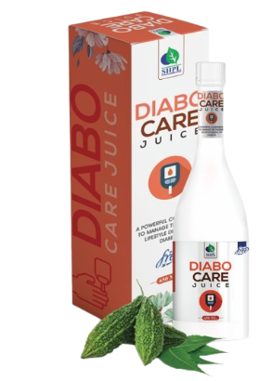
DIABO CARE JUICE
DESCRIPTION
Saarvasri Herbs introduces Diabo Care Juice which is very helpful for lowering blood sugar level, increasing the secretion of Insulin and activating the beta cells. They are enriched with some wonderful natural herbs like Neem, Jamun, Karela, Methi, Vijaysar, Chirata, Triphala etc
INGREDIENTS
Neem, Karela, Jamun, Ghritakumari, Vijaysar, Gurmar, Chiraita, Methi, Triphala.
BENEFITS
Helpful for lowering blood glucose level.
Detoxifies the Pancreas and activates the beta-cells.
Increasing the secretion rate of Insulin.
Karela provides polypeptide-p or p-insulin which helps to activate our body insulin.
Reduces sugar craving.
Reduces the symptoms of Diabetes like frequent thirst and urination.
Maintains general body health.
Reduces weakness.
DOSAGE
Mix 15ml of this juice with half glass of water & take two times a day or as directed by the Experts.

Slide 7
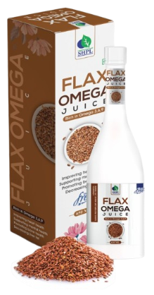
FLAX OMEGA JUICE
DESCRIPTION
Saarvasri Herbs Pvt. Ltd, introduce a unique product “Flax Omega Juice” are the golden yellow to reddish brown seeds of flax. Flaxseed has been eaten as a food or used as a medicine since 5000 BC. It contents omega 3, Omega 6, Omega 9 along with phytoestrogens, p- coumaric acid, fiber, protein 6g, vitamin B1 (thiamine ), manganese, potassium, selenium, molybdenum, vitamin b6, iron, potassium, copper, zinc, omega-3, ferulic acid, phytosterols.
INGREDIENTS
Neem, Karela, Jamun, Ghritakumari, Vijaysar, Gurmar, Chiraita, Methi, Triphala.
BENEFITS
Helpful for lowering blood glucose level.
Detoxifies the Pancreas and activates the beta-cells.
Increasing the secretion rate of Insulin.
Karela provides polypeptide-p or p-insulin which helps to activate our body insulin.
Reduces sugar craving.
Reduces the symptoms of Diabetes like frequent thirst and urination.
Maintains general body health.
Reduces weakness.
DOSAGE
Mix 15ml of this juice with half glass of water & take two times a day or as directed by the Experts.

Slide 8
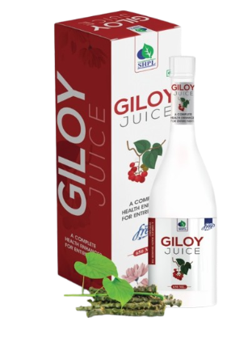
GILOY JUICE
DESCRIPTION
Tinospora cordifolia commonly named as “Giloy” is known for its immense application in the treatment of various diseases in the traditional ayurvedic literature. In Sanskrit, Giloy is known as ‘Amrita'.
INGREDIENTS
Giloy Extract
BENEFITS
Boosts Immunity
Treats Chronic Fever
Improves Digestion
Treats Diabetes
Reduces Stress and Anxiety
Fights Respiratory Problems
Treats Arthritis
Reduces Asthmatic Symptoms
Improves Vision
Reduces Signs Of Aging
DOSAGE
Mix 15ml of this juice with half glass of water & take two times a day or as directed by the Experts.

Slide 9
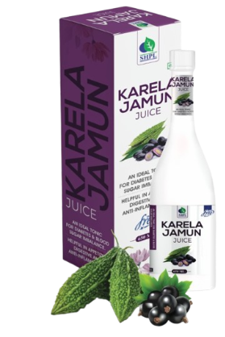
KARELA JAMUN JUICE
DESCRIPTION
Considering the nutritional components both in Karela and Jamun, they are widely used in Ayurveda. Karela (Bitter Gourd) is known for its many benefits such as achieving a glowing skin & is considered as plant insulin because of its ability to regulate blood sugar. Jamun (Indian Berry) on the other hand, has the ability to boost the healing process and it helps to control multiple diseases such as diabetes.
INGREDIENTS
Karela & Jamun extract
BENEFITS
Helps in high blood sugar
Stimulates liver to secrete digestive enzymes
Works as an appetizer
Helps remove intestinal tract worms
Purifies blood and fights infections.
Very effective in skin diseases
Helps to reduce acne and pimples on face
Helps in edema
Boosts your immune system
Helps in weight loss
DOSAGE
Mix 15ml of this juice with half glass of water & take two times a day or as directed by the Experts.

Slide 10
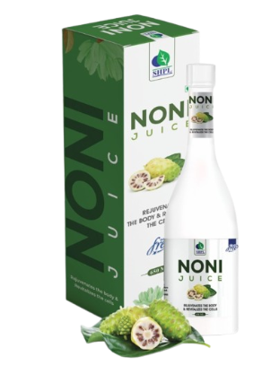
NONI JUICE
DESCRIPTION
Saarvasri Herbs Noni Juice is a panacea product made with Nature's Omnipotent Nutritional Immunizer fruit NONI. Thousands of people around the globe are the proof of its effectiveness. This has rich anti-oxidant properties so this product protects you from toxins & pollutants. This contains anti-inflammatory, astringent properties for the patient of stomach problems.
INGREDIENTS
Noni Extract with Garcinia & Ashwagandha
BENEFITS
Fights Inflammation
Promotes Heart Health
Aids Weight Loss
Improves Brain Health
Improves Skin Health
Improves Digestive Health
Improves Vision
Strengthens Hair
Supports in Cellular Repairing
Can Relieve Age-Related Spinal Damage
Reduces Muscle Spasms
Helps Relieve Fatigue
Improves Liver Health
Boosts Immunity
DOSAGE
Mix 15ml of this juice with half glass of water & take two times a day or as directed by the Experts.

Slide 11
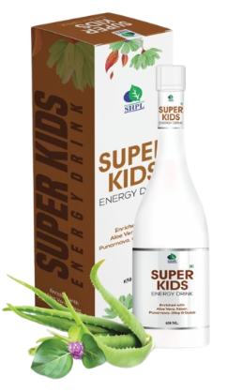
SUPER KIDS ENERGY DRINK
DESCRIPTION
Saarvasri Herbs Super Kids Energy Drink is a health drink for children to protect themselves from mal-nutrition and act on them like a growth promoter. So many natural nutritional herbs make it so effective that it can give a child his/her optimal health.
INGREDIENTS
Kesar, Elaichi, Ark Kewra, Ark Gulab, Giloy, Punarnava, Aloe Vera, Sarkara, Tulsi, Silver Leaves, Ashwagandha, Nagarmotha.
BENEFITS
Boosts Immunity power
Promotes normal growth
Improves body cells and tissues
Promotes healthy liver and digestive system
Promotes healthy skin and hair
Maintains energy and vitality
Protects from cough, cold and flu
Promotes healthy bones
DOSAGE
Mix 15ml of this juice with half glass of water & take two times a day or as directed by the Experts.

Slide 12
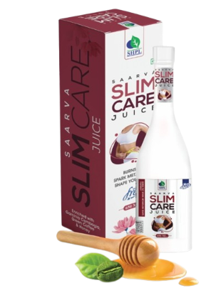
SLIM CARE JUICE
DESCRIPTION
Saarvasri Slim & Care Juice can be complete solution for weight loss and to get your body in a perfect shape. It increases body metabolism. It helps to burn excessive body fat. Controls uncontrollable hunger. The active ingredients in it helps to your weight loss in a natural way.
INGREDIENTS
Garcinia Combogia, Green Coffee, Honey,
BENEFITS
Lower high levels of fat in your blood.
Reducing the accumulation of belly fat in people who are overweight.
Have the potential to help with weight loss.
May boost fat metabolism,
Lower cholesterol and triglyceride levels,
Improve obesity-related hormone levels.
Acts as a fuel to make the liver produce glucose which keeps the brain sugar levels high and forces it to release fat burning hormones.
Honey is also known to have the power of suppressing the appetite.
DOSAGE
Mix 15ml of this juice with half glass of water & take two times a day or as directed by the Experts.

Slide 13
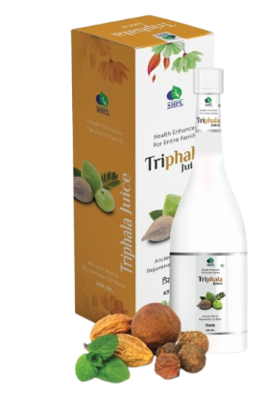
TRIPHALA JUICE
DESCRIPTION
Triphala has been used in Ayurvedic medicine since ancient times more than 1000 years, as a multi-purpose treatment. Triphala contains fruits of three Amalaki, Vibhitaka, and Haritaki. Saarbasri herbs Triphala juice a combination of synergistic polyherbal medicinal herbs.
INGREDIENTS
Amla (Gooseberry), Bahera ( Terminala Bellirica ),Harad (Terminalia Chebula).
BENEFITS
Have antimicrobial properties.
Helps in controlling diabetes.
Helps improve digestive health.
Good immunomodulatory.
Boosts dental health.
Enhances vision.
Lowers cholesterol.
Prevents viral and bacterial infections.
Has anti-allergic properties.
Normalize Hypertension.
Protect and improve liver function.
Helpful for constipation.
Acts as a detoxifier.
Improves blood circulation.
Relieves bone and joint pain.
Rejuvenates skin.
Stimulates hair growth
Helpful in curing Bad Breath
DOSAGE
Mix 15ml of this juice with half glass of water & take two times a day or as directed by the Experts.

Slide 14
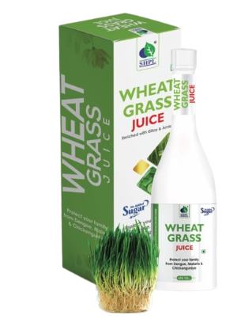
WHEAT GRASS JUICE
DESCRIPTION
High in Nutrients and Antioxidants, Saarvasri Herbs Wheat Grass Juice is an excellent source of many different vitamins and minerals. Wheatgrass is the fresh sprouted leaves of the wheat plant. Wheatgrass is a source of potassium, dietary fiber, vitamin A, vitamin C, vitamin E, vitamin K, thiamin, riboflavin, niacin, vitamin B6, iron, zinc, copper, manganese, and selenium. Wheatgrass is also a good source of essential Amino Acids.
INGREDIENTS
Wheat Grass, Amla, Giloy.
BENEFITS
It may eliminate toxins
It may help with digestion
It may help lower your cholesterol
It may help boost your immune system
It can give you energy
It can help with diabetes
It can help with inflammation
DOSAGE
Mix 15ml of this juice with half glass of water & take two times a day or as directed by the Experts.

Slide 15
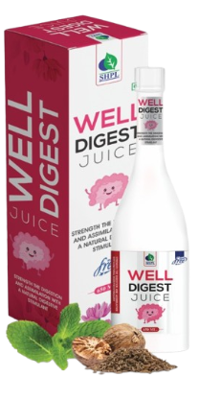
WELL DIGEST JUICE
DESCRIPTION
Well digest is strengthen the digestion and assimilation with a natural digestive stimulant. Well digest splitting the large, complex molecules mainly proteins, carbohydrates, and fats into smaller ones, allowing to be easily absorbed into the bloodstream and carried throughout the body. Well digest speed up the breakdown (hydrolysis) of food molecules into their ‘building block’ components.
INGREDIENTS
Ajwayan, Dal chini, Kali Mirch, Dhania, Jaiphal, Peepal, Long, Adarakh, Nausadar, Nimbu, Senda Namak, Sanchar Namak, Jeera, Pudina, Sounth , Amaltas Phall, Amla, Makoy, Nagar Motha, Hing .
BENEFITS
Helps you to get rid of gas, acidity, constipation problems
Boosts your metabolism and appetite
Takes care of your liver
Helps to increase helpful enzymes to digest your food properly
DOSAGE
Mix 15ml of this juice with half glass of water & take two times a day or as directed by the Experts.

Slide 16
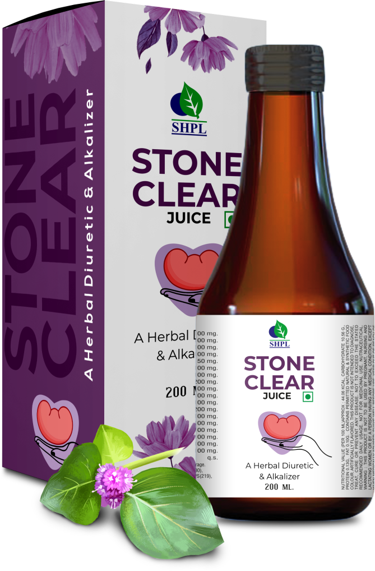
STONE CLEAR JUICE
DESCRIPTION
Saarvasri Herbs Stone Clear is a natural formula to breakdown and clear renal stones. It is rich in many natural herbs that made this product so effective. Stone Clear has been launched for kidney health. This is known to possess multiple benefits such as managing Uro-genital diseases such as Kidney stone, bladder infection and other Urinary Tract infections. Stone Clear is also a diuretic that flushes out small stones from the kidneys.
INGREDIENTS
Gokshru Beej, Palash Pushpa, Lajaloo Mool, Suddh Shilajit, Swait Parpati, Moolishar, Sheetal Chini Root, Sandhav Namak, Sajjkhar, Punarnava Root, Panchtrin Mool, Ikshu Mool, Makoi Panchang, Kakri Beej, Daru Haridra, Pashan Bhed Fruit.
BENEFITS
It is beneficial for renal calculi.
It is very effective for urinary tract infection.
Effective for renal colic urethritis, cystitis, recurrent calculi.
It breaks down renal stones and flushes out gravel.
Prevents Burning Micturition.
DOSAGE
10 to 15ml twice a day or as per advise of health provider.

Slide 17
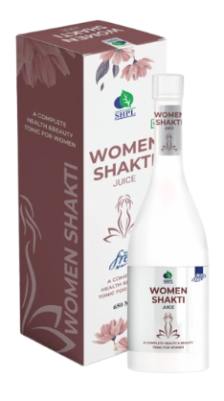
WOMEN SHAKTI JUICE
DESCRIPTION
Saarvasri Herbs Women Shakti Juice works as Female tonic that supports the needs of women for restoring normal hormonal function as well as providing relief from various gynecological related issues. Further, as these are purely herbal formulation, the juice also fulfill the demands of purification of blood as well as in overcoming –General weakness, Fatigue & Backache.
INGREDIENTS
Ashok, Amla, Sonth, Lodhra, Giloy, Gokhur, Kachnar, Chikni Supari, Ajwain, Shatavari, Ashwagandha, Triphala, Arjun, Vidarikamnd, Mustaka.
BENEFITS
Immunity booster
Helps in irregular menstruation, dysmenorrhea, abnormal menstruation
Very beneficial in Leucorrhea
Controls ovary cyst.
Helps in detoxification
Helps to boost energy level
DOSAGE
Mix 15ml of this juice with half glass of water & take two times a day or as directed by the Experts.

Slide 18
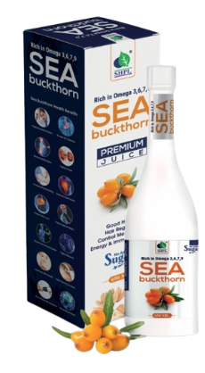
SEA BUCKTHORN JUICE
DESCRIPTION
Saarvasri Herbs Sea Buckthorn Juice is made with mainly Sea Buckthorn which is a wonderful berry with 1300 years of traditional uses. With over 190 bioactive compounds, sea buckthorn is an unsurpassed source of Omega 3, 6, and 9. And it is the world's richest source omega-7.
INGREDIENTS
Sea Buckthorn Extract
BENEFITS
Sustains energy levels.
Improves cellular health.
Beneficial for Cardiovascular support.
Relieves pain & inflammation.
Supports Joint health.
Lowers bad cholesterol level.
Moisturizes dry and damaged skin.
Improves immune health.
Decreases wrinkles and fine lines.
Reduces the symptoms of eczema.
DOSAGE
Mix 15ml of this juice with half glass of water & take two times a day or as directed by the Experts.

Slide 19
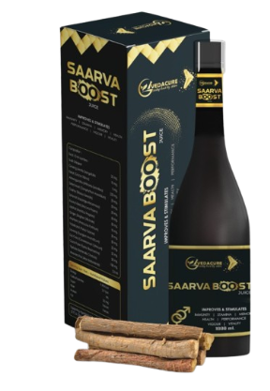
SAARVA BOOST JUICE
DESCRIPTION
Every People have different sex drive. Sex drive can be change based on things like stress, medications you take, sexual attraction, sexual behaviors, unhealthy relationship, other physical, emotional, day to day lifestyle, suffering diseases, etc. Saarvasri Herbs Pvt. Ltd. Introduced SAARVA BOOST for experiencing satisfaction towards sexual activity.
INGREDIENTS
Sudh Shilajeet, Ginseng, Kesar, Ashwagandha, Safed Musli, Gokhru, Satavari, Kounch Beej, Jaiphal, Ginger, Akarkara, Lawang, Dal Chini, Gond Pater, Triphala, Aloeavera Ras
BENEFITS
Improves sexual energy
Fights against sexual debility & sexual weakness
It restores vitality and increases the stamina
May increase natural excitement, response to stimulation
May give fantastic staying Energy and stamina for extended sexual performance
It also significantly increases sex drive!
DOSAGE
Mix 15ml of this juice with half glass of water & take two times a day or as directed by the Experts.

Slide 20
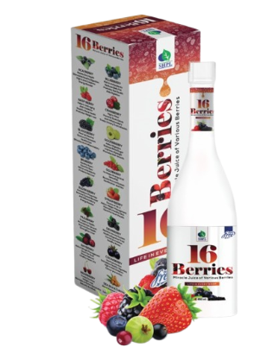
16 BERRIES JUICE
DESCRIPTION
Saarvasri Herbs 16 Berries juice contains all the vitamins, minerals and other phytonutrients present in whole berries. It serves as a source of Antioxidants. While different types of berry juice offer slightly different nutritional profiles, they share several nutritional similarities all contribute to your good health.
INGREDIENTS
Acai Berry, Blue Berry, Rasp Berry, Cran Berry, Black Berry, Goose Berry, Bil Berry, Goji Berry, Elder Berry, Straw Berry, Mul Berry, Dew Berry, Bay Berry, Crow Berry, Bear Berry, Sea Buckthorn.
BENEFITS
Very High in Antioxidants
Protect Against Heart Disease and Diabetes
Boost Weight Loss
Promote Digestion
Boost the Immune System
Increase Energy Levels
Promote Sound Sleep
Have Anti-Aging Properties
Control Pigmentation
Control Acne
Hydrate Your Skin
Strengthen Hair
DOSAGE
Mix 15ml of this juice with half glass of water & take two times a day or as directed by the Experts.

Slide 21
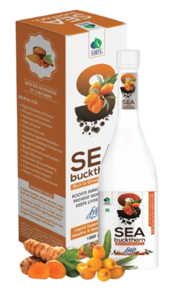
SEA BUCKTHORN WITH CURCUMIN JUICE
DESCRIPTION
Sea Buckthorn is a wonderful berry with 1300 years of traditional uses. With over 190 bioactive compounds, sea berry (sea buckthorn) is an unsurpassed source of Omega 3, 6, and 9. Curcumin is a yellow-orange dye obtained from turmeric, which has numerous health benefits.
INGREDIENTS
Sea Buckthorn ext. and Curcumin Ext.
BENEFITS
Sustains energy levels
Improves cellular health
Beneficial for Cardiovascular support
Relieves pain & inflammation
Supports Joint health
Lowers bad cholesterol level
Moisturizes dry and damaged skin
Improves immune health
Decreases wrinkles and fine lines
Reduces the symptoms of eczema.
DOSAGE
Mix 15ml of this juice with half glass of water & take two times a day or as directed by the Experts.

Slide 22
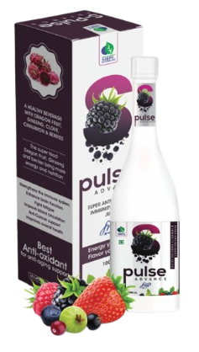
S PULSE ADVANCE JUICE
DESCRIPTION
S-Pulse encourages alternative remedy to health and wellness in future days. S-Pulse closely evaluated on the evidence of nutrition based with special emphasis of on building immunity, strengthening, and repairing our body. S-Pulse is an omnipotent, synergistic combination of nutritional supplement, meets all criteria of a dietary supplement towards ailments.
INGREDIENTS
Pomegranate, Noni Fruit, Dragon Fruit, Black Elder Berry, Beet Root, Grape Seed, Blue Berry, Bill Berry, Five Flavour Berry, Winter Cherry, Mulberry, Pears, Banana, Pineapple, Amla, Shatavari, Sea Buckthorn, Orange, Ginseng, Clove, Cinnamon.
BENEFITS
Protect Cells.
Scavenges for Free Radicals.
Restores Antioxidant numbers.
Strengthen Immune System.
Strengthens Nervous System.
Relieves Inflammation.
Fights with Bacteria and Viruses.
Combats with the effects of Diabetes.
Takes care of the Prostrate.
Strengthens the Heart.
Fights with cellular mutation.
Helps in Digestion.
DOSAGE
Mix 15ml of this juice with half glass of water & take two times a day or as directed by the Experts.

Slide 23
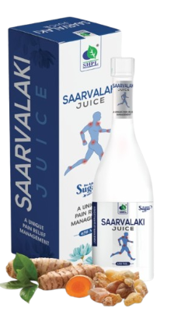
SAARVALAKI JUICE
DESCRIPTION
SHPL Saarvalaki Juice contains Shallaki & many other herbs that have anti-inflammatory & analgesic properties. Shallaki has been used in Ayurveda for thousands of years for joint support & management of pain in Arthritic conditions.
INGREDIENTS
Shallaki, Singhara, Chob Chini, Ama Haldi, Ashwagandha, Suranjjan, Shilajit, Malkangni.
BENEFITS
It prevents swelling at joints, and prevents breakdown of cartilage.
It is an effective remedy against osteoarthritis.
It is very helpful in rheumatoid arthritis.
It provides healthy blood flow to the joints.
It reduces pain and inflammations.
DOSAGE
Mix 15ml of this juice with half glass of water & take two times a day or as directed by the Experts.

Slide 24
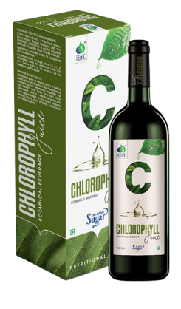
CHLOROPHYLL JUICE
DESCRIPTION
Chlorophyll plays an important role in making plants green and healthy. It also has vitamins, antioxidants, and therapeutic properties that may benefit your body. You can get chlorophyll from plants or supplements. Saarvasri Herbs Chlorophyll Juice Is an wonderful product for our optimal health.
INGREDIENTS
Chlorophyll Alfalfa.
BENEFITS
Stimulating the immune system
Increases red blood cells
Eliminating fungus in the body
Detoxifying your blood
Cleaning your intestine
Energizing the body
Maintaining pH level in the body
DOSAGE
Mix 15ml of this juice with half glass of water & take two times a day or as directed by the Experts.

Slide 25
WITH THE REGULAR USE OF SOME SHPL HEALTH CARE PRODUCTS
TAKE CARE
OF YOURSELF

