Slide 1
BECOME AN ACCREDITED GENOMIC WELLNESS CONSULTANT OF INDIA

Slide 2
DISEASES
BIRTH
OLD AGE
DEATH

Slide 3
HEALTHIER…?
WEALTHIER…?
HAPPIER…?
LONGER...?
BECOME AN ACCREDITED GENOMIC WELLNESS CONSULTANT OF INDIA

Slide 4
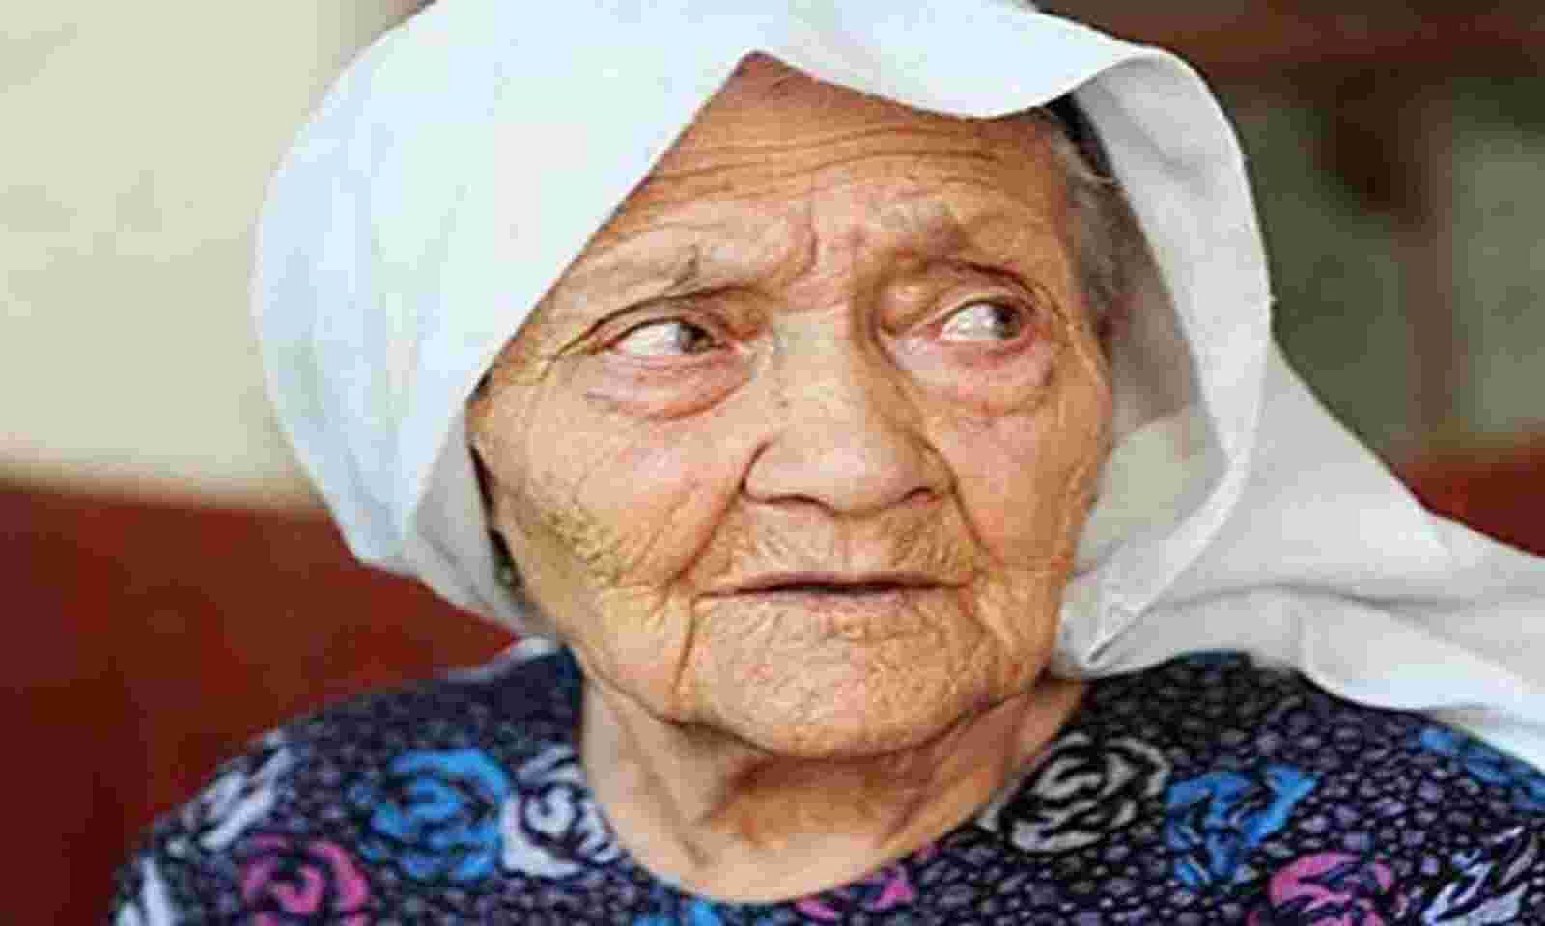
HOW LONG IS HUMAN LIFE?
HUMAN LIFE = 120 YEARS
RETIREMENT AGE = 60 YEARS (Sr. Citizens)
NO.
COUNTRY
MEN
WOMEN
BOTH
##
WORLD
70.8
75.6
73.2
01
HONG KONG
82.38
88.17
85.29
02
JAPAN
81.91
88.09
85.03
03
MACAO
81.73
87.62
84.68
04
SWITZERLAND
82.42
86.02
84.25
05
SINGAPORE
82.06
86.15
84.07
06
ITALY
81.90
85.97
84.01
Alimihan Seyiti, Kashgar, China
Longevity Town
07
SPAIN
81.27
86.68
83.99
Born : 25 June 1886
Died : 16 December 2021
Age : 135 Years
08
AUSTRALIA
82.08
85.80
83.94.
135
INDIA
69.16
71.80
70.42
Source: Worldometers.info

Slide 5
CURRENT TREATMENT PATTERN
DISEASE FIRST
Treatment Later
Prolonged Diagnosis
Adr (Adverse Drug Reaction)
ALERT INDIVIDUALS
Master Health Check-up
Discover Onset Of Disease
Smart Way Of Being Healthy
WISE PEOPLE
Genetic Sequencing
Predict Future Health Risks
Gene Based Health Solutions

Slide 7
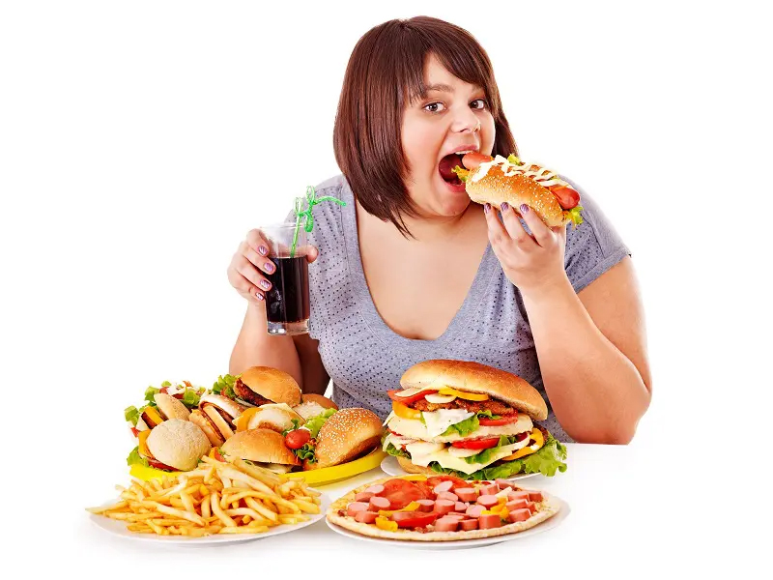
WHICH CATEGORY YOU BELONG TO?
HEALTHY PEOPLE (80%)
SICK PEOPLE (20%)
Happy-Go-Lucky Industry
Illness / Sickness Industry
LIVING CASUALLY
TO FALL SICK SOON
DOING EVERYTHING
TO GET WELL SOON
JO HOGA DEKHA JAAYEGA
PRACTCING WELLNESS PRINCIPLES

Slide 8
CHOOSE WELLNESS: IT WORKS…!!

Slide 9
BUILD YOUR LONG TERM HEALTH
CHEAPER

Slide 10
NEW MODEL OF BEING HEALTHY
EXISTING (OLD) MODEL
NEW (FUTURE) MODEL
REACTIVE
PREDICTIVE
5G
GENERALIZED
PERSONALIZED
DESEASE MANAGEMENT
PREVENTIVE
EXPENSIVE
VALUE FOR MONEY

Slide 11
THE HUMAN ANATOMY

Slide 12
The Cell

Slide 13
THE HUMAN GENOME PROJECT (1990-2003)

Slide 14
CHROMOSOMES, DNA & GENES

Slide 16
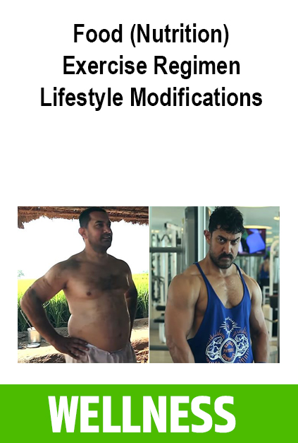
3 BROAD TYPES OF DNA TESTS

Slide 18
WHAT KEEPS YOU HEALTHY?
NUTRITION
(BALANCED)
WATER
(ALKALINE)
CLEAN AIR
(NATURAL)
EXERCISE
(SPECIFIC)
LIFESTYLE
(PERSONALIZED)

Slide 19
21 DNA PANELS
200 PHENOTYPES
OVER 300 DISEASES

Slide 20
THE BLACK BOX OF YOUR LIFE
LEARN THE SECRETS OF GENE BASED HEALTHY LIVING

Slide 21
1. YOUR HEART HEALTH
Cholesterol and Lipid Profile
Hypertriglyceridemia Risk
Triglyceride Response to PUFA
Hypertension Risk
Impact of Tobacco and Nicotine Containing Products
Blood Pressure Response to A Non Drug Approach
Hyperlipoproteinemia Type III
Hyperhomocystienima
Atherosclerosis Risk
Myocardial Infarction
Left Ventricular Hypertrophy
Atrial Fibrillation
Coronary Artery Disease Risk

Slide 22
2. DIABETES MANAGEMENT
Type 2 Diabetes Risk (Insulin Sensitivity)
HBA1c Response to Fibre
Insulin Resistance Response to Whole Grains
Glucose Tolerance to Dietary Fat
Ketogenic Diet & Type 2 Diabetes Risk
Dinner Timing & Type 2 Diabetes Risk
Risk of Type 1 Diabetes
Risk of Diabetic Retinopathy
Tendency of Insulin Resistance
Impact of Smoking

Slide 23
3. DIABETES ASSOCIATED COMPLICATIONS
Risk of Diabetic Retinopathy
Risk for Diabetic Cataract
Impact of Tobacco and Smoking on Diabetic Cataract
Risk of Diabetic Nephropathy
Impact of Tobacco and Smoking on Diabetic Nephropathy
Impact of Stress on Diabetic Nephropathy
Risk of Diabetic Neuropathy
Impact of Tobacco and Alcohol
Risk of Foot Ulcers

Slide 24
4. ORGAN HEALTH MANAGEMENT
Gall Stone Predisposition
Inflammatory Bowel Disease (Ulcerative Colitis)
Alcoholic Liver Disease (Alcoholic Liver Injury, Alcoholic Cirrhosis, Hepatocellular Carcinoma)
NAFLD (Non Alcoholic Fatty Liver Disease)
NAFLD Mitigation and Choline Deficiency
Tendency of Developing Liver Cirrhosis
Requirement of Fat in Liver Cirrhosis
Impact of Alcohol On Liver Cirrhosis
Risk of Hyperuricemia
Glaucoma Risk
Risk of Cataract
Age Related Hearing Loss
Gum Disease (Periodontitis)

Slide 25
5. THYROID RISK MANAGEMENT
Hypothyroidism
Requirement of Iodine Intake
Sleep Pattern
Impact of Alcohol and Smoking On Hypothyroidism
Hashimoto’s Thyroiditis
Grave's Disease

Slide 26
6. KIDNEY HEALTH MANAGEMENT
Risk of CKD
Requirement of Sodium and Potassium Intake
Requirement of Fluid Intake
Tendency of Alcohol Sensitivity
Tendency of Alcohol Flush

Slide 27
7. NEUROLOGICAL HEALTH MANAGEMENT
Risk of Parkinson Disease
Alzheimer's Disease
Vascular Dementia
Depression Rumination
Requirement of Anti-Inflammatory Food
Requirement of Flavonoids
Impact of Alcohol and Caffeine
Response to Pesticide Exposure
Risk of Migraine (With Aura)
Impact of Caffeine and Alcohol (On Migraine)
Impact of Cheese (on Migraine)
Requirement of Physical Activity in Restless Leg Syndrome
Requirement of Iron Rich Food (Restless Leg Syndrome)
Impact of Caffeine and Alcohol (Restless Leg Syndrome)
Septic Shock
Pain Sensitivity

Slide 28
8. MENTAL HEALTH & PERSONALITY DISORDER RISKS
Autism Risk
Schizophrenia Risk
Attention Deficit Hyperactivity Disorder (ADHD) Risk
Tendency of Panic Disorder
Requirement of Sleep (Panic Disorder)
Requirement of Exercise (Panic Disorder)
Impact of Medication (Panic Disorder)
Caffeine Intake (Panic Disorder)
Impact of Alcohol (Panic Disorder)
Impact of Smoking (Panic Disorder)
Personality Disorder(antisocial)

Slide 29
9. REPRODUCTIVE HEALTH MANAGEMENT
WOMEN
Polycystic Ovarian Syndrome (PCOS) Risk
Neural Tube Defect Risk in Offspring
Adverse Pregnancy Outcomes with Prenatal Caffeine Intake
Risk of Spot Baldness in females (Alopecia Areata)
MEN
Male Infertility
Effect of Alcohol consumption on LDL cholesterol
Testosterone Response
Risk of Spot Baldness in males (Alopecia Areata)

Slide 30
10. WEIGHT MANAGEMENT
Obesity Risk
Impact of Alcohol on Obesity
Satiety
Response to Dieting
Ideal Weight Loss Diet
Weight Regain Risk
Adiponectin Level
Appetite Response to Ginger Supplementation
BMI Response to PUFA
Tendency of Snacking Between Meals
BMI Response To MUFA
Desire for food(Emotional Bingeing)

Slide 31
11. INFLAMMATION MANAGEMENT
Risk of Inflammation
Tendency of Skin Allergy
Rheumatoid Arthritis
Tendency of Osteoarthritis
Allergic Rhinitis Risk
Risk of Asthma
Pancreatitis
Chronic Obstructive Pulmonary Disease

Slide 32
12. DNA DAMAGE RISK & OXIDATIVE STRESS
DNA Damage & Toxicity Risk from eating tandoori food
Lifespan and Longevity
Tendency of Oxidative Stress
Requirements of Antioxidants
Requirement of Sunscreen
Impact of Alcohol and Smoking on Oxidative Stress
Impact of Radiation and Pollution on Oxidative Stress
Tendency of Detoxification
Impact of Smoking and Alcohol on Detoxification Process

Slide 33
13. SKIN HEALTH MANAGEMENT
Risk of Developing Acne
Risk of Sunburns
Risk of Sun Spots/Freckles
Tanning Ability
Tendency of Psoriasis
Nutritional Requirement for Psoriasis Management
Requirement of UV Radiation for Psoriasis Management
Risk of Developing Eczema
Risk of Vitiligo
Requirement of Vitamin D for Vitiligo
Impact of Gluten on Vitiligo
Pemphigus Folaceous

Slide 34
14. BIOLOGICAL CLOCK MANAGEMENT
Time of Exercise
Time of Metabolism
Time of Carbohydrate Intake
Tendency of Morning Fatigue
Tendency of Sleep Disorder

Slide 35
15. MODERN MEDICINE EFFICACY
Metformin response
Response to Pioglitazone treatment in Type 2 Diabetes
Response to Sulfonylureas treatment in Type 2 Diabetes
Response to Statins Use
Warfarin response
Response to Antidepression Medication(Paroxetine)
Therapeutic Response to Rheumatoid Arthritis Medications

Slide 36
16. DEPRESSION & ADDICTION RISK MANAGEMENT
Dopamine Metabolism
Depression Risk
Impact of Alcohol on Depression
Requirement of Sleep (Depression)
Requirement of Exercise (Depression)
Anxiety Disorder Risk and Caffeine
Eating Disorders
Alcohol Dependency
Addiction towards Drugs
Addiction towards Smoking
Decision Making Ability

Slide 37
17. VITAMIN DEFICIENCY MANAGEMENT
Vitamin A Deficiency
Vitamin B2 Deficiency
Vitamin B6 Deficiency
Vitamin B9 Deficiency
Vitamin B12 Deficiency
Vitamin C Deficiency
Vitamin D Deficiency
Vitamin E Deficiency

Slide 38
18. MINERAL DEFICIENCY MANAGEMENT
Calcium Deficiency
Iron Metabolism
Tendency of Magnesium Metabolism
Requirement of Magnesium Nutrient
Risk of Magnesium Deficiencies
Tendency of Vitamin K Metabolism
Requirement of Vitamin K Nutrient
Risk of Vitamin K Deficiencies
Tendency of Selenium Metabolism
Requirement of Selenium Nutrient
Tendency of Antioxidant Metabolism
Requirement of Antioxidants
Tendency of Copper Metabolism
Requirement of Copper
Tendency of Zinc Metabolism
Requirement of Zinc

Slide 39
19. FOOD INTOLERANCE MANAGEMENT
Gluten Intolerance
Impact of Gluten Products
Risk for Developing Celiac Disease
Impact of Gluten Intake on Celiac Disease
Lactose Intolerance
Blood Pressure and Heart Attack Response To Caffeine (Caffeine Metabolism)
Tendency of Caffeine Induced Obesity
Tendency of Salt Metabolism
Blood Pressure Response to Sodium (Salt Sensitivity)
Risk for Developing Peanut Allergy

Slide 40
20. EXERCISE REGIMEN
Ideal Exercise Strategy
Power / Endurance Training
Requirement of Training Session for Improving Lactate Threshold
Requirement of HIIT (High Intensity Interval Training)
Requirement of Foods to Improve Aerobic Capacity
Body Odour (Axillary Osmidrosis)
Training Required to Improve Endurance
Endurance Response to Caffeine & Other Suppl.
Ideal Weight maintenance strategy
Cold Tolerance
Requirement of Training to Improve Power
Requirement of Nutritional Supplements
Avoiding Inflammatory Foods
Motivation to Exercise
Exercise Associated Inflammation Risk
Exercise Recovery Time

Slide 41
21. INJURY RISK MANAGEMENT
Risk of ACL Injury
Risk of Muscle Injury
Risk of Tennis Elbow
Risk of Achilles Tendinopathy
Acute Ankle Sprain
Requirement of Antioxidants to Prevent Injury
Prevalence of falls in elderly people
Risk of Intervertebral Disc Degeneration
Susceptibility to Knee Injury
Risk of Osteoporosis

Slide 42
TECHNOLGY PARTNER
SINCE 2017
PIONEERS & MARKET LEADERS IN GENE BASED WELLNESS SOLUTIONS IN INDIA
PREDICTIVE GENETIC SEQUENCING
CREATING MASSIVE GENOMIC AWARENESS THROUGH

Slide 43
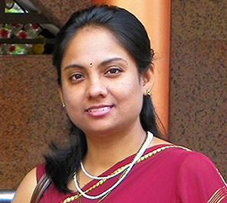
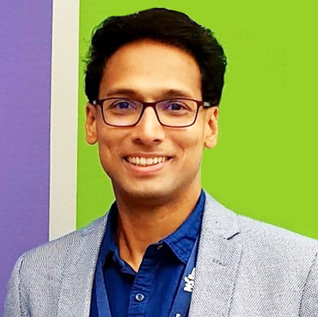
WELOCITY GENETICS MANAGEMENT
STAN SERRAO
CMD
MILIND DOSHI
CPO
ARNAVAZ KOLLAH
Chief Genetics Officer
NEHA BHOJANI
Bioinformatics Adviser
DR RADHIKA WAGHLE
Bioinformatics Adviser
DR VIMAL KARANI, UK
Scientific Adviser - Nutrigenomics

Slide 44
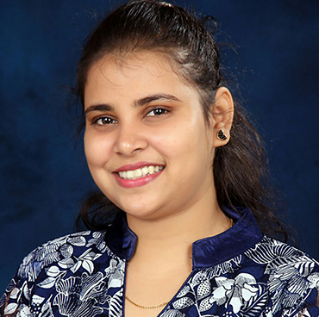
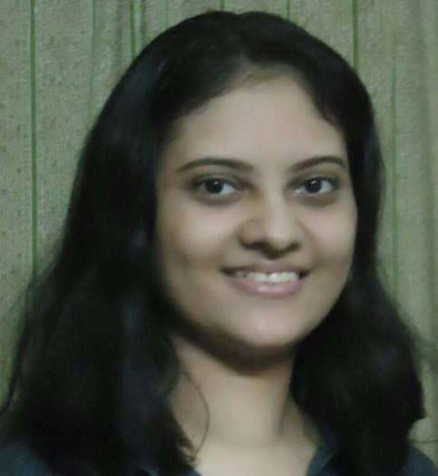
GENETIC COUNSELLORS & NUTRITIONISTS
RINA BALIGA
Nutrigenomics Counsellor & Nutritionist
LAVINA CARDOZA
Nutrigenomics Counsellor & Nutritionist
RIDDHI SHAH
Nutrigenomics Counsellor & Nutritionist
RHEYA DOSHI
Nutrigenomics Counsellor & Nutritionist
RICHA LIMAYE
Nutrigenomics Counsellor & Nutritionist
KIRTANA SRI M.
Nutrigenomics Counsellor & Nutritionist
PRASANTHI SURYANARAYANA
Nutrigenomics Counsellor & Nutritionist
SUKRITI GHIMMIRE
Nutrigenomics Counsellor & Nutritionist

Slide 45
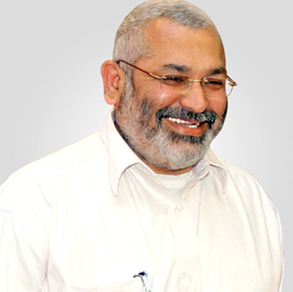
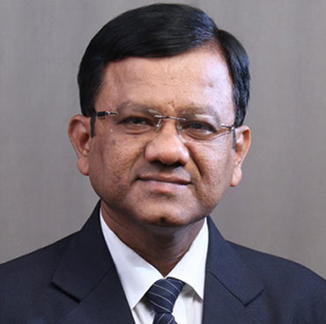
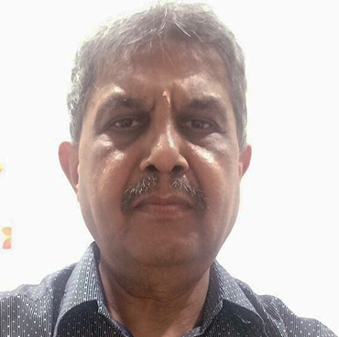
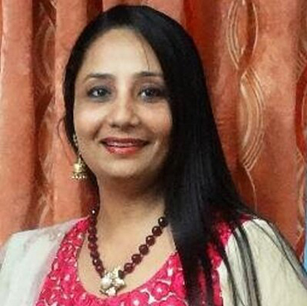
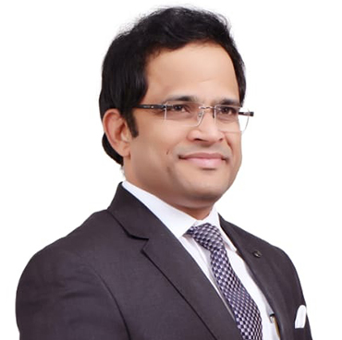
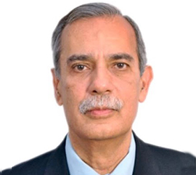
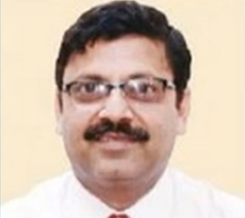
MEDICAL / SCIENTIFIC ADVISORY BOARD
DR. NIKHIL BALJEKAR
Urologist & Consulting Surgeon, Mumbai
DR. MAHENDRA SAWANT
Physician & Diabetologist, Mumbai
DR. KISHORE D SHAH
Leading Radiologist, Mumbai
DR. SUMITA PRAJAPATI
Ayurveda Expert, Boston, USA
DR. RAVI VAIRAGADE
Homeopathic Expert, Nagpur
DR. KEDAR TAMBE
Integrated Health & Wellness Expert, Pune
DR. DARRYL DEMELLO
General Physician, USA / Mumbai
DR. GIRISH CALLY
Anaesthetist, Delhi

Slide 46
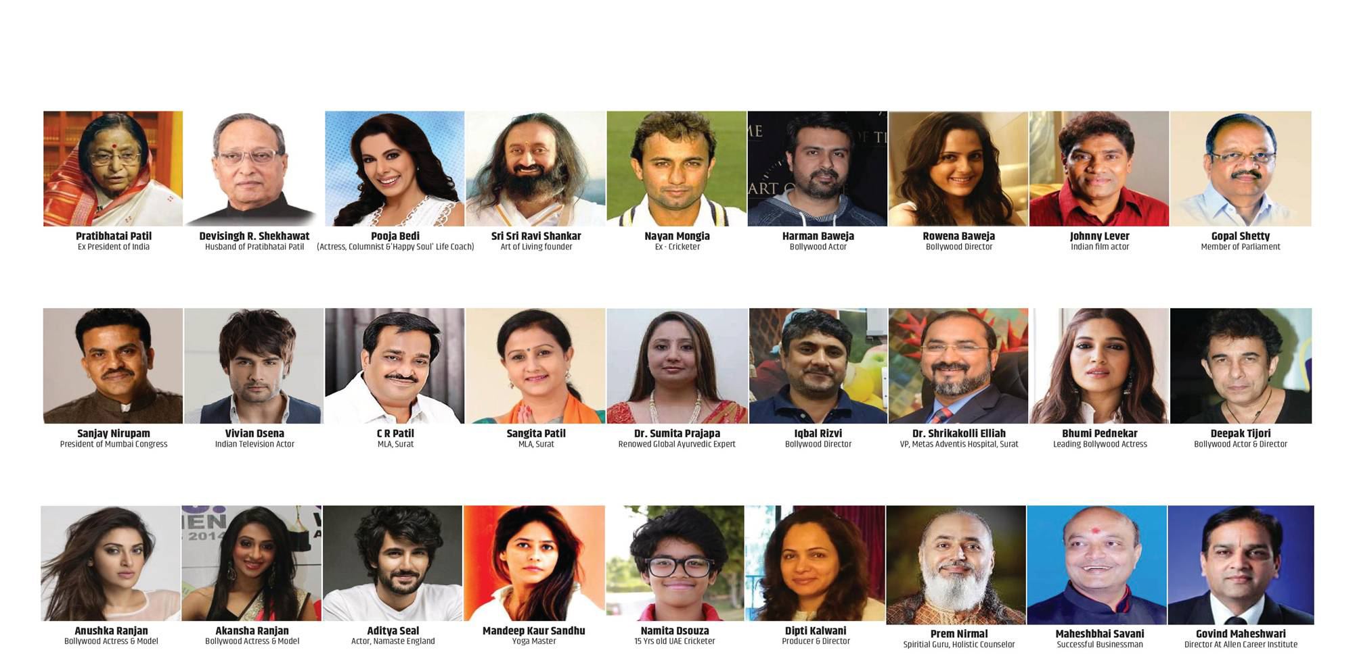
HEALTH-CONSCIOUS PATRONS
OVER 11,000 SATISFIED CUSTOMERS PAN INDIA & 20 COUNTRIES

Slide 47
SHPL GENOMAX : INCLUSIONS
Your GENOMAX Saliva Sample Collection Kit
Within 7 Working Days of
Online Order (Not Gallery)
Watch A Simple Saliva Sample Collection Process Video
Genetic Report within 21 working Days from Batch Date
Get 1-Hour Personalized Genetic Counselling
on Phone / Zoom / Video
Based on Your Genetic Report Clubbed with Current Lifestyle
Get All Your Queries Answered by Our Genetic Experts
6-Year Gene Banking Facility
available for Upgraded Tests

Slide 48
MOST ECONOMICAL HEALTH PROGAM
MRP
Rs. 49,000
Rs.41,525 + Rs.7475 (18% GST
BOOKING STARTS FROM
2 MAY 2022
DP
Rs. 37,500
Rs.31780 + Rs.5720 (18% GST)
DNA KIT DISPATCH FROM
15 MAY 2022
FIRST PURCHASE
5 BP + 1000 FOP
RE-PURCHASE
18,000 BV
AVAILABLE
ONLY THROUGH SHPL
ONLINE ORDER

Slide 50
BECOME AN ACCREDITED GENOMIC WELLNESS CONSULTANT OF INDIA

