Slide 1
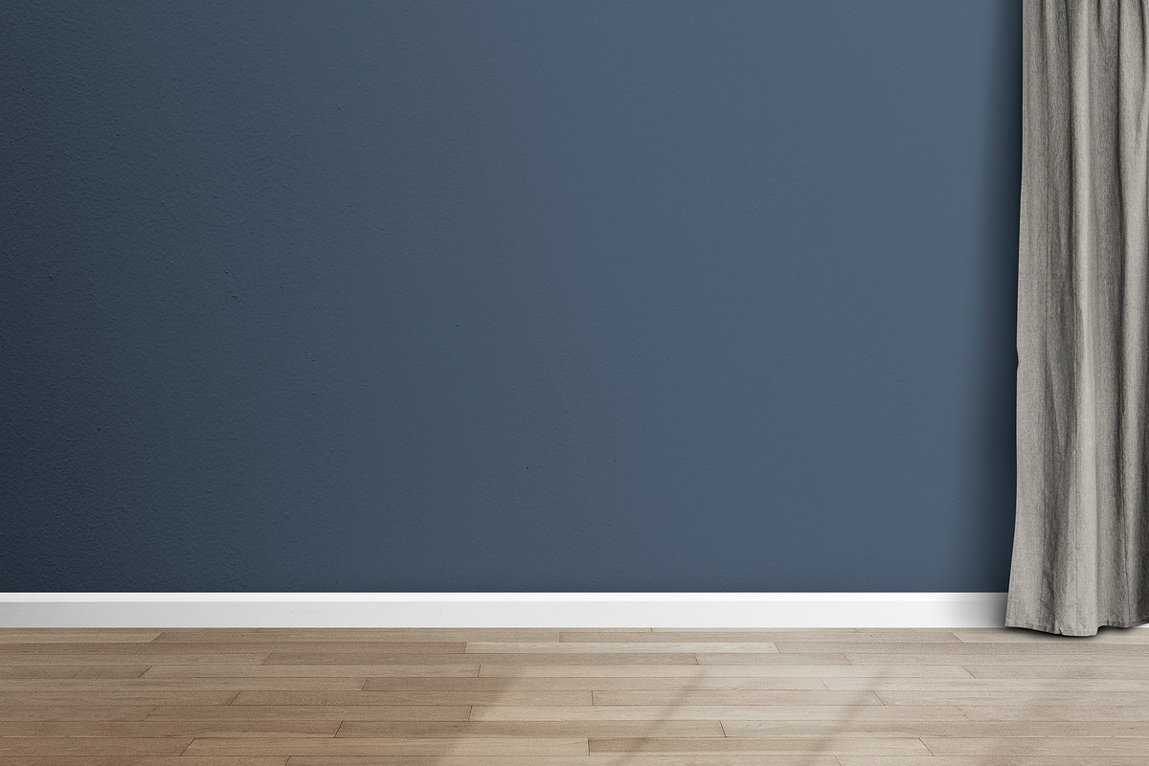
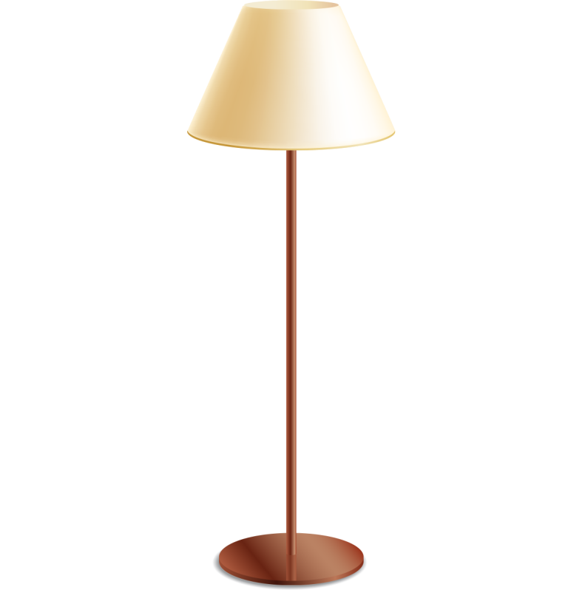
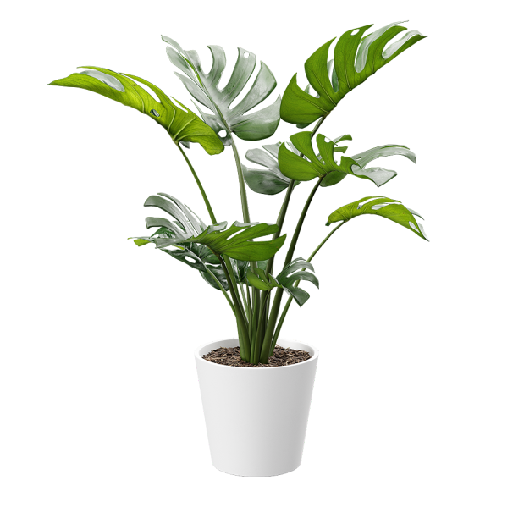
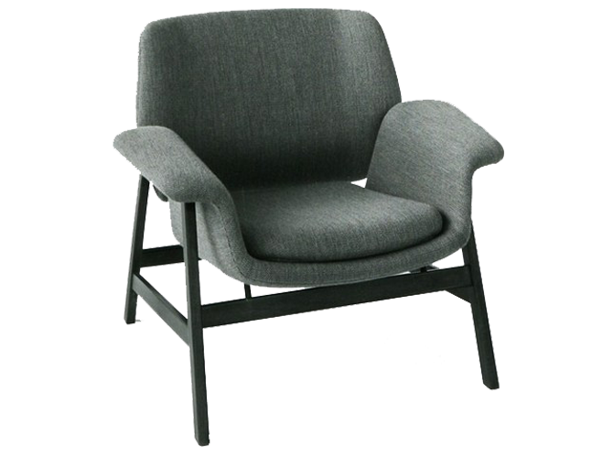
WELCOME TO THE WELLNESS WORLD OF SAARVASRI

Slide 2
THE AIR INSIDE OUR HOUSE IS
MORE SAFER THAN OUTSIDE
WHAT DO YOU THINK

Slide 5
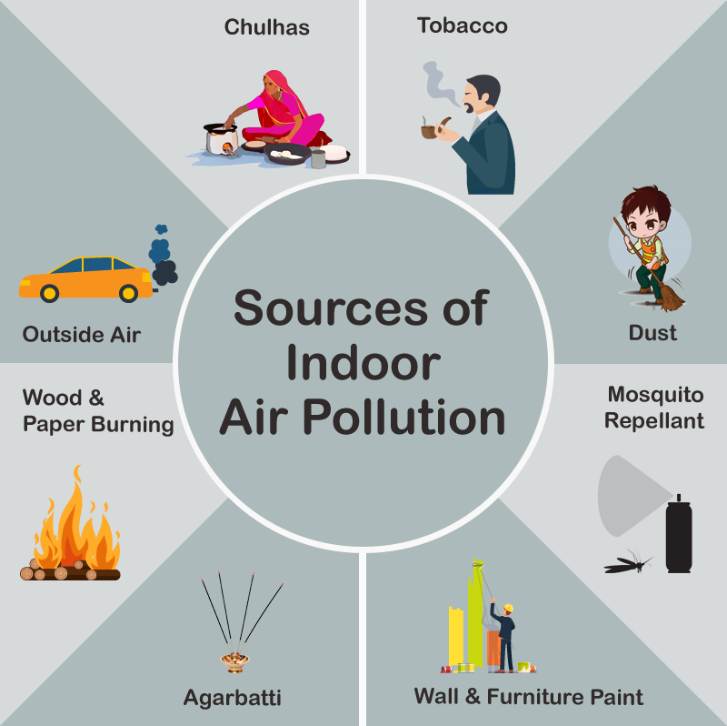
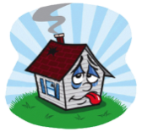

Slide 6
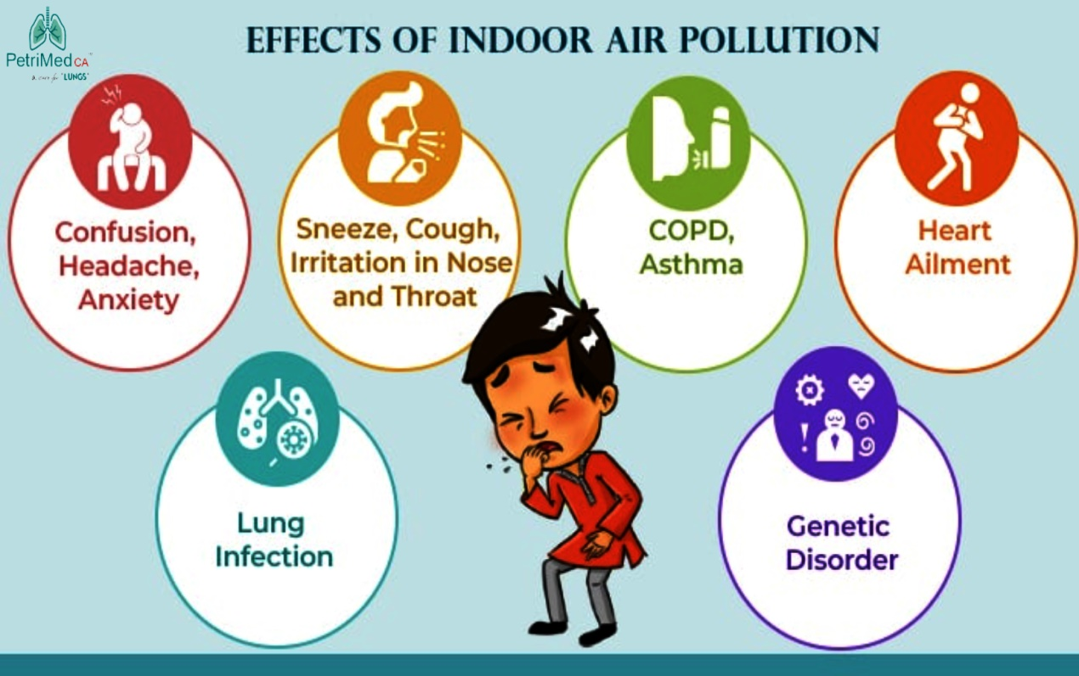

Slide 7
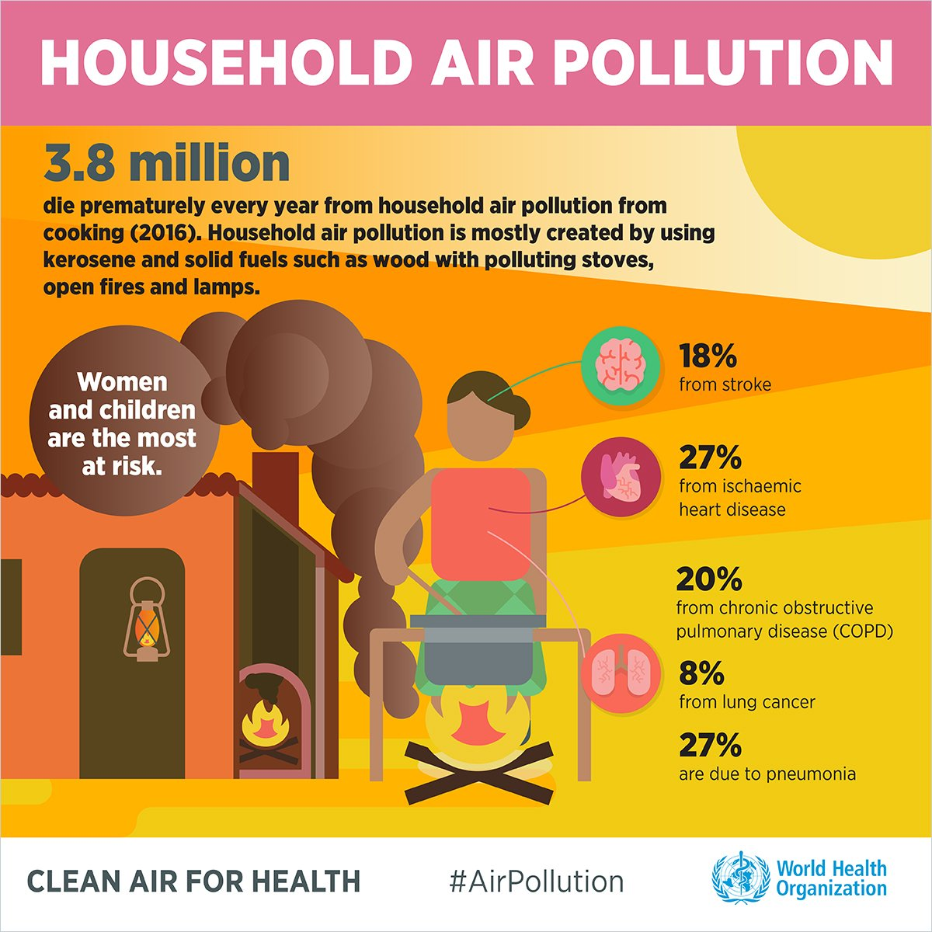

Slide 8
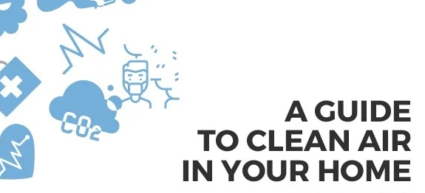
DON’T WORRY
SHPL HELPS YOU
TO IMPROVE
INDOOR AIR QUALITY

Slide 9
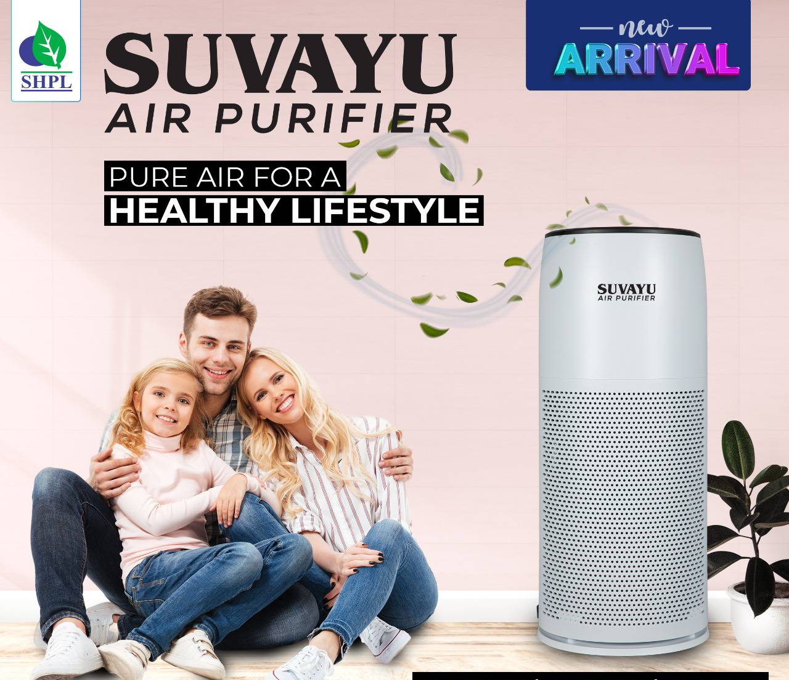
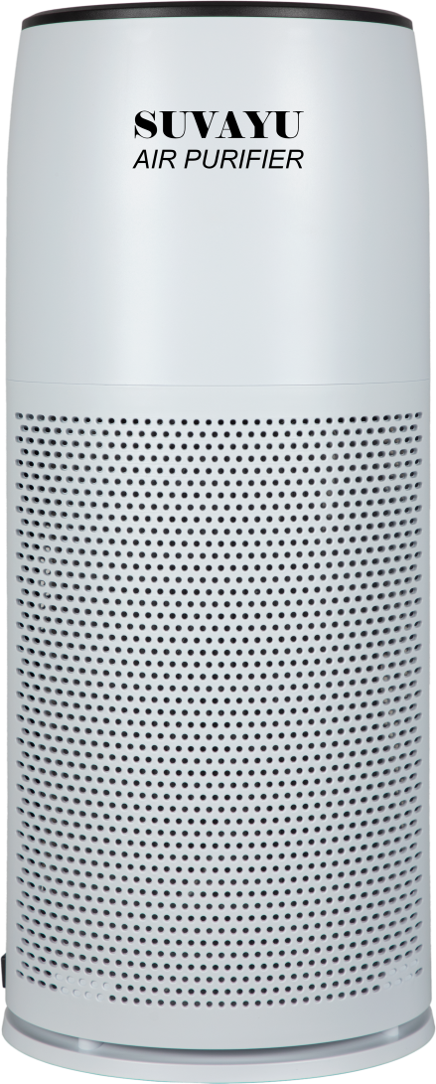
SHPL INTRODUCES

Slide 10
SUVAYU AIR PURIFIER
Ensures natural air inside the room.
Removes 99.99% pollutants from indoor air.
Active plasmacluster technology neutralizes harmful VOC & toxic gases.
Kills microbes & other contagious pathogens.
High performance HEPA filters captures 99.99% of 0.3 micron dust particles.
Active carbon filter helps in removal of smoke & chemical fumes.
Highest CADR or Clean Air Delivery Rate, is extremely efficient and effective.

Slide 11
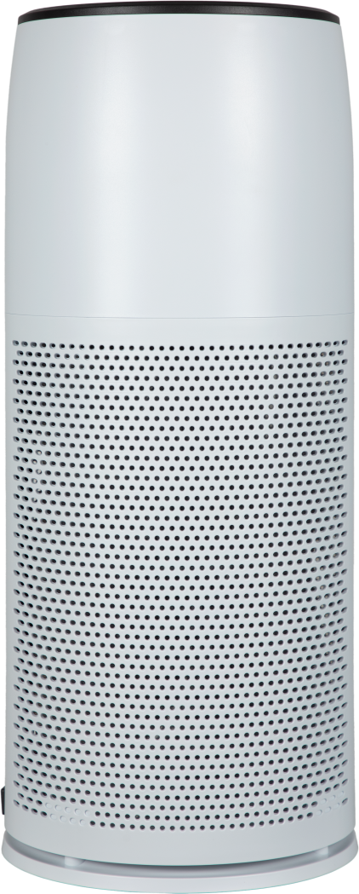
SUVAYU
AIR PURIFIER
LET’S PROTECT OUR HOME BY USING SUVAYU AIR PURIFIER.

Slide 12
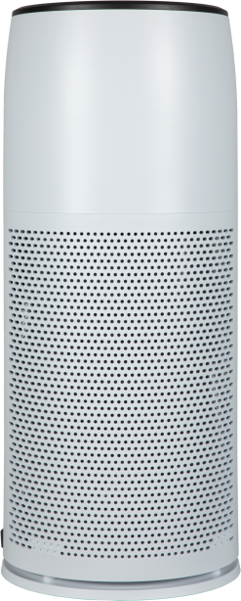
THANK YOU
SUVAYU
AIR PURIFIER

